Slide 1
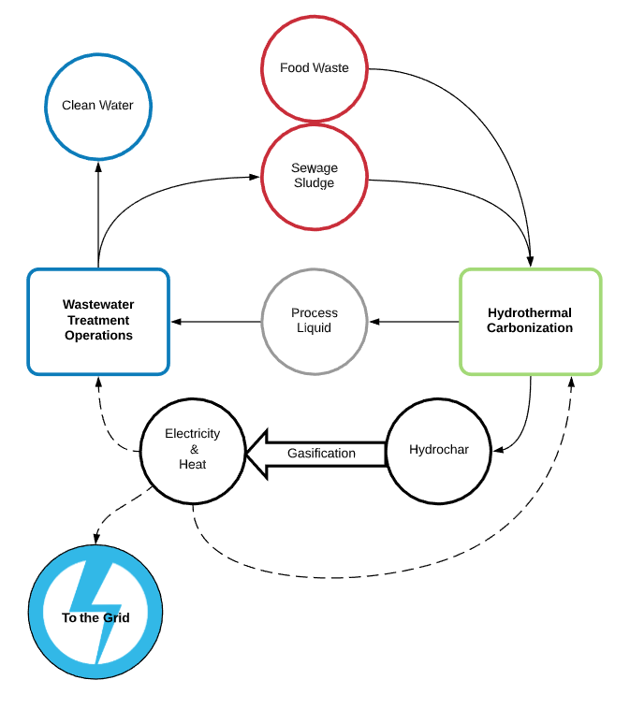
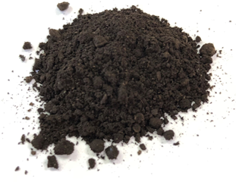
SoMax and the Borough of Phoenixville, Pennsylvania present the first commercial scale Hydrothermal Carbonization (HTC) reactor in North America.
Coming 2021
Efficient Energy Recovery
  Generates 10X more electrical energy than it consumes
  Creates 153% of electrical demand of WWTP operations
  Generates over 100% of thermal demand of HTC process
Industry Leading Carbon Efficiency
  Carbon Efficiency of 90%
  Increases energy density of blended feedstock by 46.5%
  Lowest GHG emissions of any biomass conversion process
Barrier Breaking Innovations
  Increased solids handling capacity by 10X without increasing plant footprint
  Polymer-free dewatering of hydrochar over 50% TS
  New pathways for nutrient recovery
Attractive Economics
  $38,780,000 savings over 20-year lifetime
  6.1 years - Project payback period
  19.9% - 20-year IRR

