Slide 1
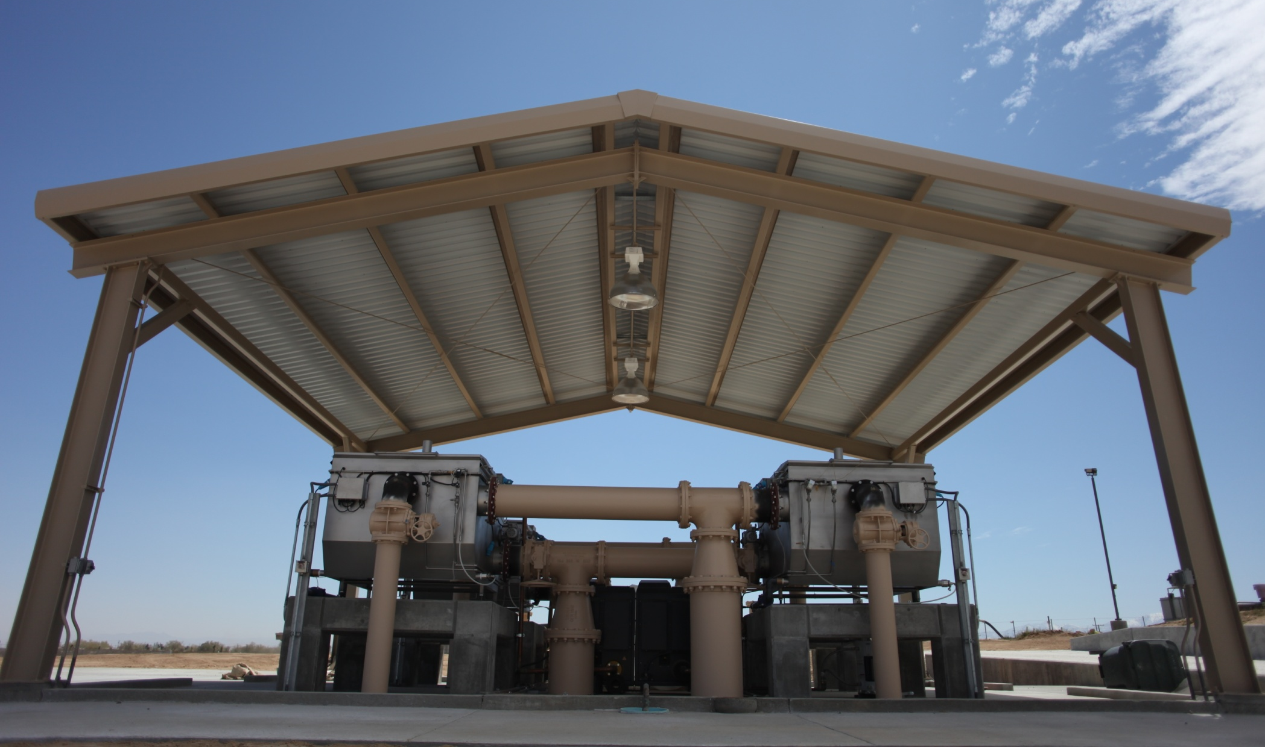
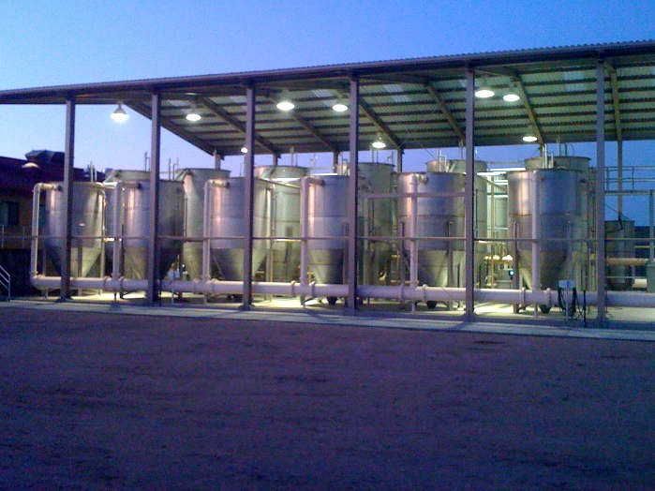


Get it Fast, Get it Early: Extracting Solids from Wastewater to Maximize Energy Recovery
Microscreens:
Conventional activated sludge (CAS) is inefficient:
Consumes energy to burn valuable organics
Locks the remaining organics in hard-to-use biosolids.
Most of the materials in wastewater are fine particulates
We use microscreens and continuously-backwashed sand filters to intercept solids at the front of the plant.
The filtered water is simpler to treat downstream
Solids are dewatered, dried, and burned to make steam and electricity
Resource Recovery:
Treatment plant flips from energy consumer to green power plant
Exporting 539 kW to the grid for a 12.4 MGD (47,000 m3/d) plant
Reduce plant footprint by 72% and solids production by 96%.
Photo credit: MicroMedia Filtration
Continuously-backwashed Sand Filters
Photo credit: MicroMedia Filtration

