Slide 1
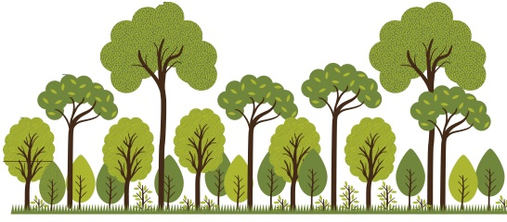
New paradigm shift
POSATIVE | NEGATIVES
Decentralized | Stranded asset?
Shift cost to building owners | Reduce volume / revenue
No capex | Benefits achieved before the wastewater plant
Capture micro plastics at the source | Securitization of revenue changes
Extended treatment plants population capacity
Better utilization of wastewater treatment plant
Social benefits (Out of wastewater silo)
Trees to shade buildings
Trees to cut heat island
Trees to sequester carbon
Holistic approach for urban environments
Decentralized Greywater Diversion
onsite to grow trees and landscapes;
Avoid 20- 40% of the volume going to the
wastewater treatment plant =
20% to 40% reduction in variable cost

