Slide 2
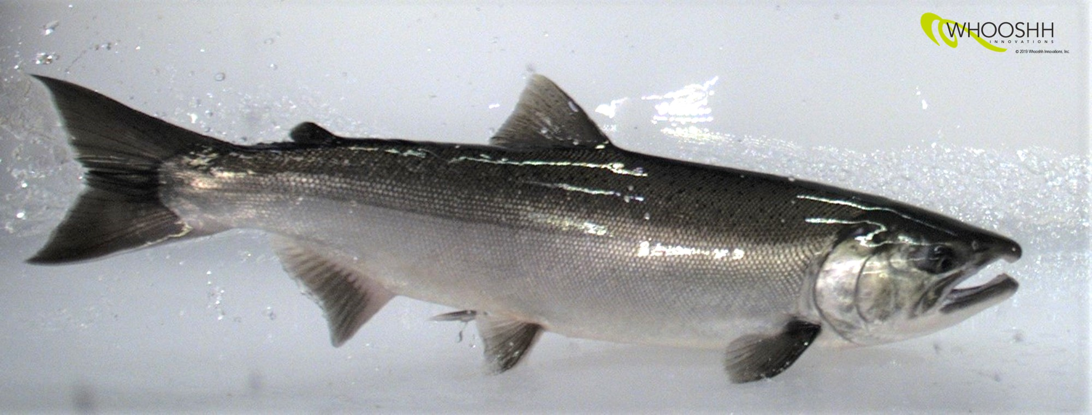
Invisible Field Guidance System
Whooshh Innovations, Inc
From water diversions to intakes, it’s all about improving ways to keep fish out of danger.
Various forms of electrical barriers and guidance systems have been tried over the years, with varying levels of success
  Issues with such systems have included fish safety, guidance efficacy, high power consumption, and limited flow effectiveness
The Whooshh invisible field guidance system, modeled after an electric fish blocking system developed in China, is a fundamental advancement over current technology.
  A pulse electrical field continually adapts to optimize the electrical field to changing river conditions. This keeps fish safe, power consumption low, and remains effective in variable flow conditions
  The distance of the electrical field can be extended to the full depth of the waterway. This means that you are not limited to just shallow, slow-moving water.
  The pulse electrical field radiates horizontally from the vertical electrodes, allowing fish to sense voltage change and turn away from the “danger.”
  This allows for better fish guidance, channeling fish away from a water diversion or intake at a hydropower dam.

