Slide 1
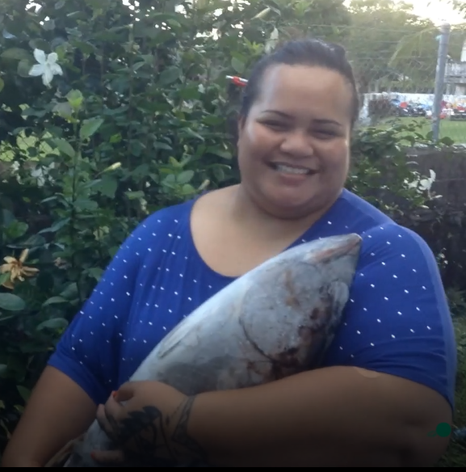
Funny Fish
Antonina Te’o

Slide 2
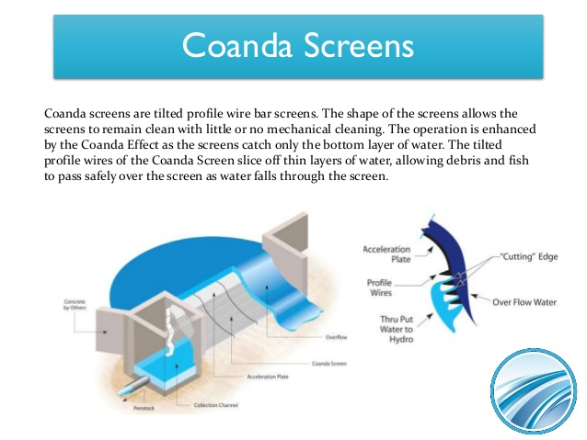

Slide 3
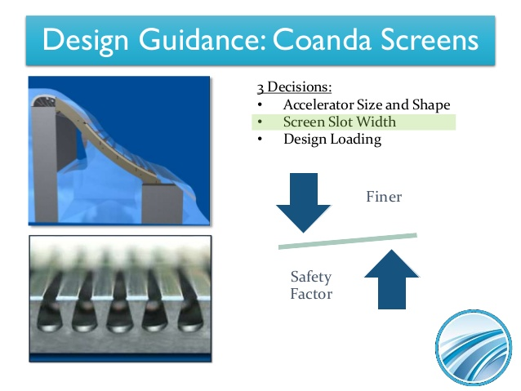

Slide 4
Passive screens:
Self cleaning
Self cleaning pump intake screen
Self cleaning irrigation screens
Water intake screen
Pump suction
Coanda Screen has strong points of high flow capacity screen and can be adopted using Aquashear

Slide 5
Technical Notes and Guidelines of Passive Coanda Screening:
Standard Application flow diversion at an elevation drop.
Strong Point of the screen has a high flow capacity and can be designed using USBR Coanda Screen design program
Challenges are controlling the bypass flow and possible dewatering of the screen toe and loss of bypass flow during flows.
Self cleaning screen material, self cleaning pump intake screen, self cleaning irrigation screens, self cleaning water intake and the pump suction.
The flow capacity at one cubic feet by square feet and do not need power requirement for fish and debris are transported by non-diverted flow passing over screen surface.
The screen are commercially available if plan to install in larger dams, rivers and lake.

Slide 6
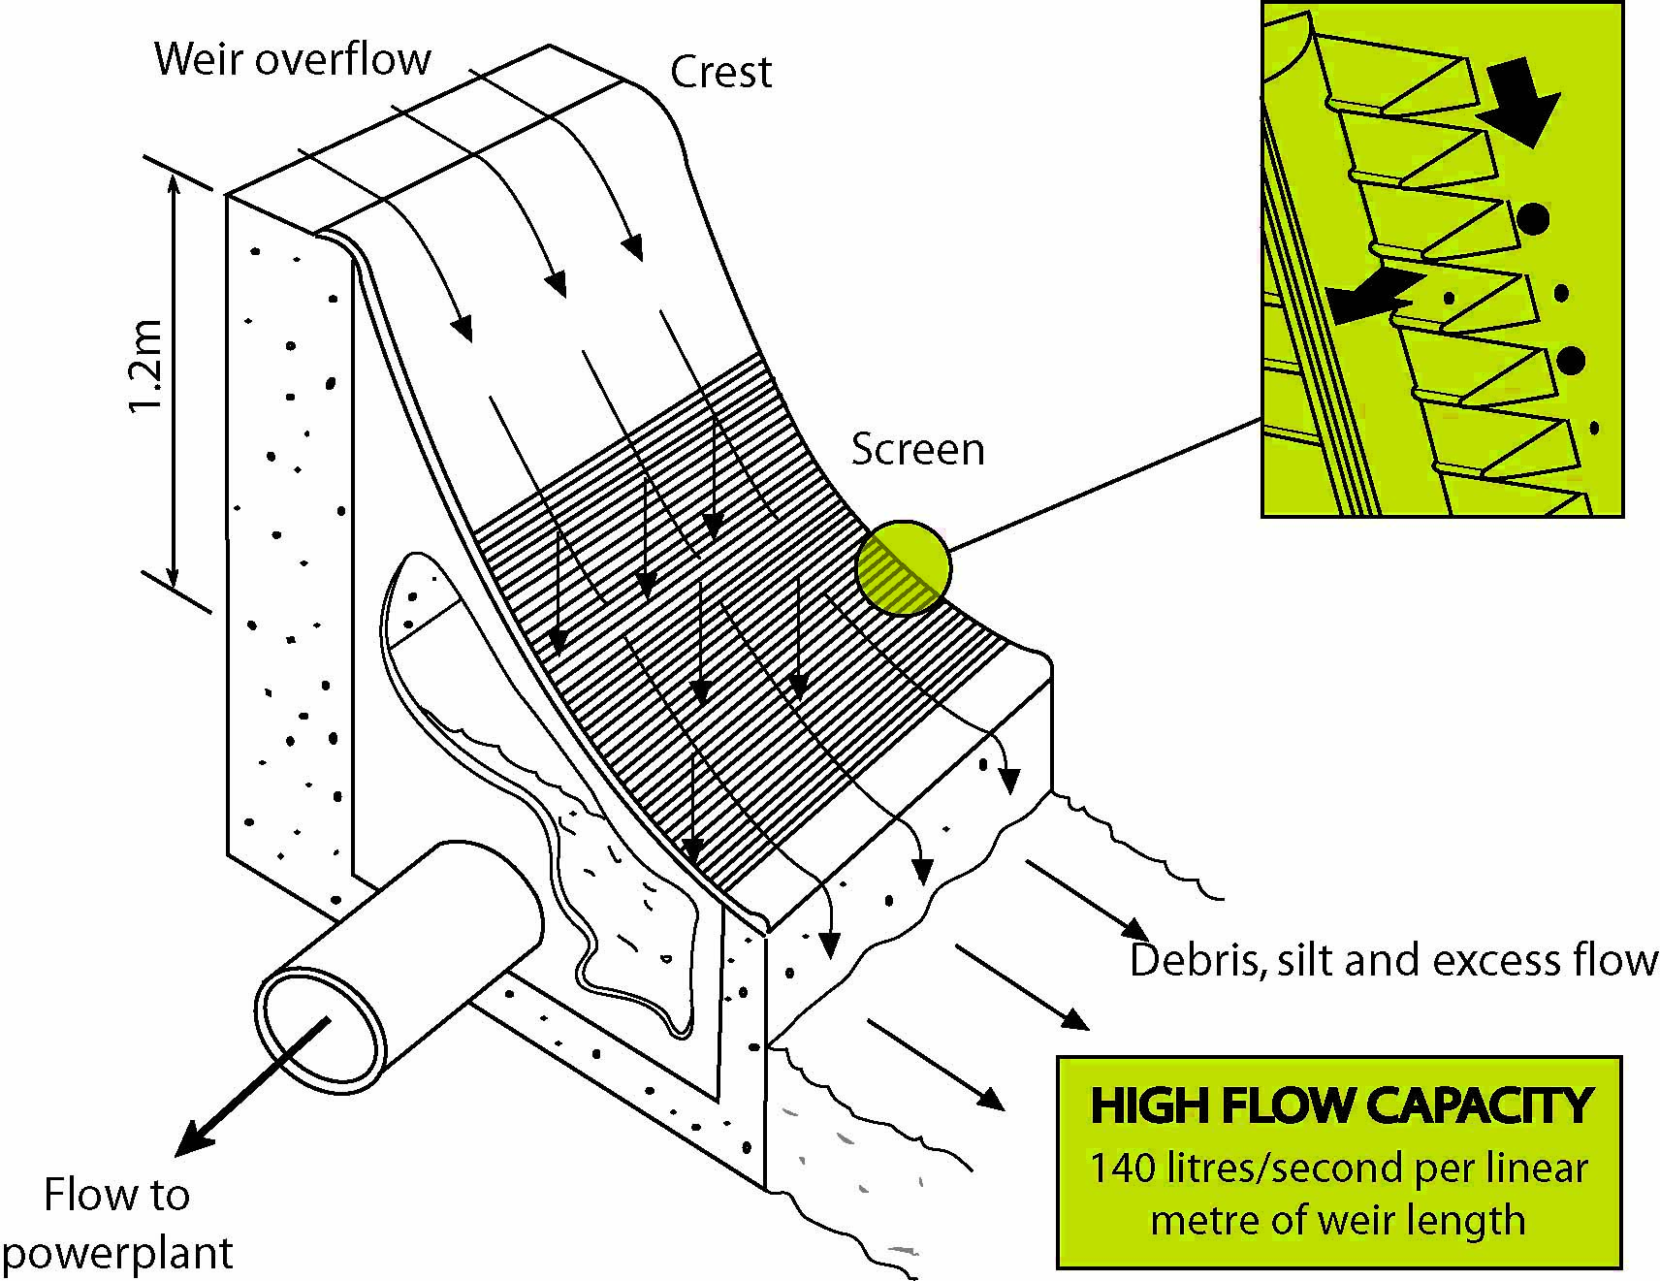
Passive Screen Diagram of Coanda Screen

Slide 7
REFERENCE:
Someah, Kaveh.,Control of Invasive Carp Using Non-Physical Barriers., Ovivo Bringing water to life, USA.
US Department of Agriculture, Natural Resources Conservation Service, Technical Notes, Albuquerque, New Mexico, September 2013.
Mefford, Brent., Pocket Guide to Screening Small Water Diversions, US Bureau of Reclamation,Denver.
Web site: https://en.wikipedia.org/wiki/Fish_screen
The Royal Society Publishing, February 2014. Web site: http://www.ncbi.nih.gov/pmc/articles/PMC3869156/
Walker, Kent., Wagner, Jason., Paquette, Christensen, Rick., Investigation of Fish Screen Cleaning by Air Burst and Water Jet System, U.S. Department of the Interior, Bureau of Reclamation , September 2017.
U.S. Army Corps of Engineers, Sensory Deterrent Systems, April 2012.

