Slide 1
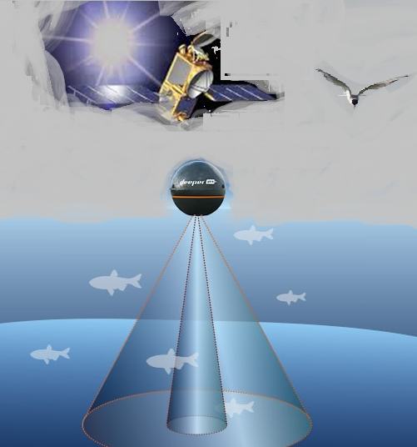
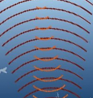

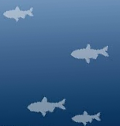
AI-DAD
detect and divert
AI-DAD
Leverages Artificial intelligence to identify fish migration patterns to strategically place and dynamically operate Shine Light systems .
Shine Light systems use sun light to illuminate under water and promote phyto planktons which attract biota, Fish
Shine light systems illuminate during night to attract and guide fish away from exclusion zones

