Slide 1
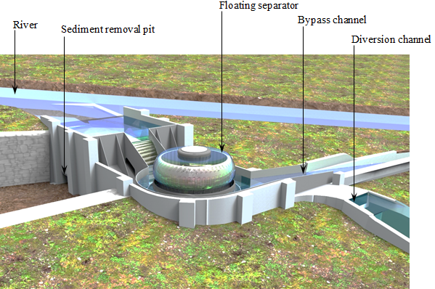
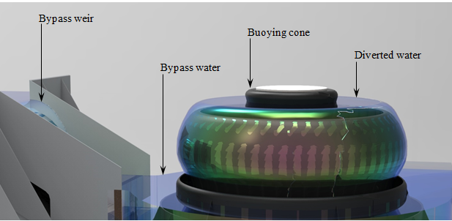
Fish Exclusion
with a Floating Separator
Leverages the Coandă Effect to Separate Fish
Optimal Safety Profile
Efficient Sediment Removal
Low Requirement for Hydraulic Head
Works for Broad Range of Flow Conditions
Prevents Long-Term Biofouling

