Slide 1
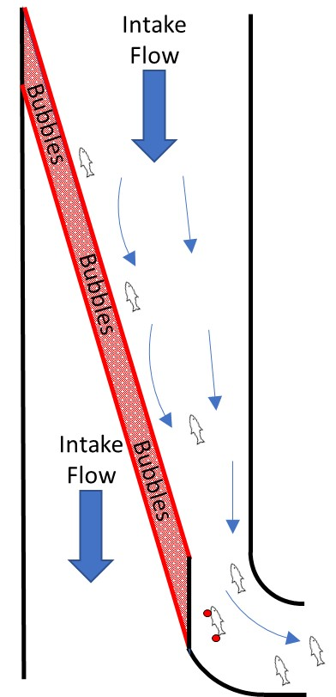
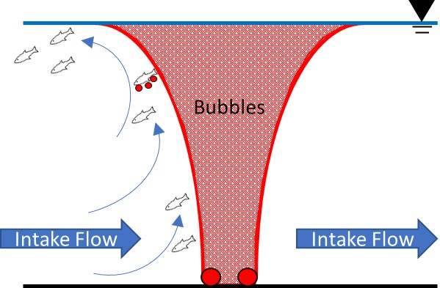

Air Bubble Curtain for Physical Exclusion
Who: fish eggs/larvae and debris
What: physical (floatation) and hydraulic (induced upward current) properties of an air bubble curtain to reduce entrainment
Where:
  Industrial facilities with water intakes (e.g., power, desalination, irrigation);
  Canals, dams, rivers, lakes, oceans
When: permanent or seasonal
Why: protect passive early life stages, reduced O&M, eliminate risk of clogging/fouling
How: technology to be developed through comprehensive lab, pilot, and prototype testing, initial proof-of-concept completed
Section View
Plan View

