Slide 1
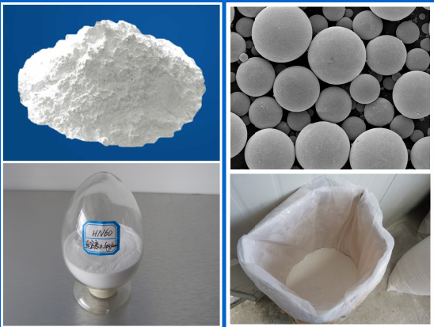
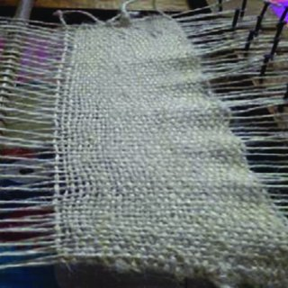
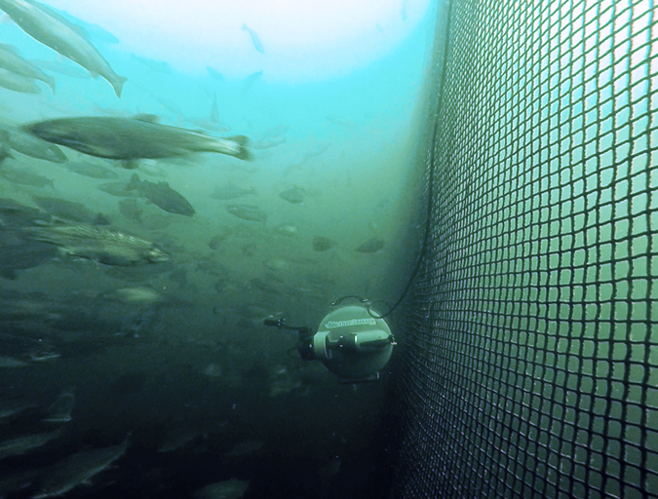
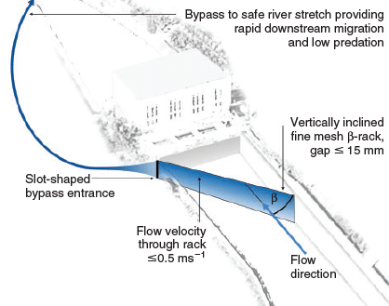
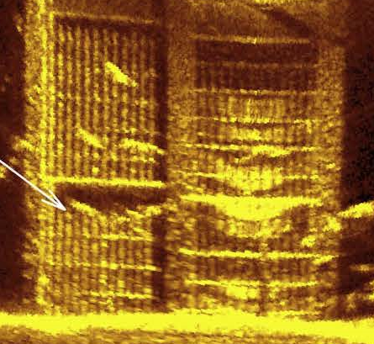
Enhanced Fish Guidance Netting Systems for Cost Effective Maintenance and Sustainability
Glass microsphere material additive improves strength and enables acoustic reflectivity.
Material manufacturing process remains unchanged except for the addition of microspheres to the liquid polymer.
Implementation of net guidance systems has already been developed and has a history of effectiveness.
Diagram for one
type of deployment configuration.
Example of sonar examination of net system.

