Slide 1
FISH PROTECTION
New method to screen fish and hydrophytes
proposal by Mirza Baig

Slide 2
INTRODUCTION
This is a theoretical idea to screen fish and hydrophytes during intake for hydroelectric dams. This particular idea modifies the design of the dam resulting in improved safety of the fish.

Slide 3
HYPOTHESIS
This is a theoretical idea to screen fish and hydrophytes during intake for hydroelectric dams. This particular idea modifies the design of the dam resulting in improved safety of the fish.

Slide 4
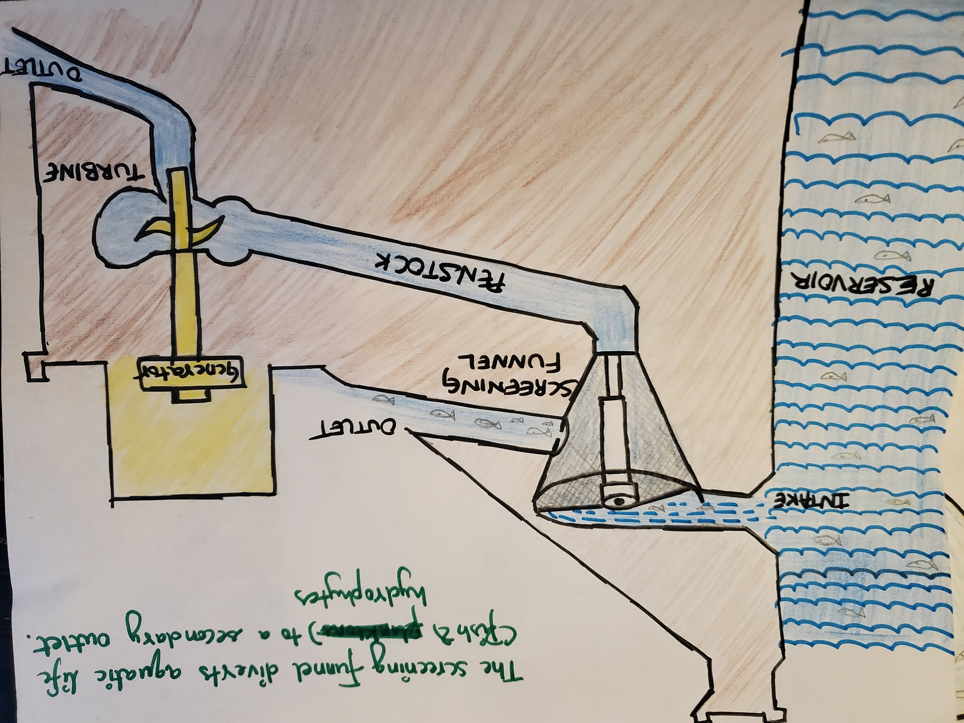

ADAPTED FOR A HYDROELECTRIC DAM

Slide 5
How does the proposed design
work? whirlpool generating masonry funnel for fish screening

Slide 6
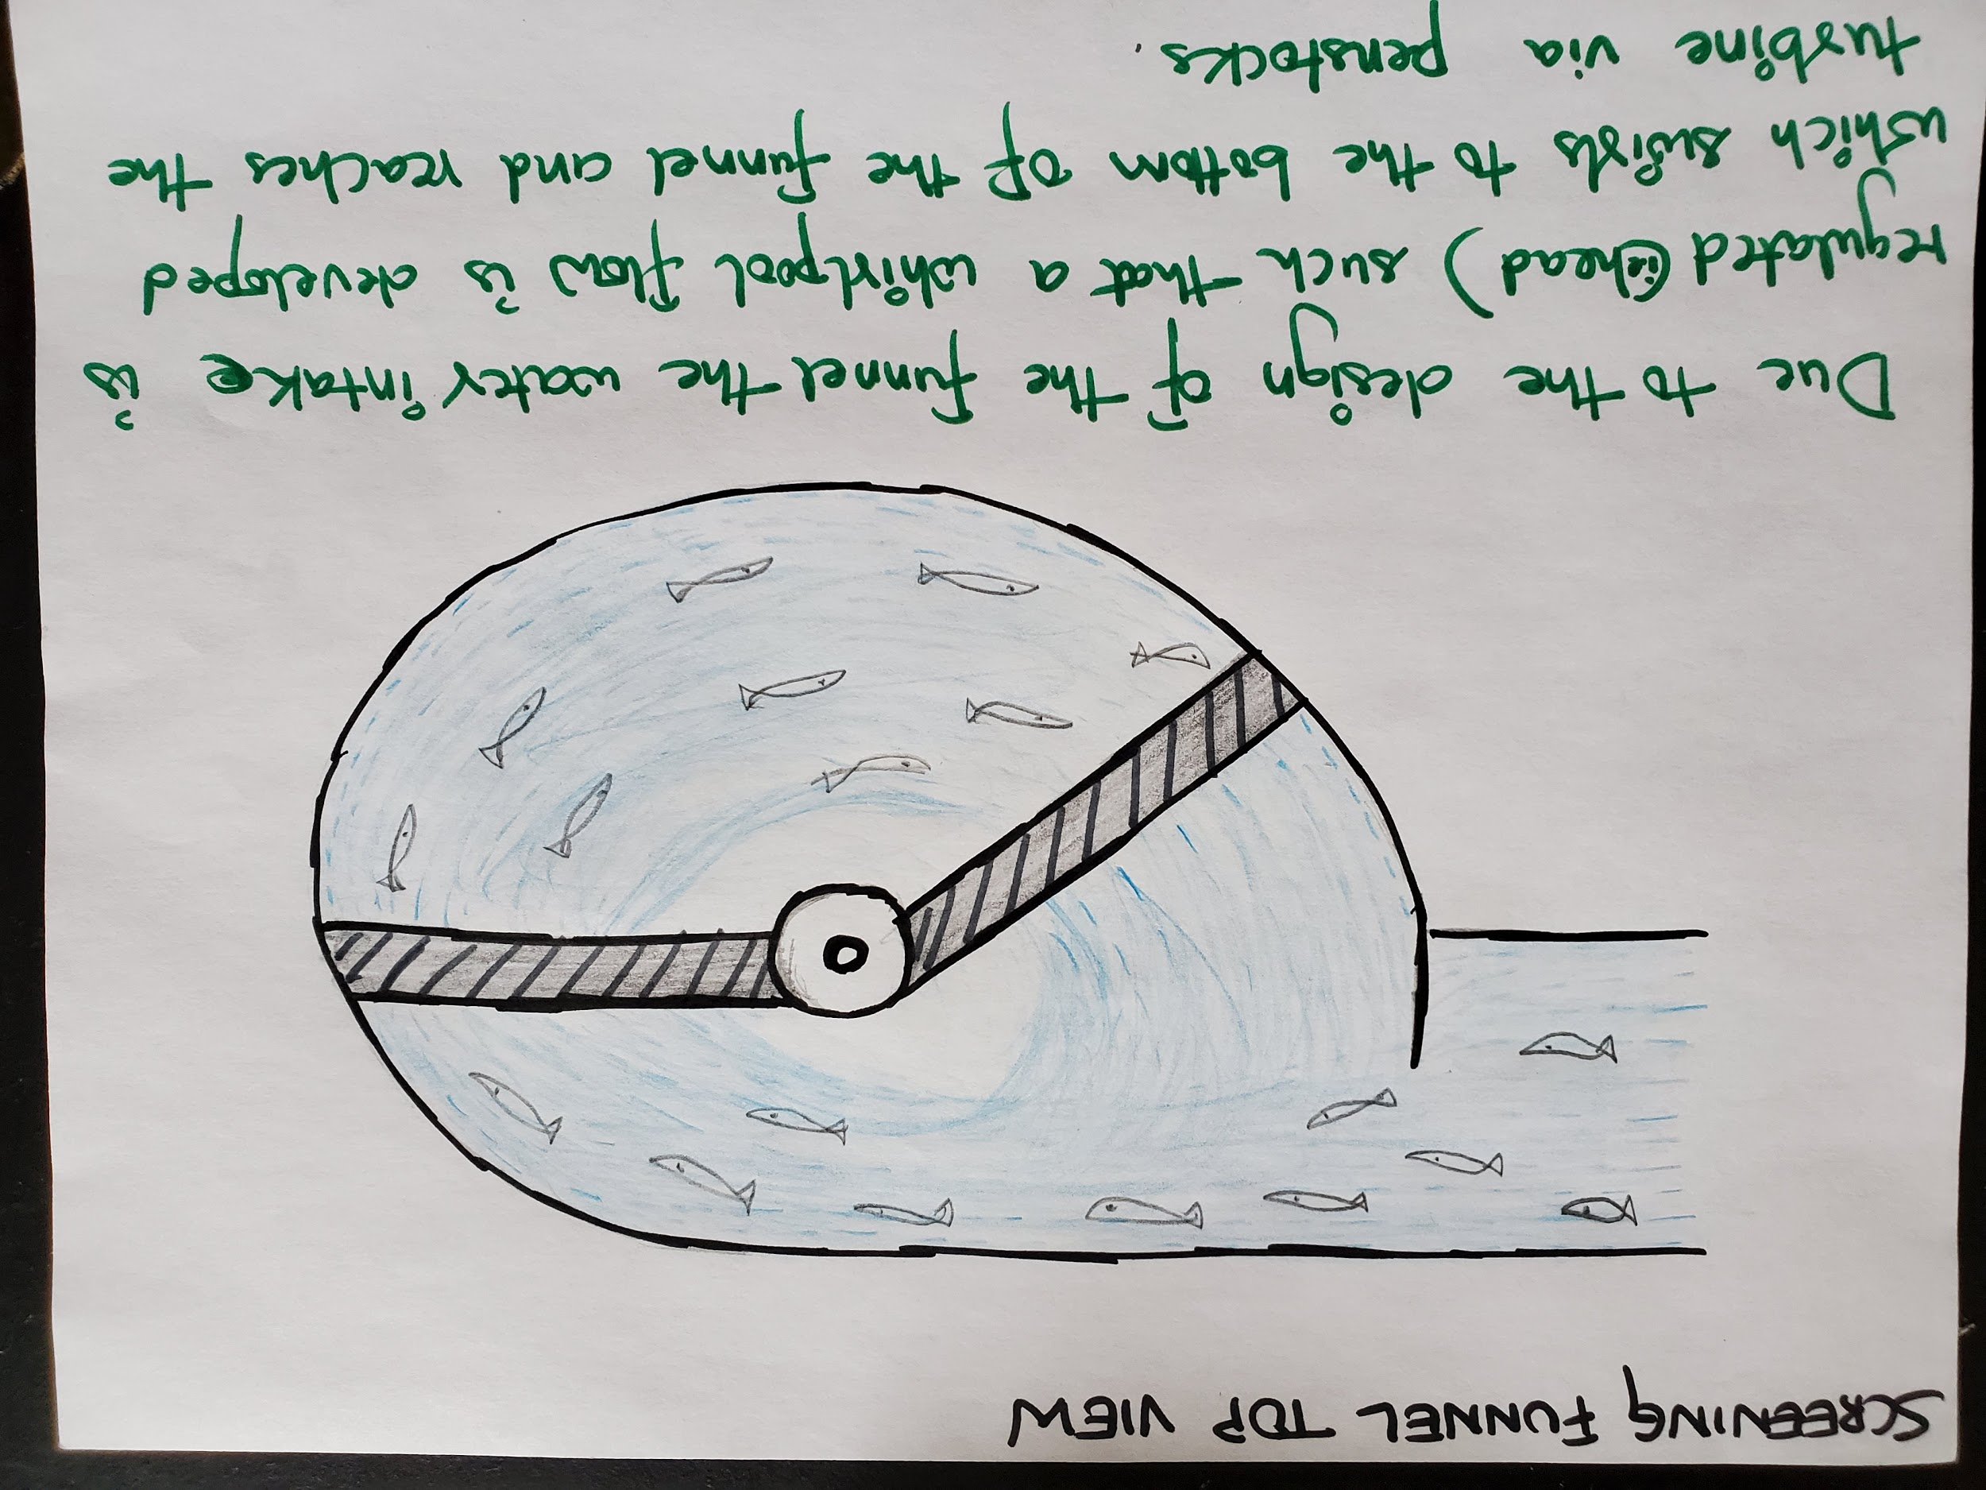
Whirlpool flow & metal frame for smp nets

Slide 7
DESIGN FEATURES
Masonry structure with smooth curved surfaces generatES the whirlpool flow.
fine meshed metal gate at the base of the structure lets water through to the turbine via a penstock .
secondary outlet for fish and hydrophytes to escape and rejoin with the river downstream.

Slide 8
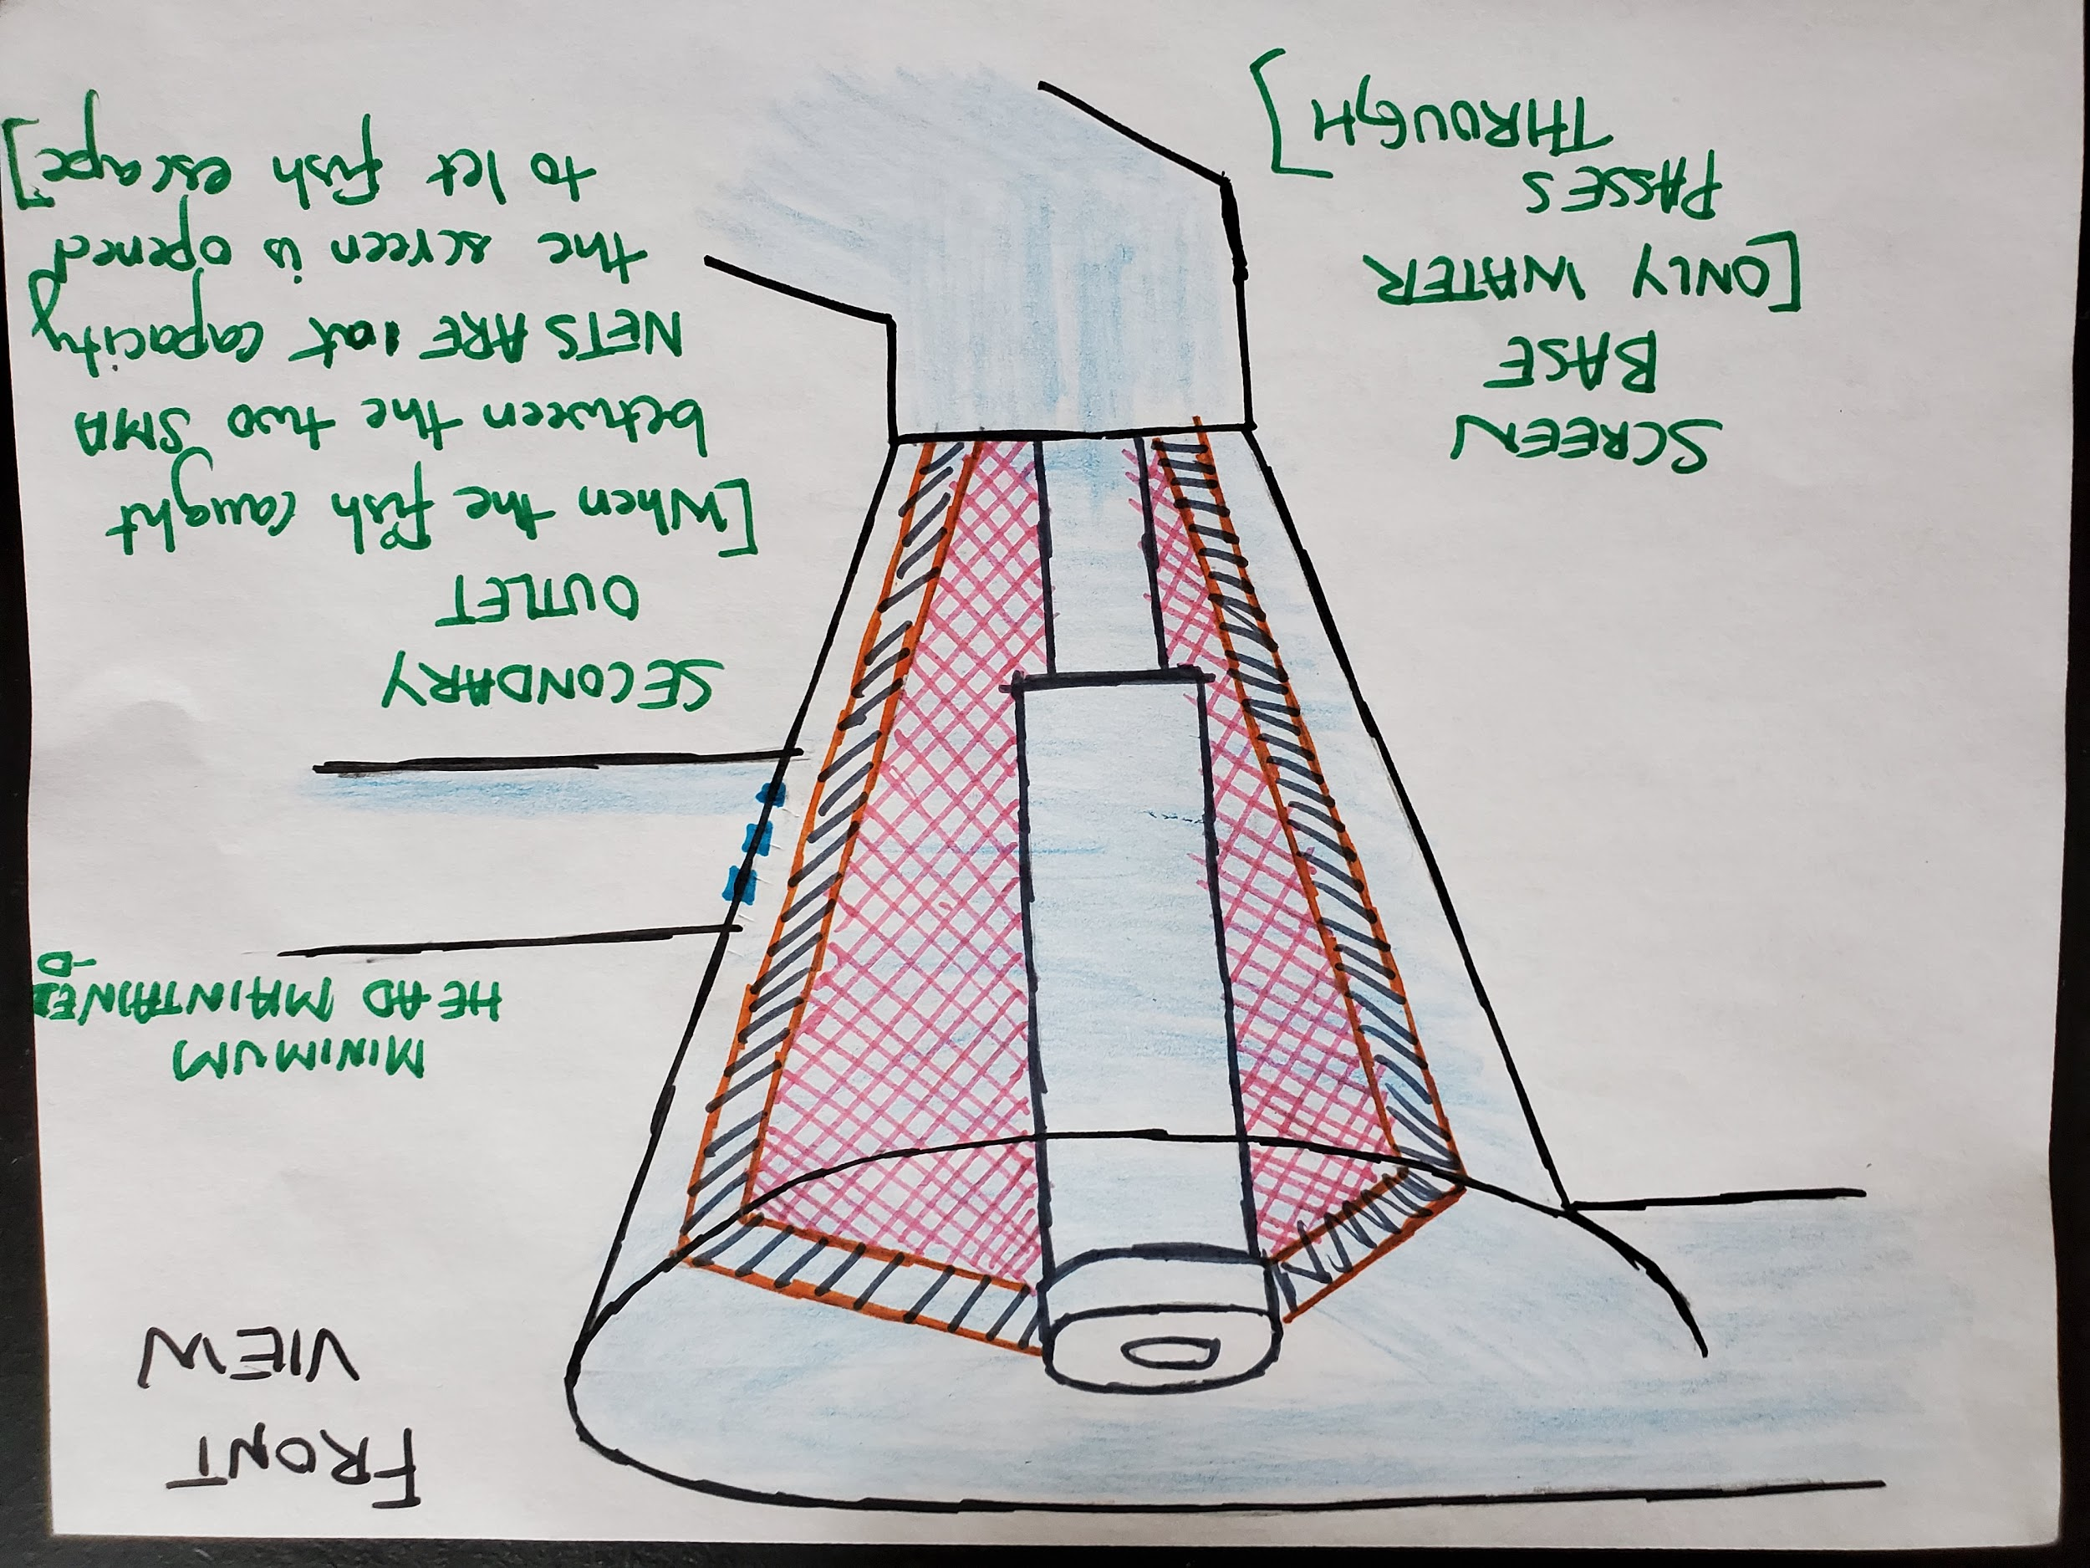
smp nets
Gathering the fish to an area

Slide 9
DESIGN FEATURES
circular support column for the two SMP(shape memory polymer) nets which help in limiting the fish to a proposed area.
electric stimulus refines the shape memory polymer net and obstructs the fish and hydrophytes from passing through.
shape memory polymer nets are fixed to the roller support frame which can be maneuvered around.

Slide 10

RESULTS
The proposed idea for screening fish accomplishes the objective successfully and also redirects the fish such that there is no sudden change in elevation which is paramount for fish safety.
Note: The positioning of the whirlpool generating masonry funnel for fish screening in the design process of a hydroelectric dam can be adapted.

