Slide 1
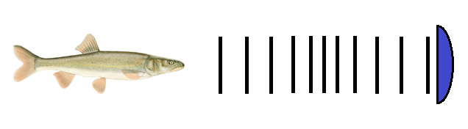
Sensory Deterrent System Based on Electromagnetic Longitudinal Wave Barrier for Fish Exclusion from Water Diversions and Intakes
The Jophiel Group team proposes using electromagnetic longitudinal waves as fish exclusion barriers for water intake canals. The proposed methods provide fish exclusion by using physical features of fishes as freshwater animals, that includes reversible changes in transmission of signals in fish nervous system that will completely prevent penetration of these species inside of intake channels. The proposed method can be realized with minimal capital cost and minimal following maintenance and thus this method will solve the problem of fish exclusion with maximal economical efficacy.
www.jophielgroup.com

