Slide 1
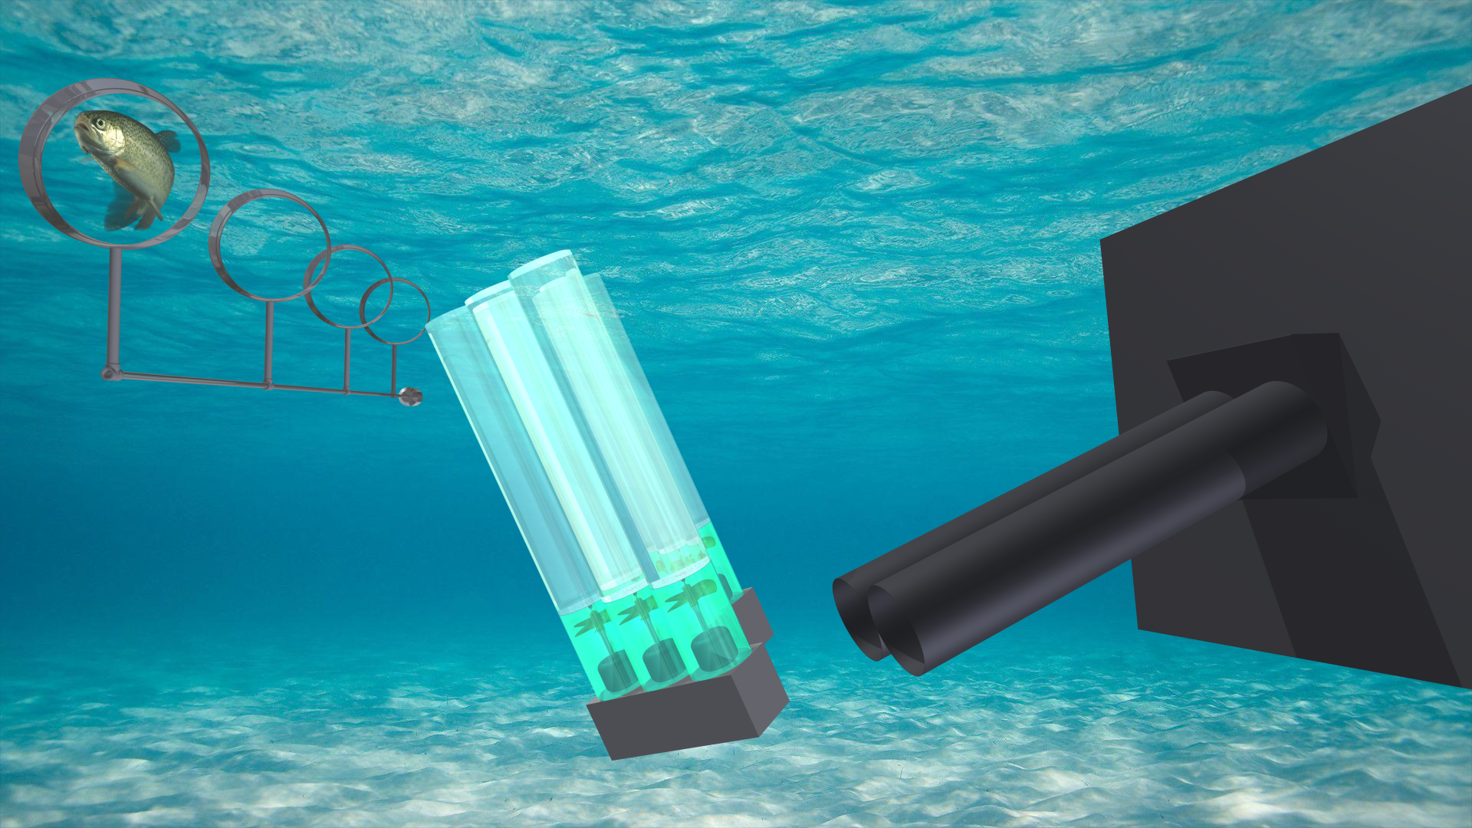
Cavitation occurs when the pressure in a fluid rapidly changes. Cavitating water flows created by propellers can deter fish movement into unscreened intakes and diversions.
Annular airfoils are ring-shaped nozzles with the cross-section of an airplane wing. They generate smooth, laminar flows that can direct fish to safety.
These technologies can protect salmonids and other fish from diversion entrainment. They are harmless to fish, low cost, and friendly to the environment.
Safer Salmonid Habitats through
Cavitation Barriers and Annular Airfoils

