Slide 1
ECO BUBBLE
By Brooks Matthew Benefiel

Slide 2
WHAT IS A BUBBLE?
Can we be good people in good space by making things better by making things more natural, but what if we did it with finese and instead of feeding fish or organizing fish or hypnotizing them. We just give them a incentive. Go this way. Its awesome.

Slide 3
BUBBLES ARE ALL AROUND US, hell we live on one That means bubbles must answer alot of question about things that make us feel good.

Slide 4
FISH SWIM UPSTREAM
And the downstream
But the upstream feels the best

Slide 5
WHY? I think its the BUBBLES. I LOVE THE BUBBLES IN THE POOL THAT MAKE ME FEEL LIKE I AM MASSAGED. I THINK THATS WHY WE LOVE THE JETS IN THE HOT TUB AND PLAYING WITH WATER.

Slide 6
A HAPPY FISH IS A HAPPY RIVER
Wh

Slide 7
FISH SWIM WITH LOVE
2020
2025
FISH ARE CONFUSED, they think water is the world of them and don't excpet you to be in the way.
2020
FISH THINK THEY HAVE SOMETHING COOL TO LIVE FOR. It has something more to help them in that tube. So they keep swimming.

Slide 8
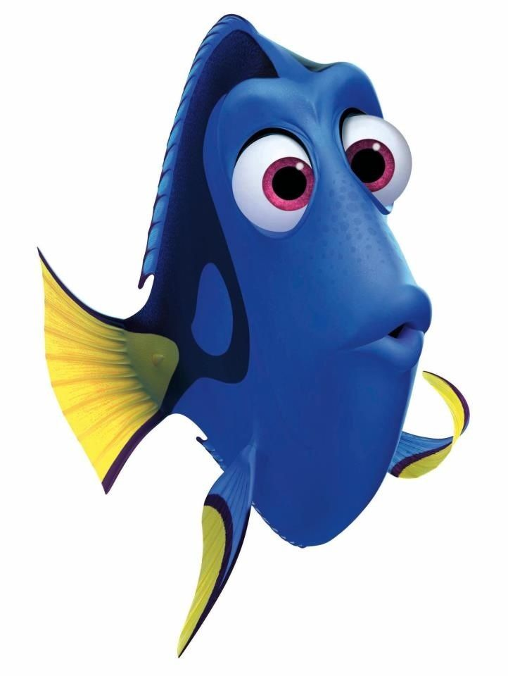
JUST KEEP SWIMMING.

