Slide 1
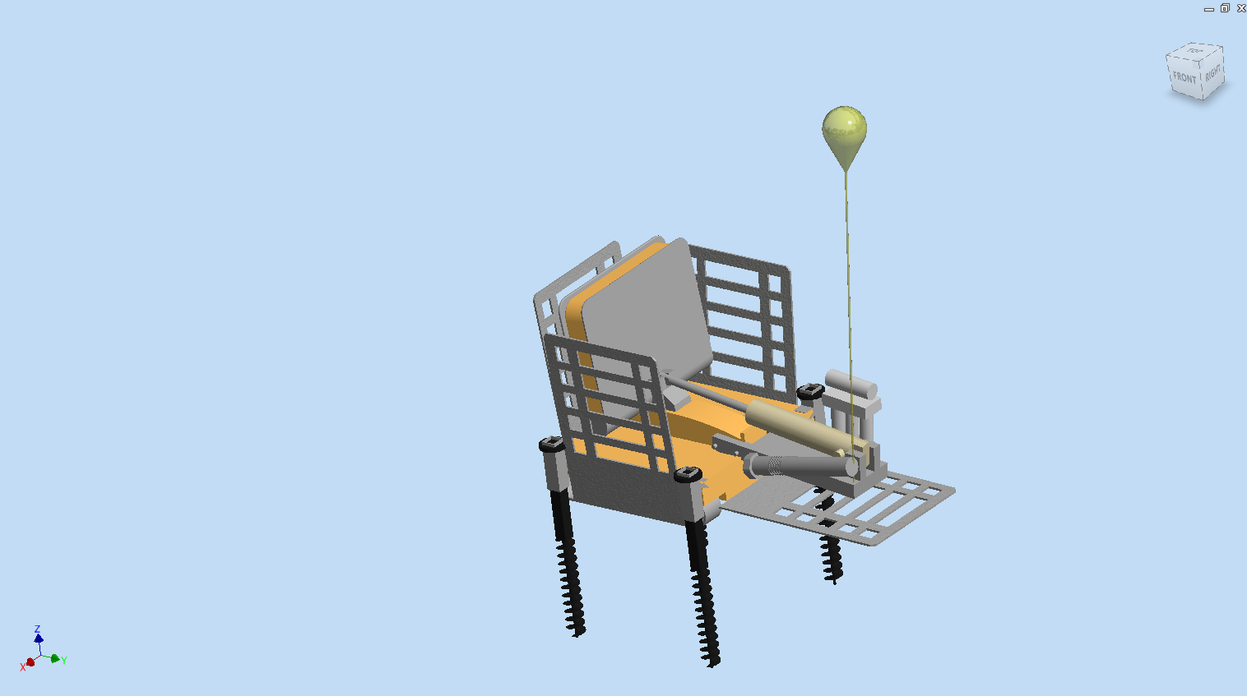
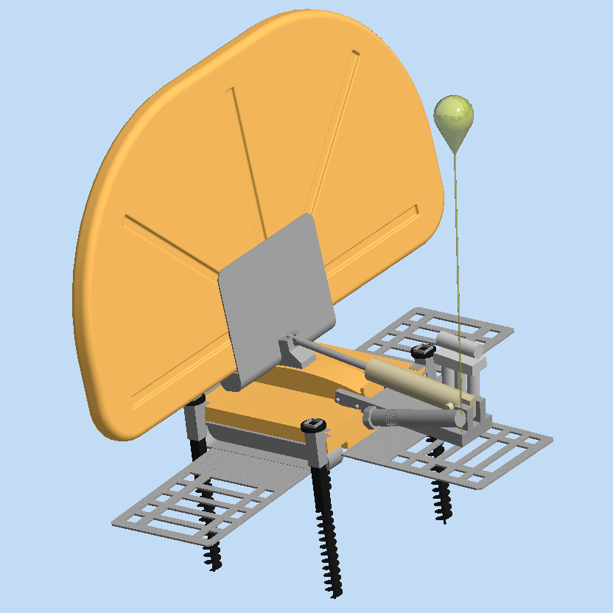
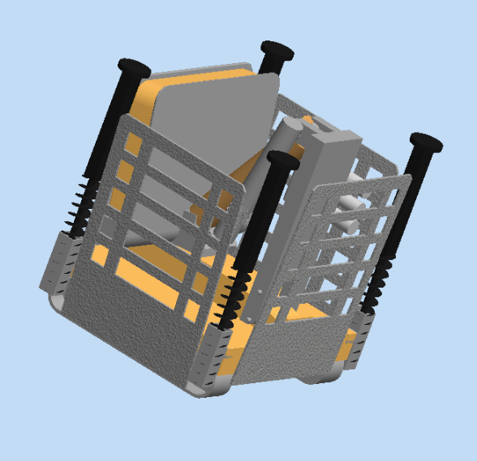
Little setup and maintenance required
Maximum desalination per wave with BRIMES RO energy recovery system
12ft Wave Catching Area
Compact, scaling design
Powered by 12V Car battery via umbilical cord
Retracting Drills mounts
Dual Mounting System
Sturdy Tank Treads
OWAW
Ocean Wave Absorbing Wall

