Slide 1

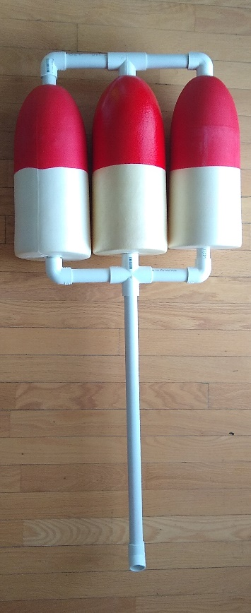
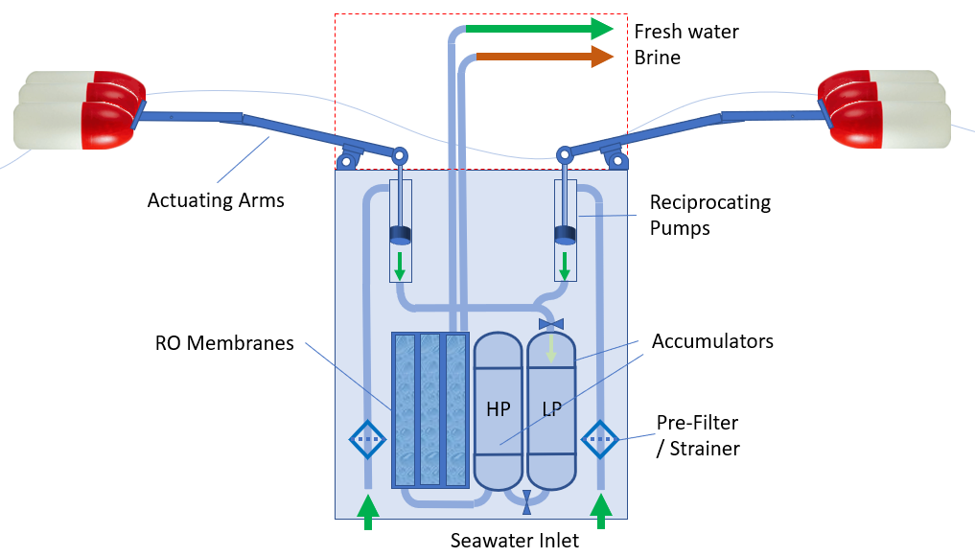
Aquaceano
Aquaceano is a wave-powered reverse-osmosis (RO) seawater desalination system. Its direct Wave power to hydraulics design eliminates inefficient power conversion losses.
Modular and Robust Design that can be deployed anywhere around the world on short notice.
We believe Aquaceano can play a role in supplying clean water to areas of the world facing water shortage, an in emergencies when immediate water supply is vital.

