Slide 1
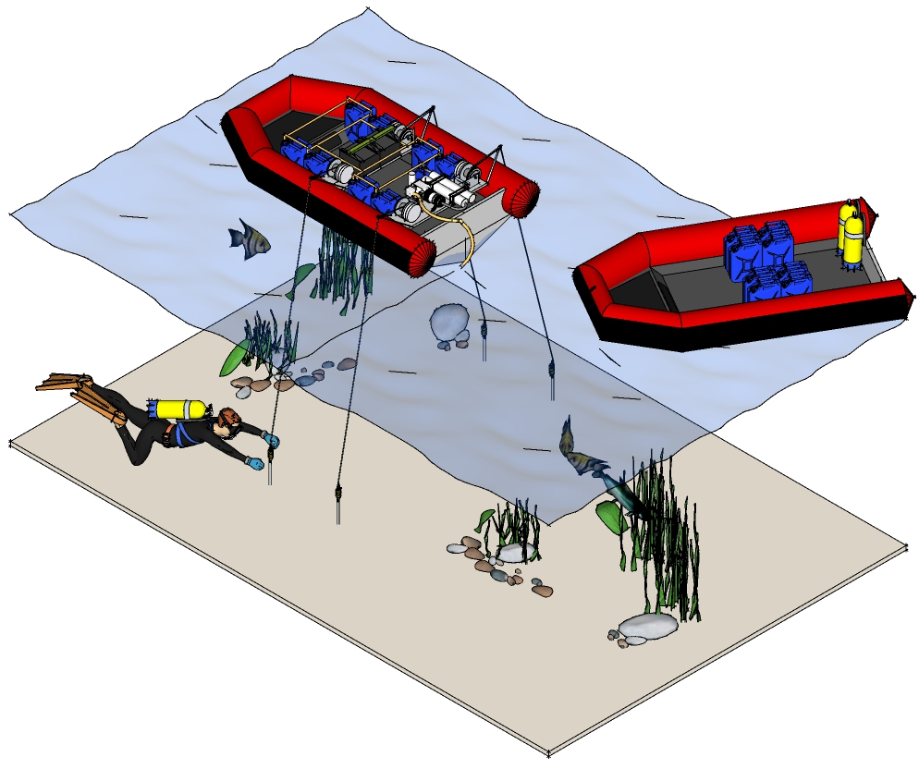

Simple mechanical systems
COTS/Modular components
Use of beach materials
Fast deployment
Dr Ryan Weed, Edwards AFB, CA ryanweed@gmail.com,
Corey Struck, Edwards AFB, CA cstruck02@gmail.com
Anthony Mirabile, Edwards AFB, CA anthony.t.mirabile@gmail.com

