Slide 1

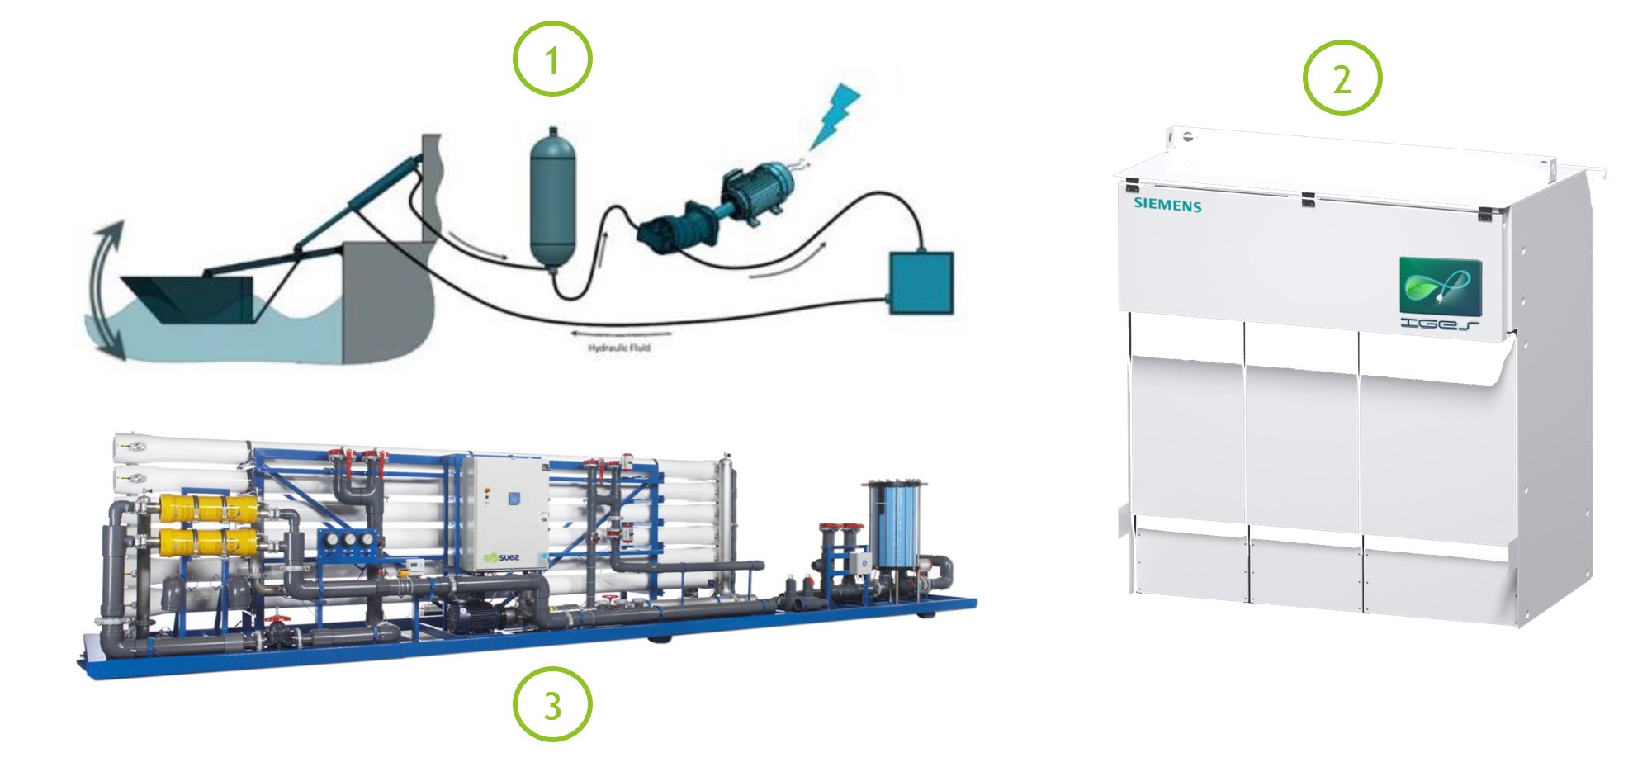
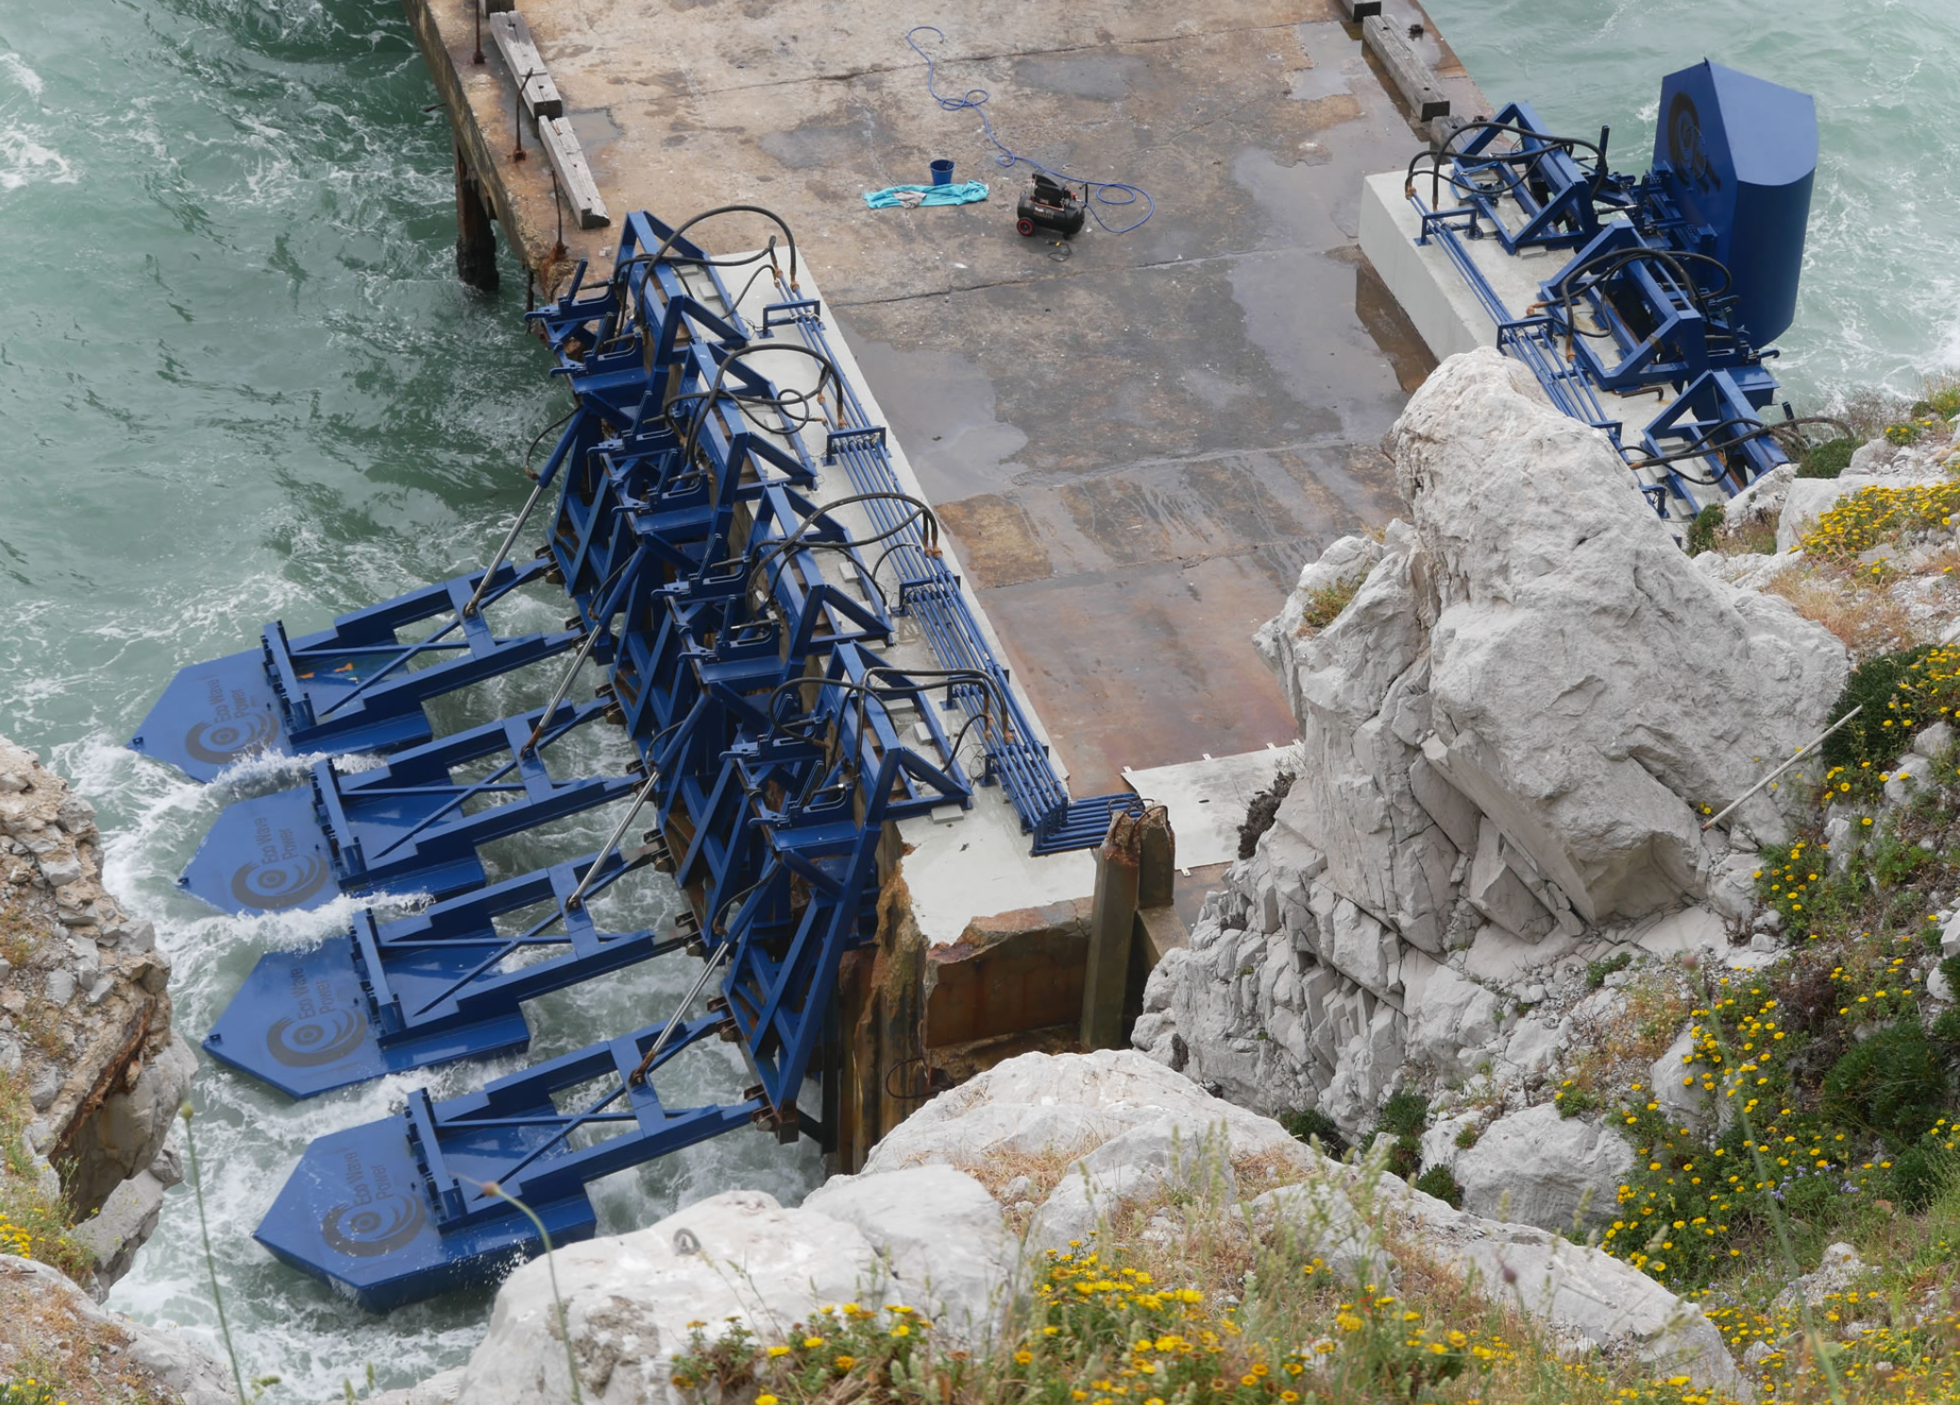
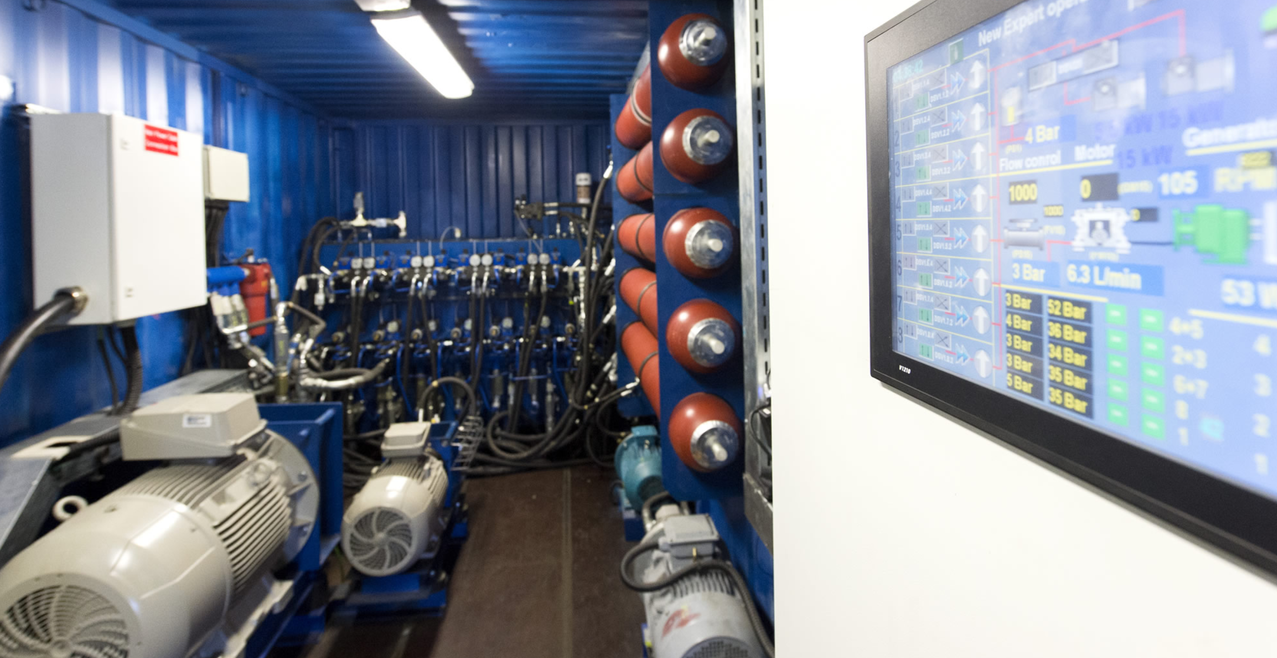
Infinite Eco Water System IEWS
Invent for a Great Environment & Society
Wave Power Converter System
Smart Inverter System with Energy Storage
Saltwater Desalination System

