Slide 1
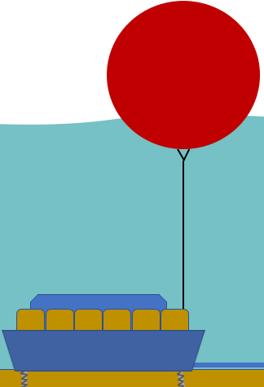
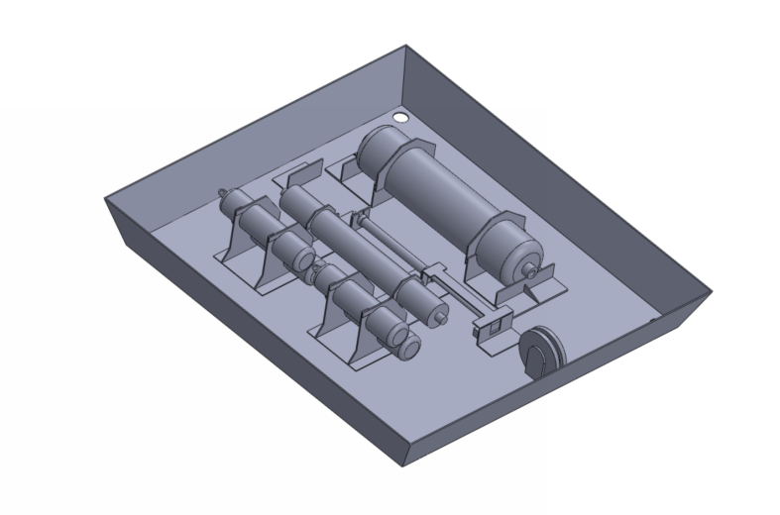
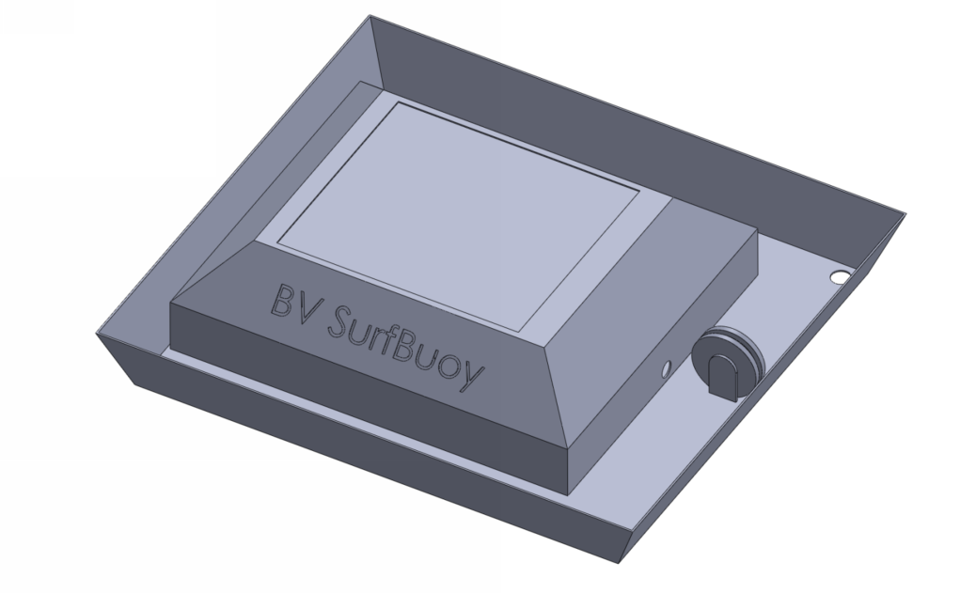
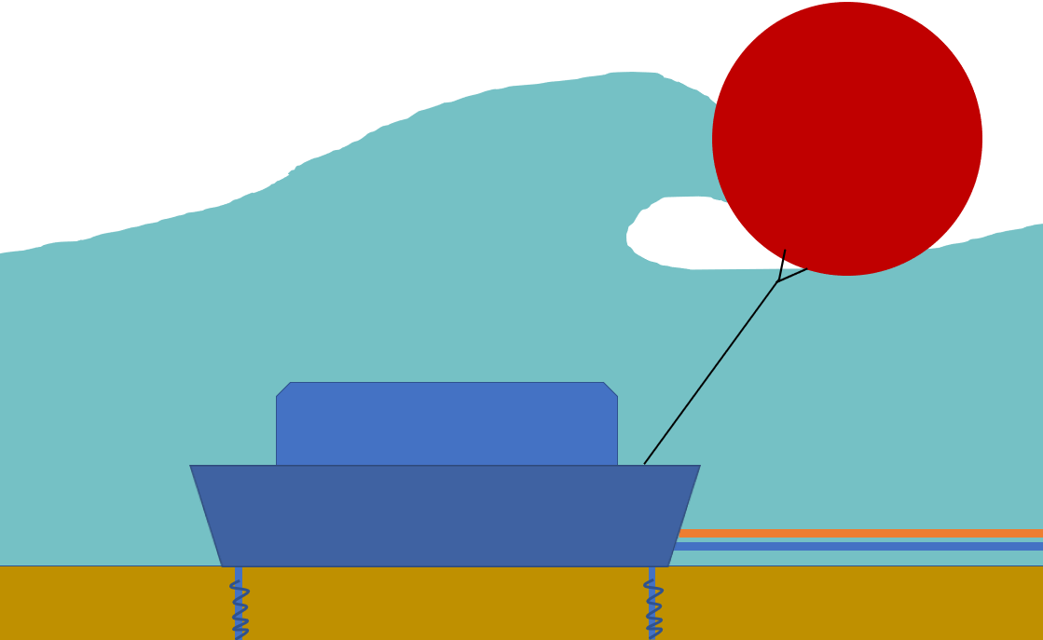
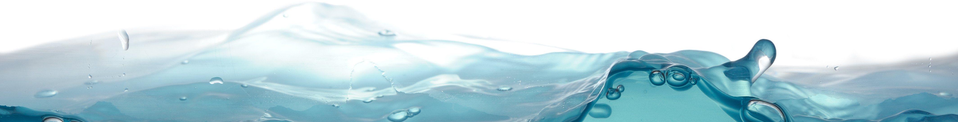

BV SurfBuoy
Anti-roll protective housing
Holes for sand screws (x4) in each corner to fix device to the sea bed
Pressure Accumulator to supply constant pressure to reverse osmosis membrane
Water intake - meshed grate (hidden)
Maintenance hatch
Rope Connection to inflatable buoy
4 x Prefilters
Deep water operational mode
Tray for sandbags when sand screws are not feasible
Low pressure hose to shore
Runners to improve ability to drag sled (underneath)
Pulley to accept a range of angles
RO Membrane
Sprung piston to pressurize incoming water
Key Features
Designed to fit within 45 x 48 x 42 inch container
Inflatable buoy attached to piston pump with pulley, to provide pressurized water to RO unit
c. 250L/day drinking water produced
Breaker waves operational mode
Check out our YouTube channel here!

