Slide 1
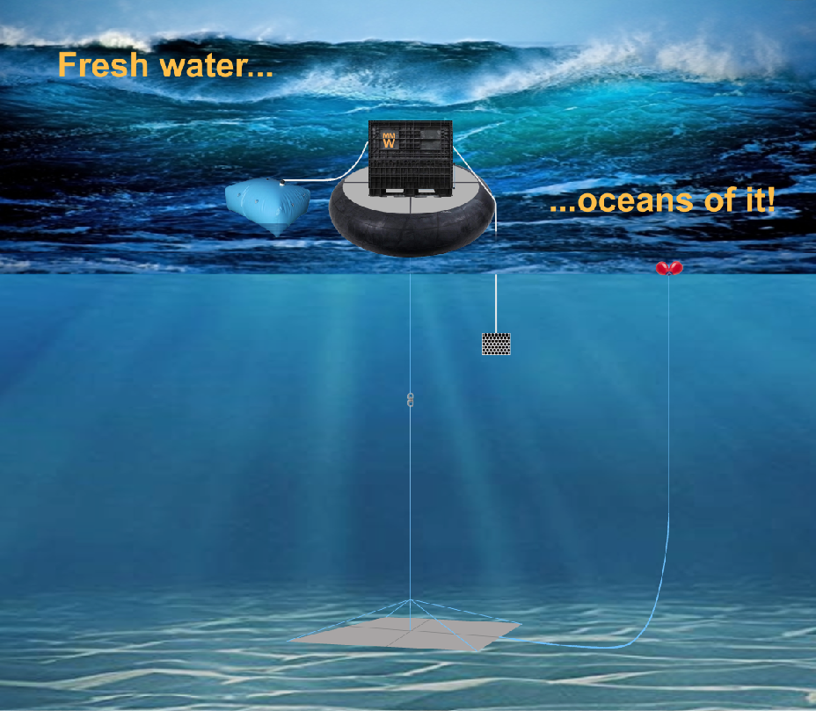
O’Desal
O’Desal is a reverse osmosis salt water desalination plant using only wave energy to produce dinking water.
A brine converter transforms the brine into useful sodium hydroxide and sodium hypochlorite reducing the need for brine disposal by almost 100 percent and protecting the environment.

