Slide 1
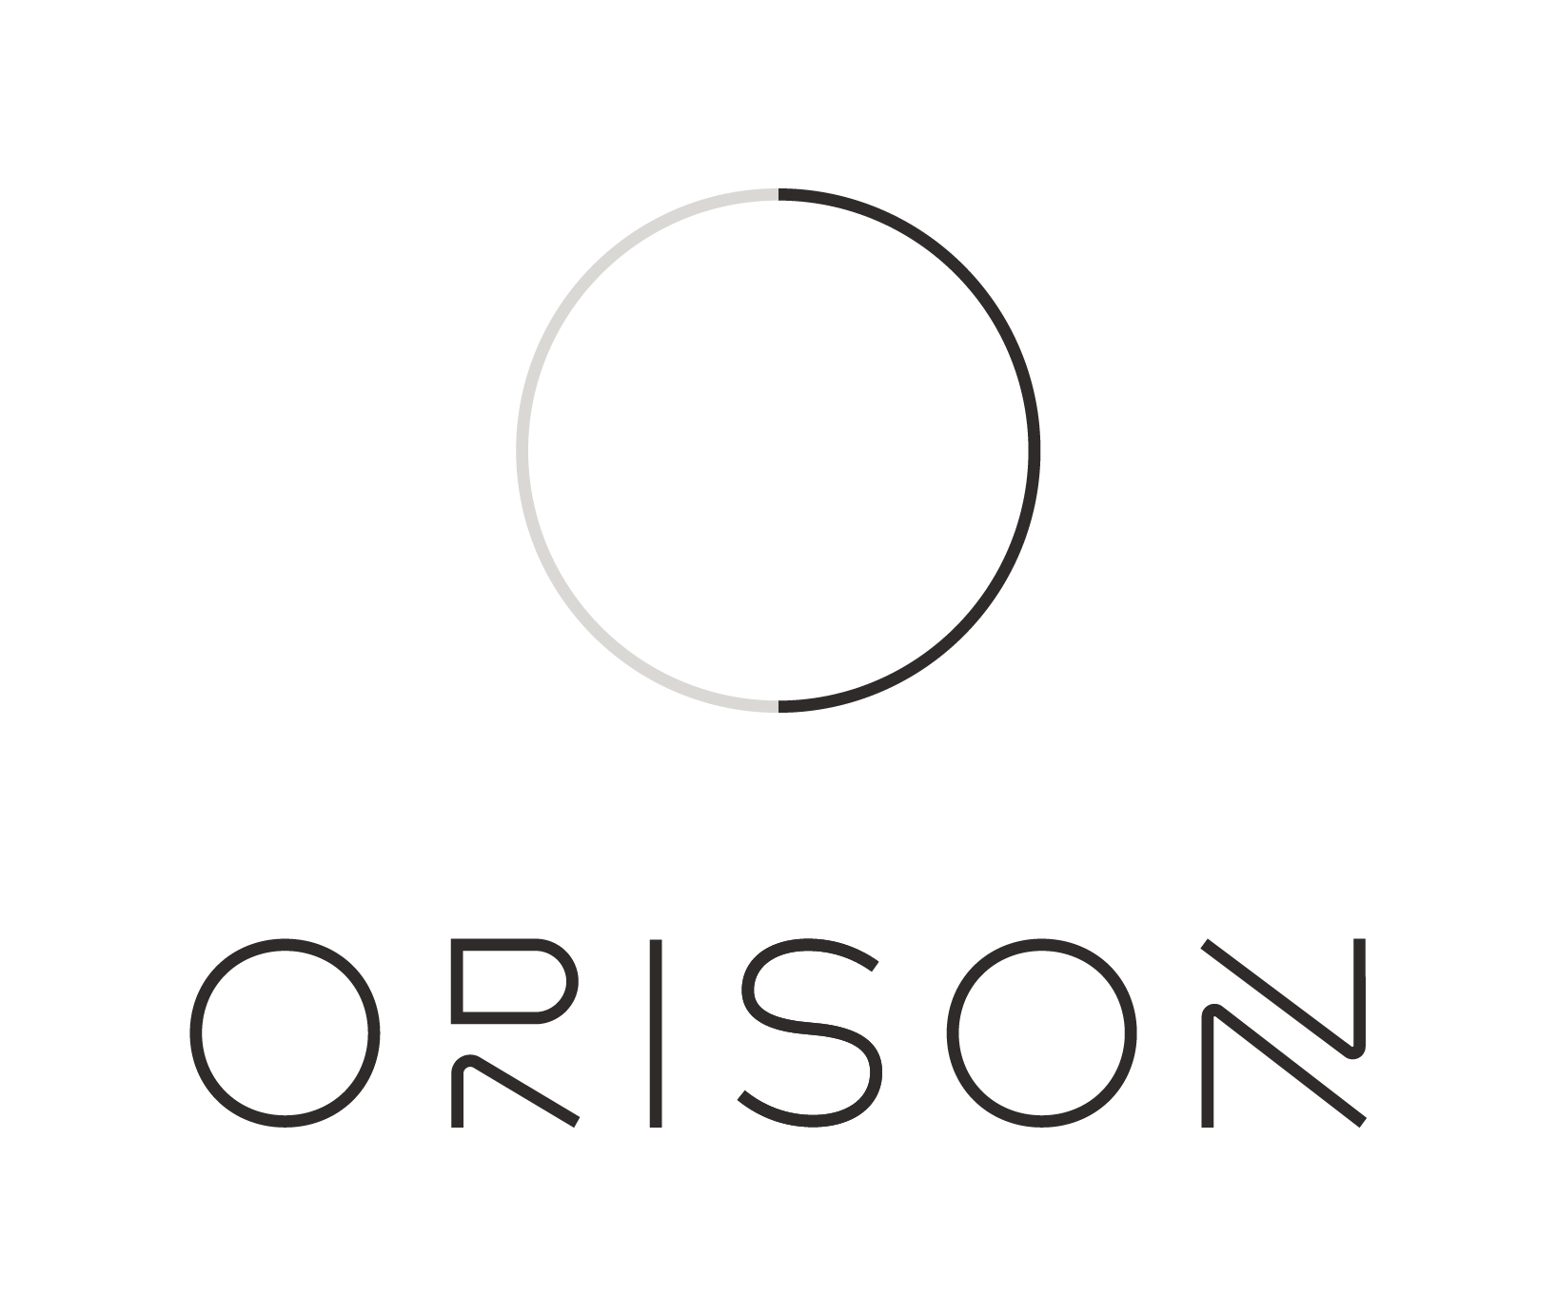
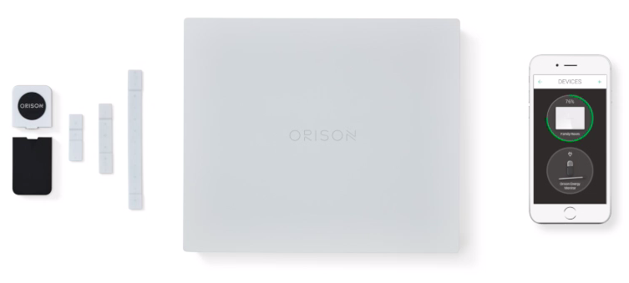
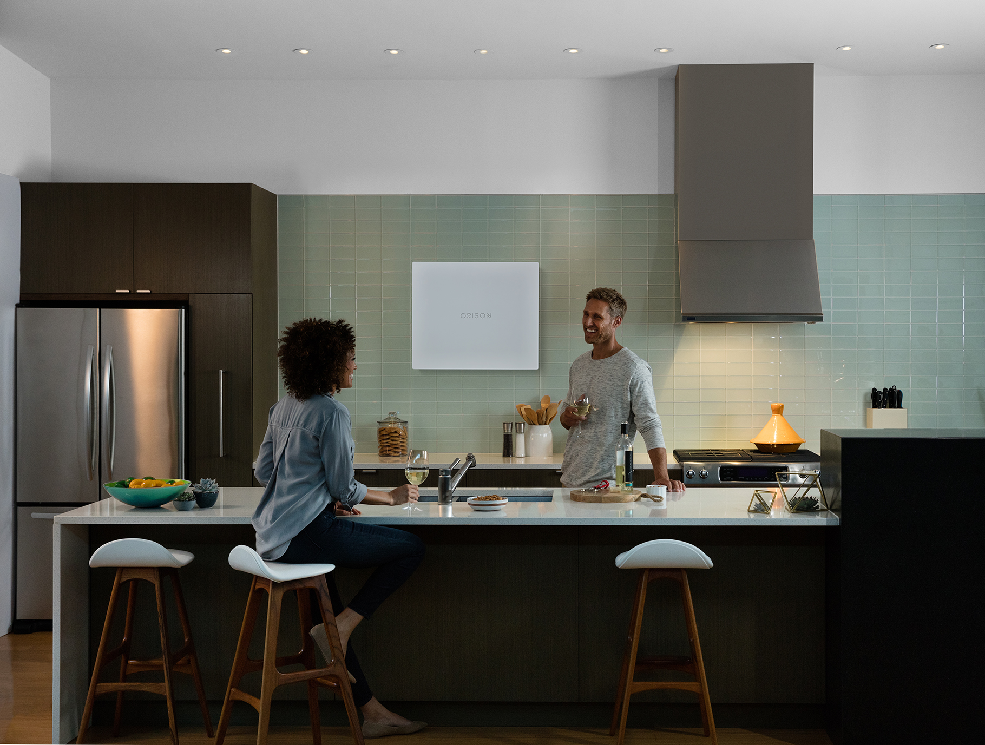
The world’s only self-installable energy storage enables solar
Orison - Scalable Home Battery System
One compact package: 2.2 kWh battery, power electronics, LED lighting, and IoT communication hub
Self-installable inside the home: Plug Orison battery systems into any home wall receptacle without utility approval or electrical permitting
Flexible and scalable for all homes: Single-family, apartments, rental properties, high-density urban homes
Controlled from your pocket: Orison App allows you to “set it and forget it” and benefit from patented smart controls and user-friendly functionality
Low “entry level” cost: Smaller-scale, modular units open new market with home battery consumers by offering low entry level cost compared to other energy storage

