Slide 1
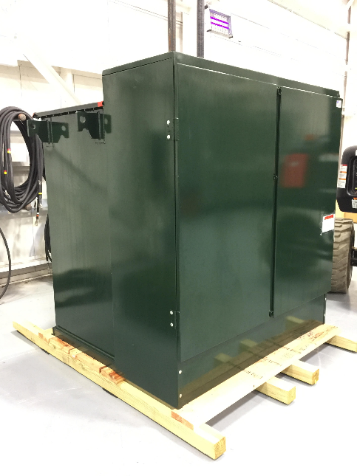

World’s first utility grade multi-port Power Router 1.5MVA 15kV (125kV BIL) delivered for third party testing at 20MVA Duke Energy eGRID in Charleston, SC
Expedited interconnection
No transformer inrush current
No transformer magnetizing losses
Higher efficiency through DC
Higher voltage for lower impedance
Harmonics far below IEEE 519
Eliminate switchgear / no load break / fuses only / integrated HVDC breaker
Harmonic cancellation with parallel unit synchronization
Higher stability / active damping
Higher safety with reduced arc flash risk from MV side through current limiting fuses
Shorter lead times without transformer
Optional battery / peaker plant
Optional utility control points for VARs, voltage, and frequency regulation
Optional SCADA integration with any other VAR sources
Powerline communication transfer trip disconnect
Full rating up to 40C
Up to 2x overload current for less clipping or tripping
Integrated Medium voltage self test
Integrated PT and backup with protection from grid
Lower conductor costs (could transmit MVDC)
Turnkey container or mobile trailer installation

