Slide 1

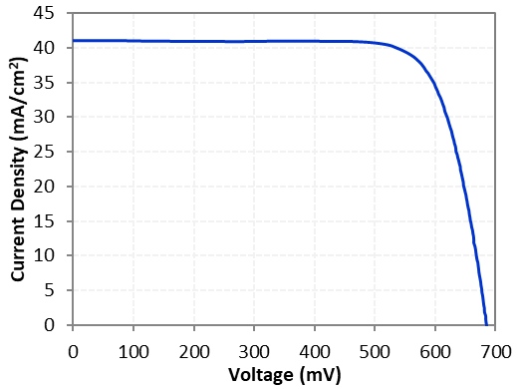
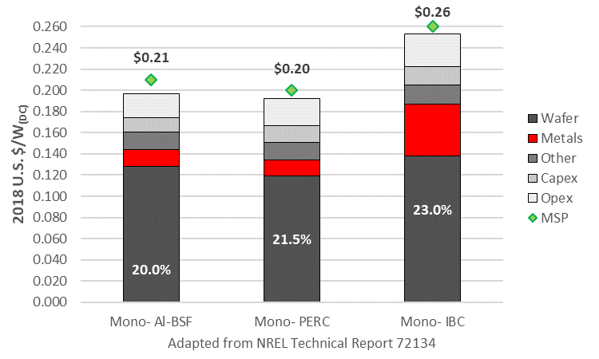
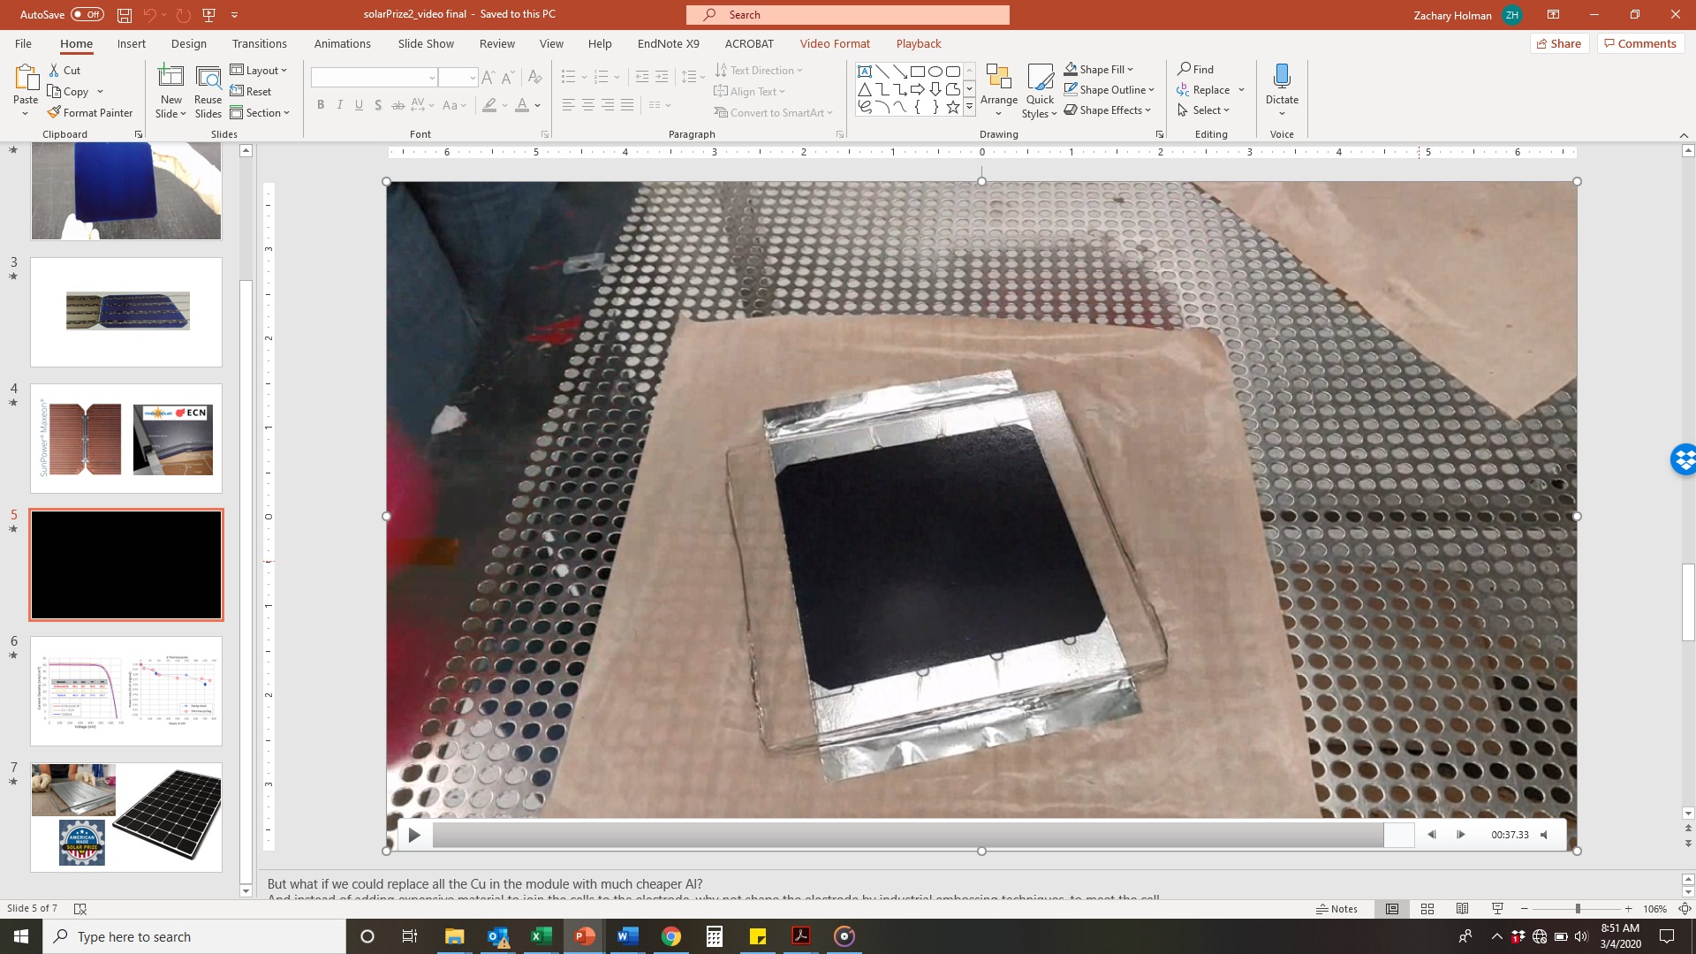
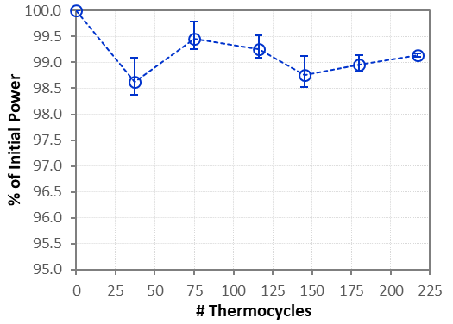
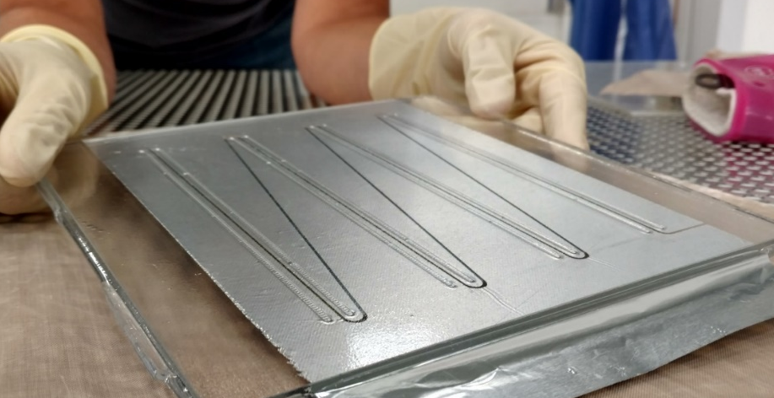
Single-cell modules demonstrated with 22% efficiency and <2% power loss after IEC 61215 reliability testing → reduced LCOE compared to PERC
3
EFFICIENCY RISING
Our SunFoil module technology replaces printed silver or plated copper with aluminum foil welded to the back of the cells → same projected cost as PERC
1
Back-contact cells beat PERC efficiencies, but their rear metallization is cost-prohibitive
2
J_{sc} = 41.0 mA/cm²
V_{oc} = 685 mV
FF = 77.7%
Eff. = 21.8% (after thermocycling)
22.0%
Front
21.8%
Rear
IEC Pass
4
Set! plan: Fabricate 4-cell mini-modules and perform accelerated degradation testing and outdoor performance characterization at Nat’l Labs—side-by-side with PERC—to demonstrate scaling of performance and reliability; complete stakeholder engagement (cell/module manufacturing partners, supply chain); enter into joint venture with US module manufacturer

