Slide 1
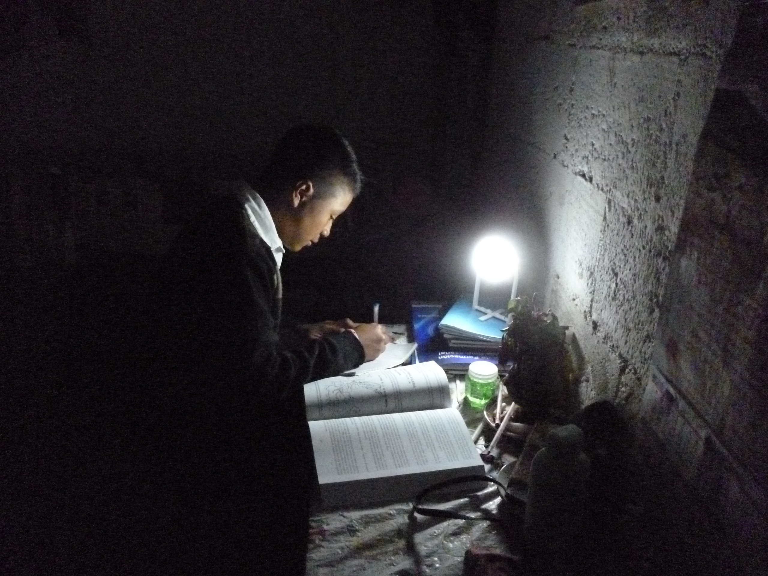

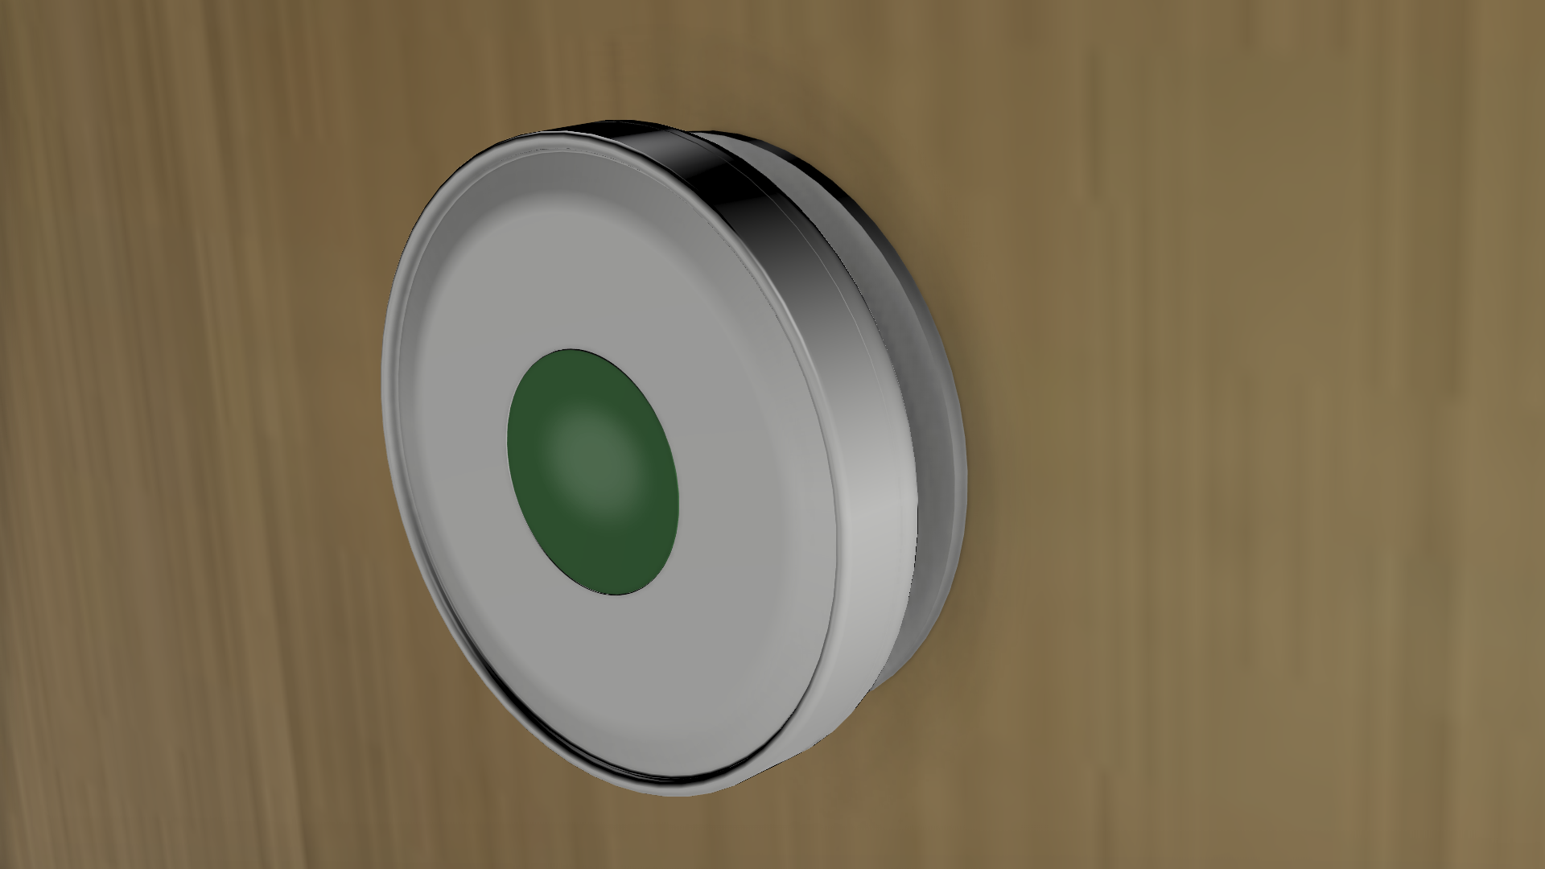
Solar.20
A 20 year solar power solution for remote parts
of the world living without access to electricity.
20 year batteries provide 400% more light, and require less maintenance.
Solar.20 Simple Controller

