Slide 1
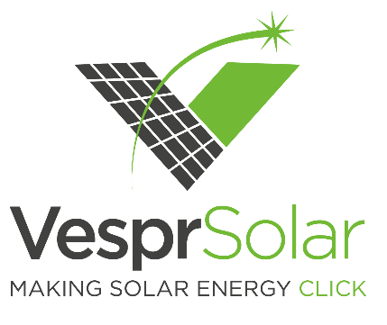
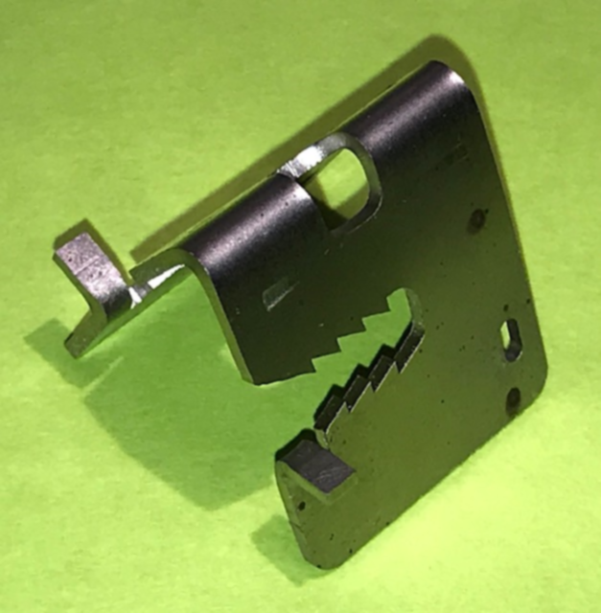
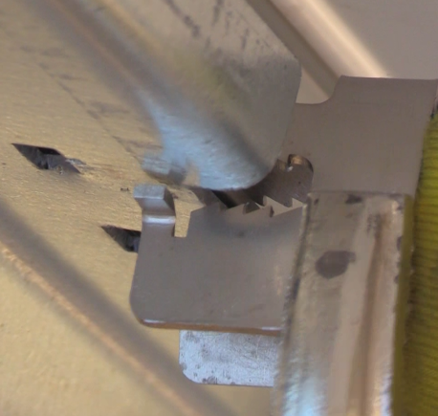
Introducing the
Installs as Easy as 1-2-3
It Works!
V-Clip
Pliers compress V-Clip while it is pushed in place
Antennae ‘click’ to lock in place – simple visual inspection shows the V-Clip is secure
Releasing pliers activates V-Clip teeth so they “bite” into PV module frame and rail to hold module in place and provide electrical bonding
Preliminary Structural, Electrical, and Ergonomic Testing Very Successful!
Prototypes Developed to Meet Most Industry Needs
  Optimized prototypes for single axis trackers, fixed tilt, and canopies in portrait configuration
  Preliminary prototypes for single axis trackers, fixed tilt, canopies, and flat roof in landscape configuration
A New Standard for
PV Module Attachment
Product Overview
13-gram steel, spring-based clip physically secures PV module to underlying rail, driving ¾ of a cent per watt savings in utility-scale installation and maintenance costs
The V-Clip In Action
antenna
Business Case - BIG Savings Opportunity!
3 cm
1. Impact of ¾ Cent Per Watt Savings
Extremely Fast
Increases Module attachment speed by 3X
Reduces utility scale install time by weeks or months
Key Benefits
Initial Target Market
GLOBAL UTILITY SCALE MARKET
$1.1 B Annually
Intersolar 2022 High Projection: 149 GW, or ~400 million panels
Reliable & Secure
Hear and see V-Clip lock in place
Sustains uplift loads of 185 mph
No torqueing! Eliminates maintenance!
2.5 cm
13 grams
antenna
GLOBAL PV MARKET
$1.8 B Annually
Intersolar 2022 High Projection:
233 GW, or ~600 million panels
Customer Interest is Strong!
Conducted >20 customer interviews to confirm industry need for new attachment solution
Secured (2) pilots for 2020 (confirming more soon!)
Received 7 customer letters of support and testimonials
2. Project Savings Example
100MW Project Example
Universal
Portrait & landscape module orientations
Works with most utility-scale PV modules and racking systems
Framed and frameless PV modules (requires adaptor)
$1.5 M
50% Cost Reduction
$0.75 M
Select customer discussions include:
SunPower, Soltec, Cypress Creek Renewables, Norwich Technologies, Everest Solar, ReVision Energy, Quest Renewables, Greentown Labs, Bithenergy, Powerhouse, Radiance Solar, Catamount Solar, Solaflect Energy
Save over $800k or
>3/4 Cent Per Watt
Finish Weeks Faster!
PV Attachment Costs Today
Labor & Material Savings
Present Value Savings of Torque Audits
V-Clip Expected Costs
Labor & Materials
Present Value of Torque Audit Costs
Savings

