Slide 1
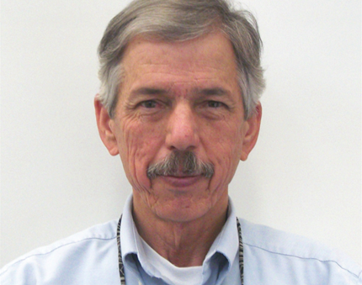
NREL American Made Solar, Round 2 – SET Competition
Solar Powered Backup Systems for Traffic Network
Critical Node Infrastructure Support (CNIS)
Solar Powered Back-up Systems for Traffic Signals, answering the question of, “what happens to your traffic network when you lose the electrical grid”.
We initially focus on bicyclist and pedestrian safety by powering the pedestrian-activated hybrid signals, or HAWKs.
Currently in design and engineering of system development, with funding from USDOE-NREL, American Made Solar (AMS)
______________
Under Round 2 – Ready
Completed sourcing research, specifications, engineering design and early customer discovery.
Submitting for SET, to build and test the prototype, leading to pilot testing with our Industry Partner, Tucson Department of Transportation.
We have received assistance from the AZ Center of Innovation and the Nation of Makers
We will test the Prototype at NREL in the environmental chamber.
We will continue our early customer discovery efforts, with municipalities, transportation and public works departments, counties and associations of governments.
Sundial Energy, Inc TEAM
Bob Freitas, President
bobf@sundialenergy.com
520-256-2444
PO Box 1309
Tucson, AZ
85702

