Slide 1

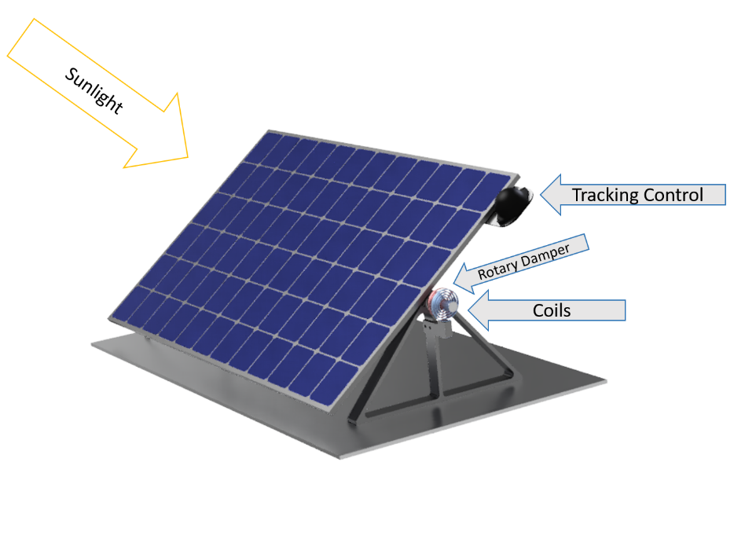
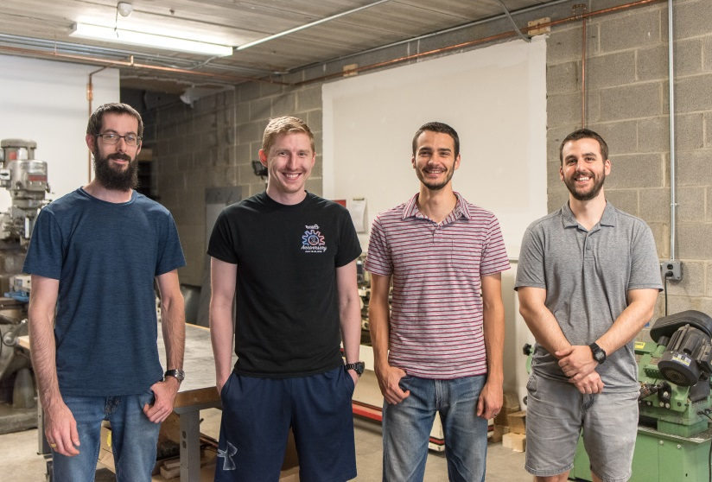

Reliable, Low Cost Solar Tracking
Solar tracking by panels can increase efficiency by up to 40%.
Current systems are uneconomical due to significant maintenance and part costs.
Our economical system uses robust shape memory alloy coils and a simple circuit to track the sun throughout the day.
When the sun moves, a sensor circuit sends power directly from the panel to heat one coil, causing it to contract and the panel to tilt towards the sun.

