Slide 1

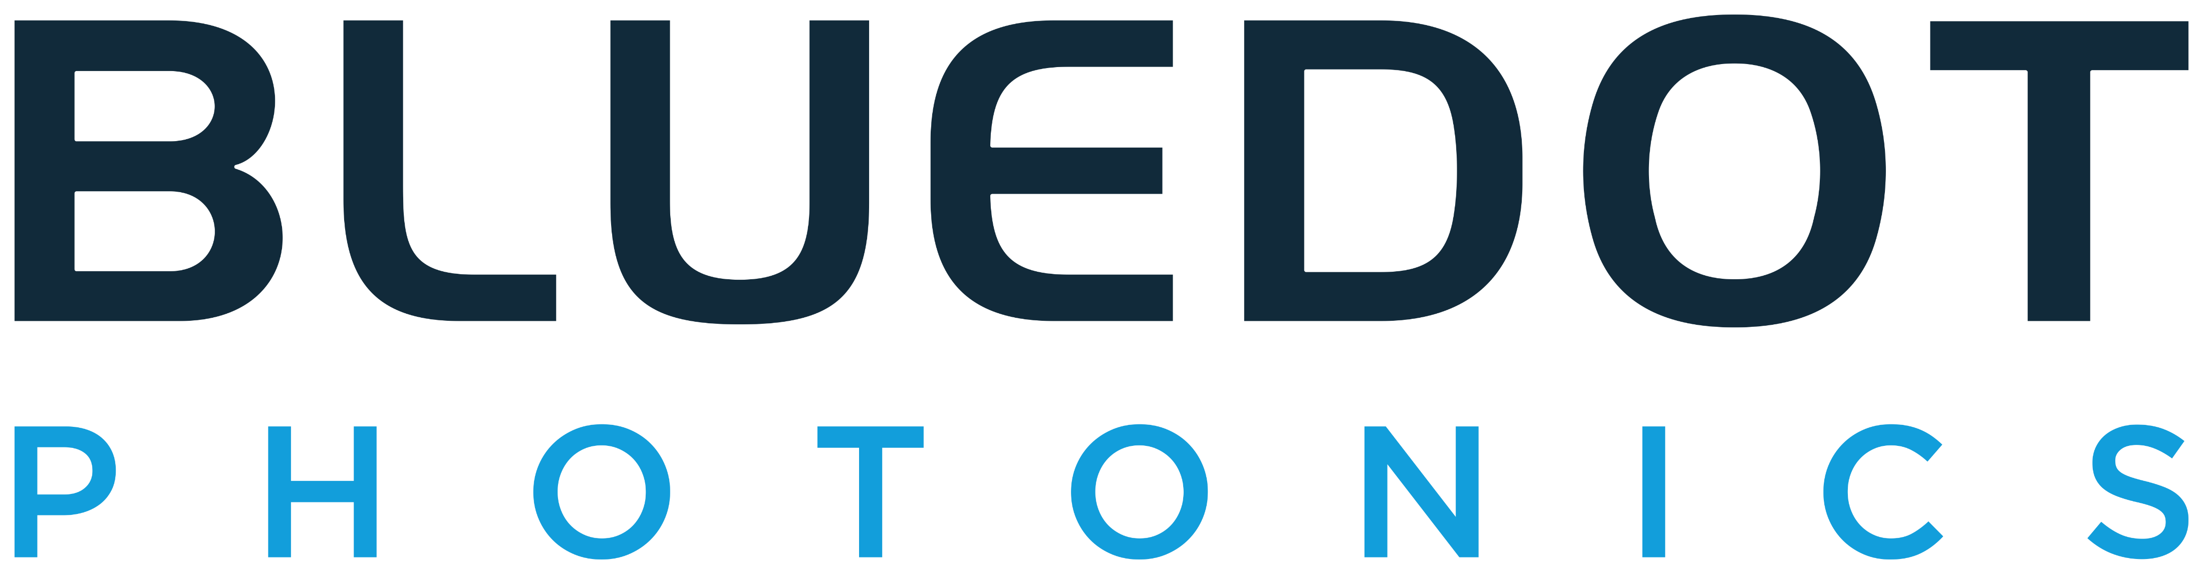
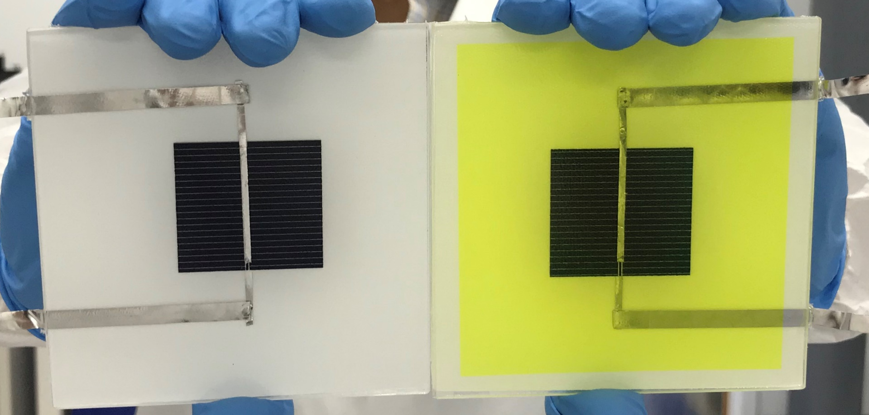
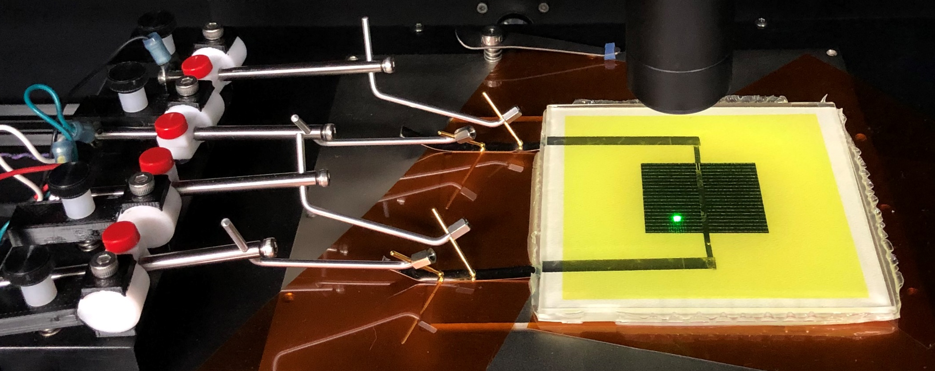
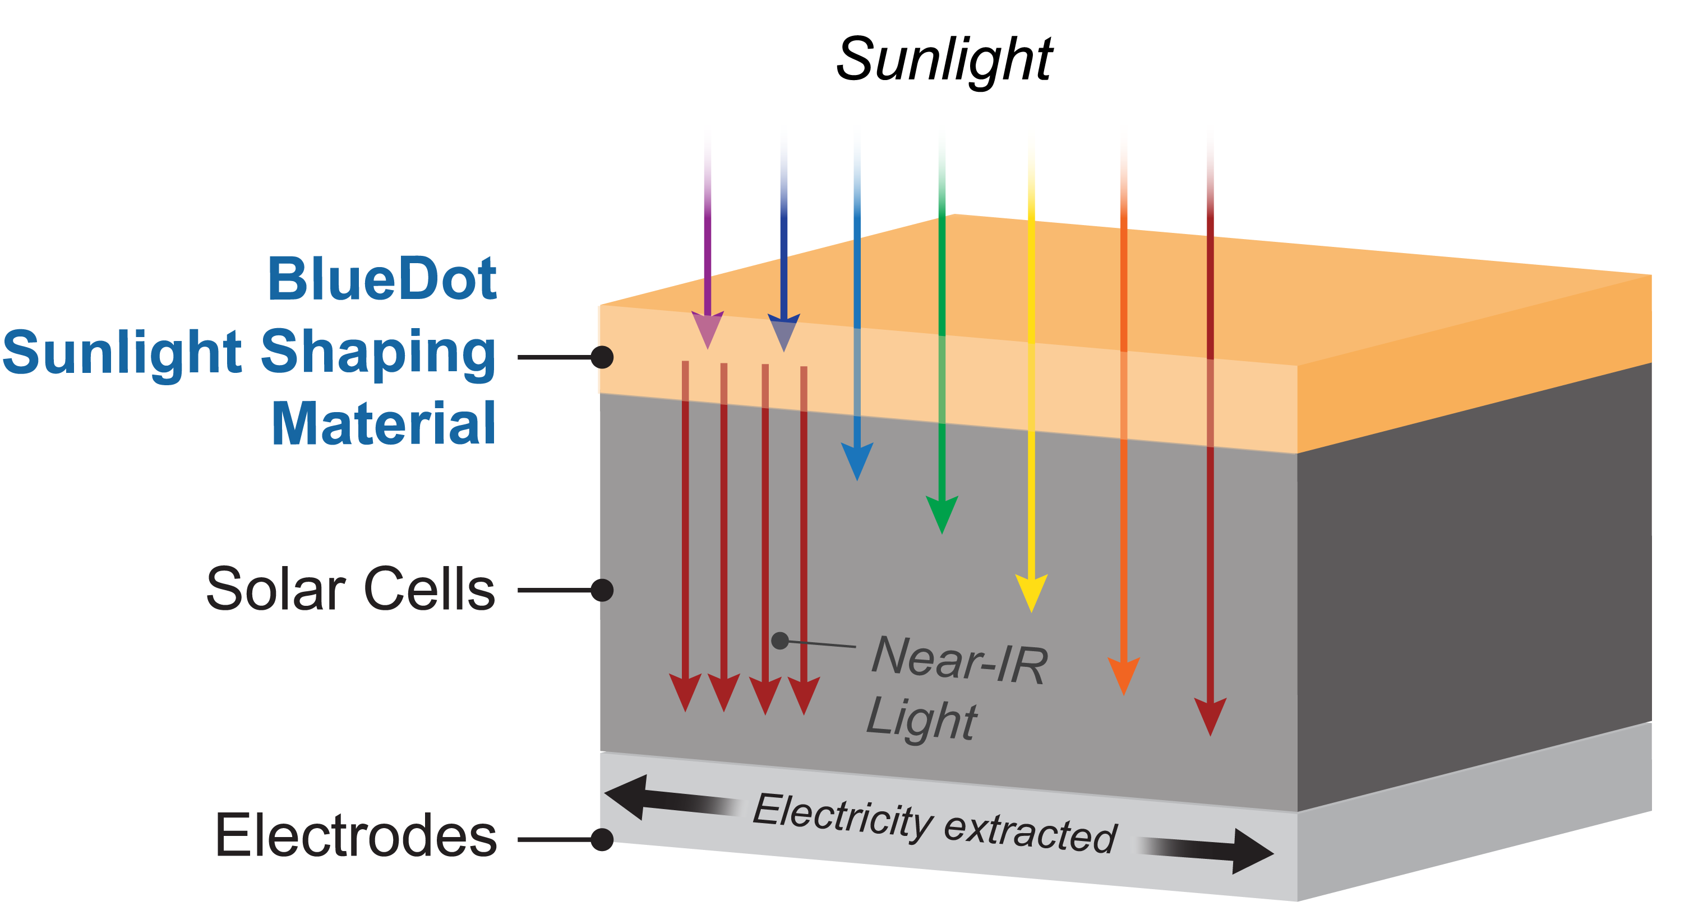
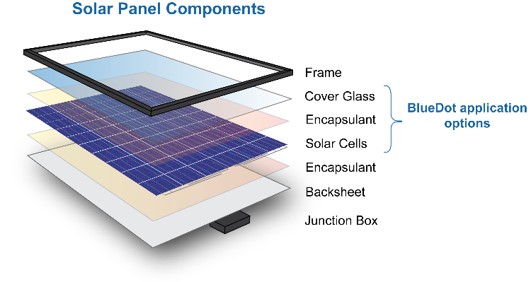
Sunlight-Shaping Solar Panels
The Problem: Solar panel efficiency is not improving fast enough
Improvements in the power output and sunlight-to-electricity conversion efficiency of solar panels is stagnating. Panel manufacturers are spending millions of dollars to improve panel efficiency from 22.5% to 22.6% (<0.5% relative improvement).
Prototype “coupon” cells made using Ready! award. Baseline cell on the left, cell with sunlight-shaping coating on the right.
Go! Demo Day Goals
Identify optimal processing conditions for applying sunlight-shaping materials at WCET, achieving consistent luminescence quantum yields of >150%.
Fabricate a 4” x 4” “coupon” cell prototype with sunlight-shaping technology that achieves a power conversion efficiency boost of >10%.
Continue testing “coupon” prototype stability in environmental chambers following IEC protocols
Certify “coupon” cell performance at NREL
Obtain a letter of commitment from a US solar panel manufacturer to incorporate our sunlight-shaping technology into a pilot-scale production of c-Si modules and field testing of systems.
Our Solution: Engineering better solar panels by making a better sun
BlueDot applies our sunlight-shaping material to any of the top three layers of a solar panel to create an integrated package that is 10-17% more efficient (22.5% → 24.8% efficient) and 5-10% cheaper on a $/watt basis than today’s commercial panels.
Measurement of a prototype cell’s photoresponse at Washington Clean Energy Testbeds, an AMSP Network member
Our coating “shapes” the incoming sunlight to increase the number of photons the underlying solar cell can convert to electricity.
Projected economic impact of sunlight-shaping coating on a utility-scale solar system.
Sunlight-shaping coating can be applied to any of the top three layers of a solar panel and boost power output.
−7.5%

