Slide 1
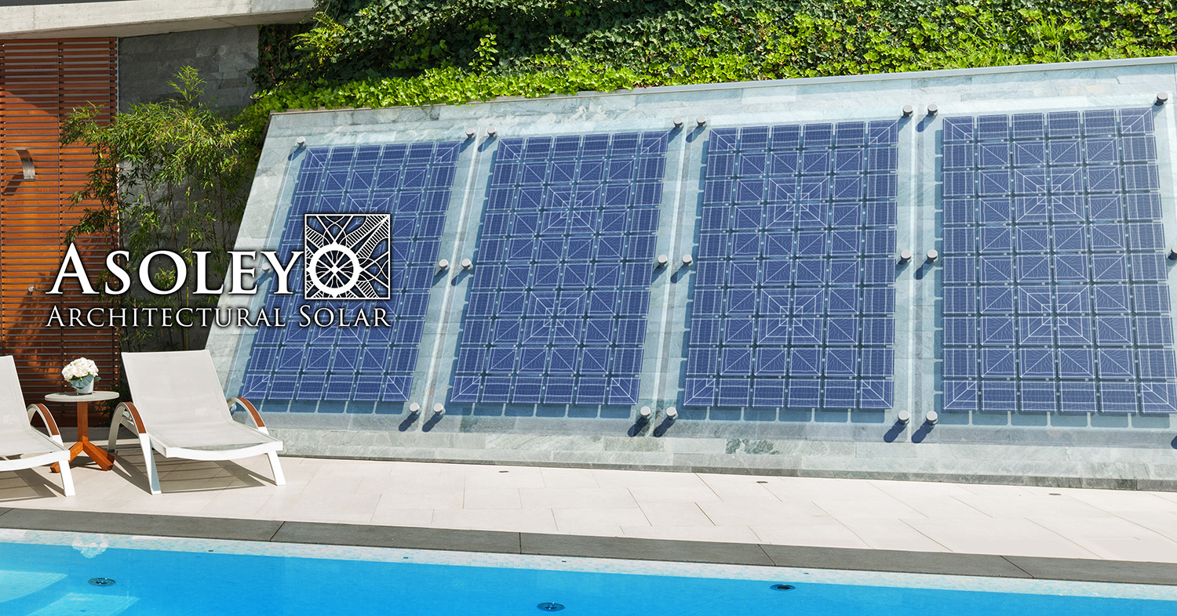
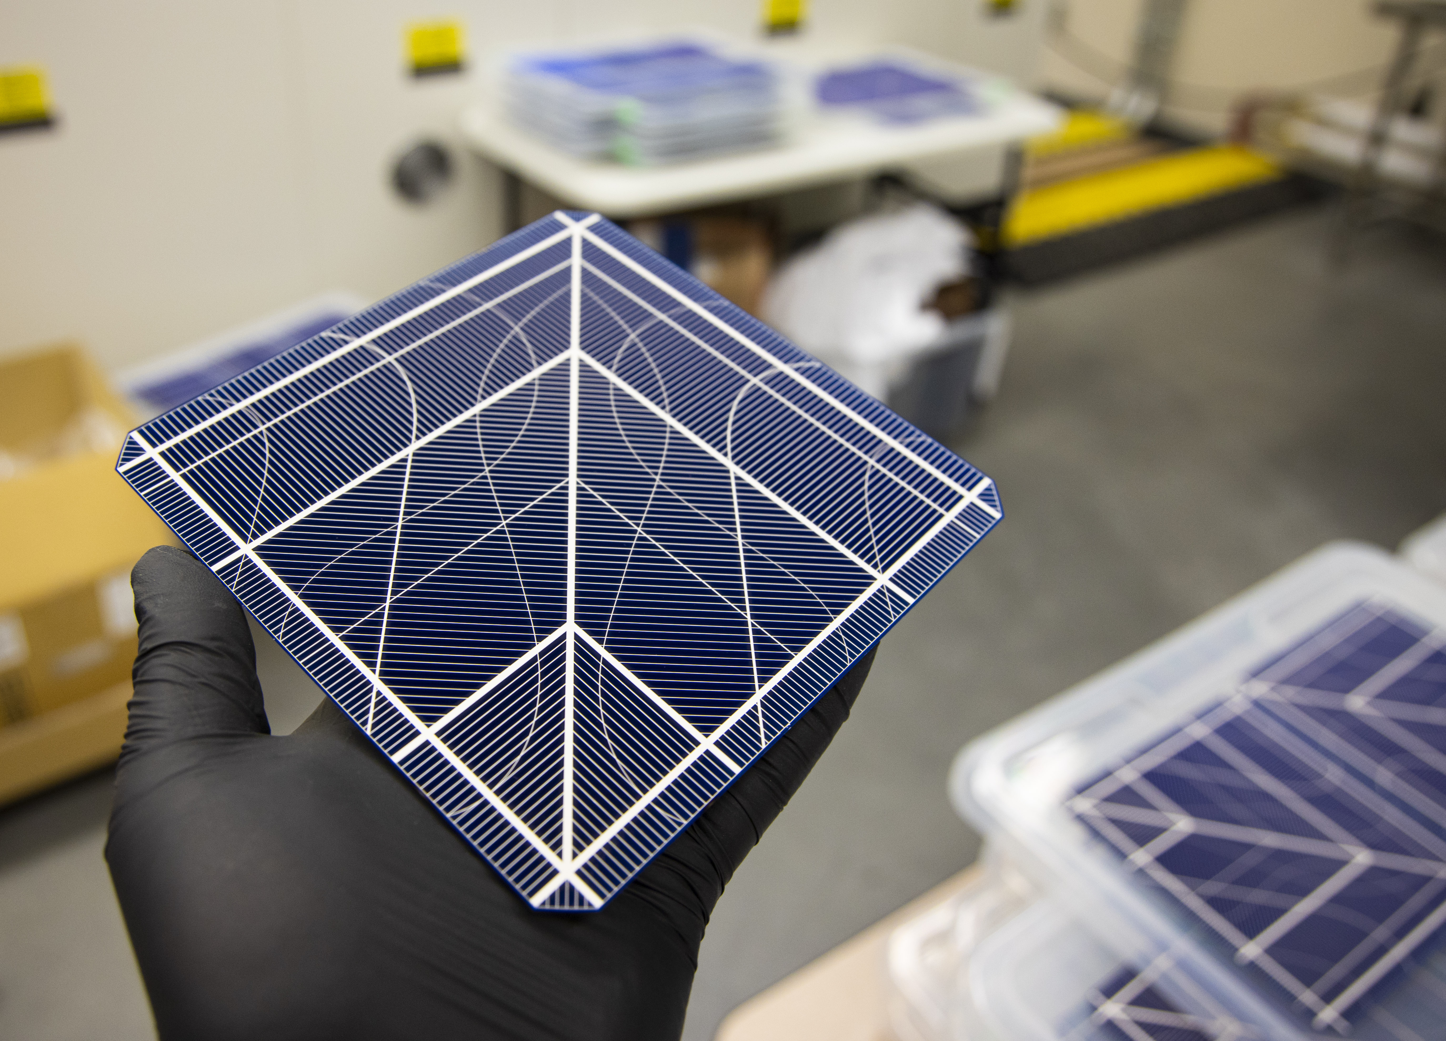
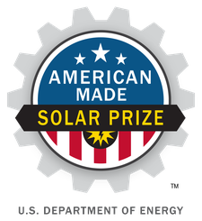
We apply artistic principles to the design of the basic unit of solar energy production: the solar cell. This enables integrated photovoltaic surfaces that are both attractive and functional, with manufacturing costs similar to standard solar cells.

