Slide 1
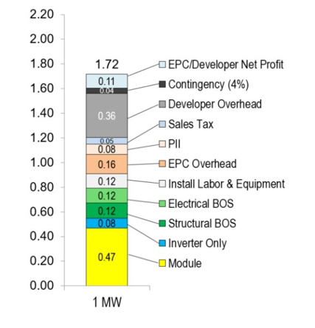
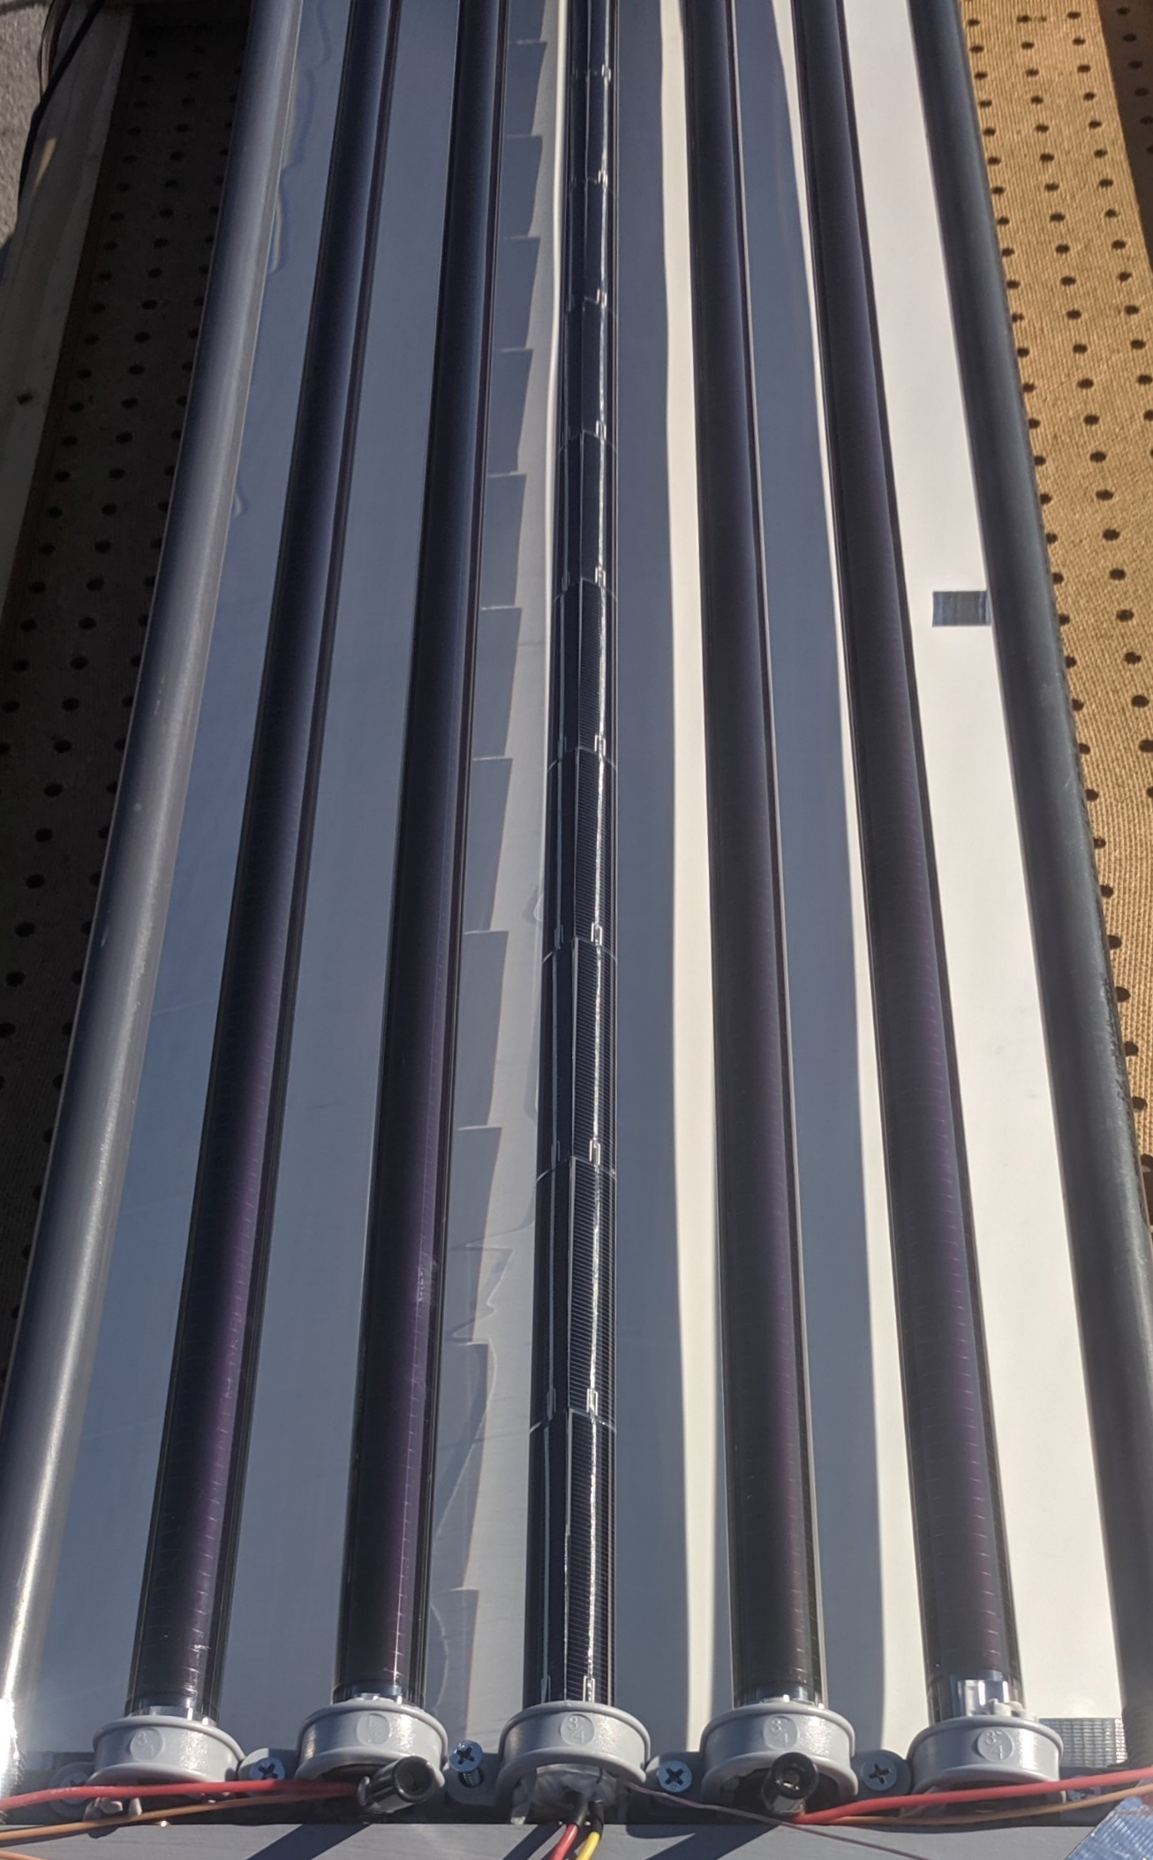
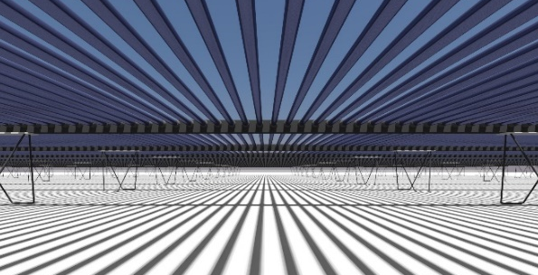
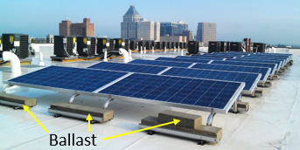
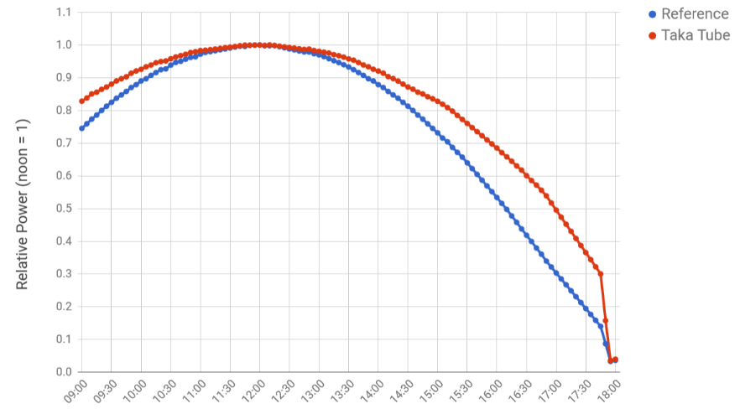



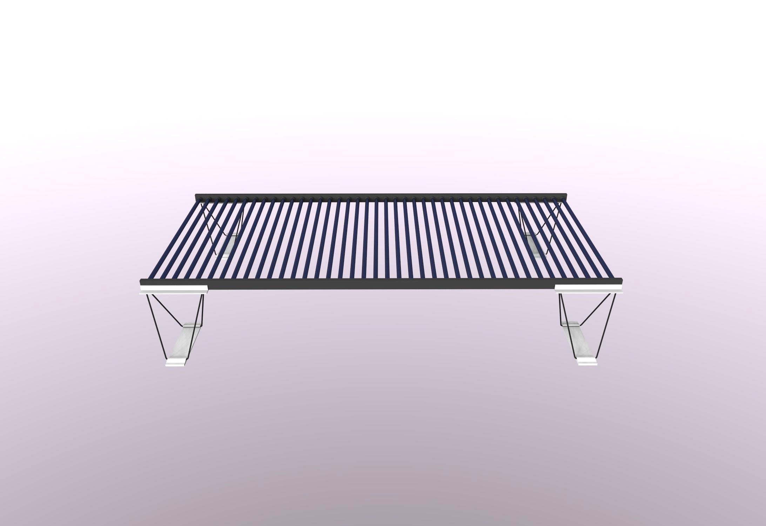
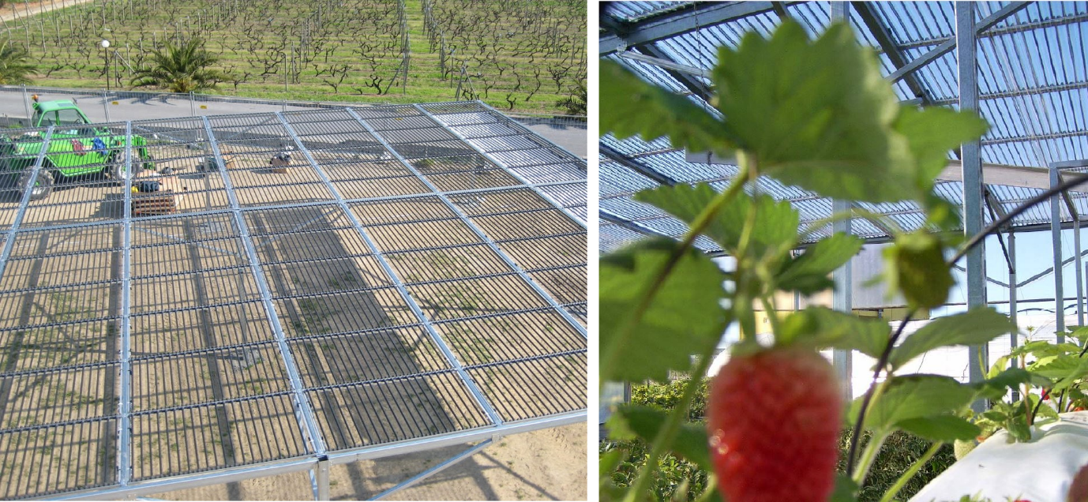

Taka Solar Advanced Bifacial Panel Summary
Commercial Solar Challenges
Taka Solution and Benefits
Cost Challenge: Non-hardware costs
Prototype panel
360°Energy capture: +15% Energy
½ the aero loads: Installs 2x Faster
All Other
Costs
$ per watt
System hardware
Wind loads – Drive ballast
requirements and install expenses
Test results
More Energy
w/ Taka
Standard panel
Team
Chris Barnes
Noriko
Hara
David
Frost
Taka Panel rendering
Enables Co-location w/ crops
CE0
10 yrs. Solar
Stanford PhD
Finance
Sony, Epson
and Honda Exp.
Biz Dev
20 yrs. Energy
Harvard MBA

