Slide 1
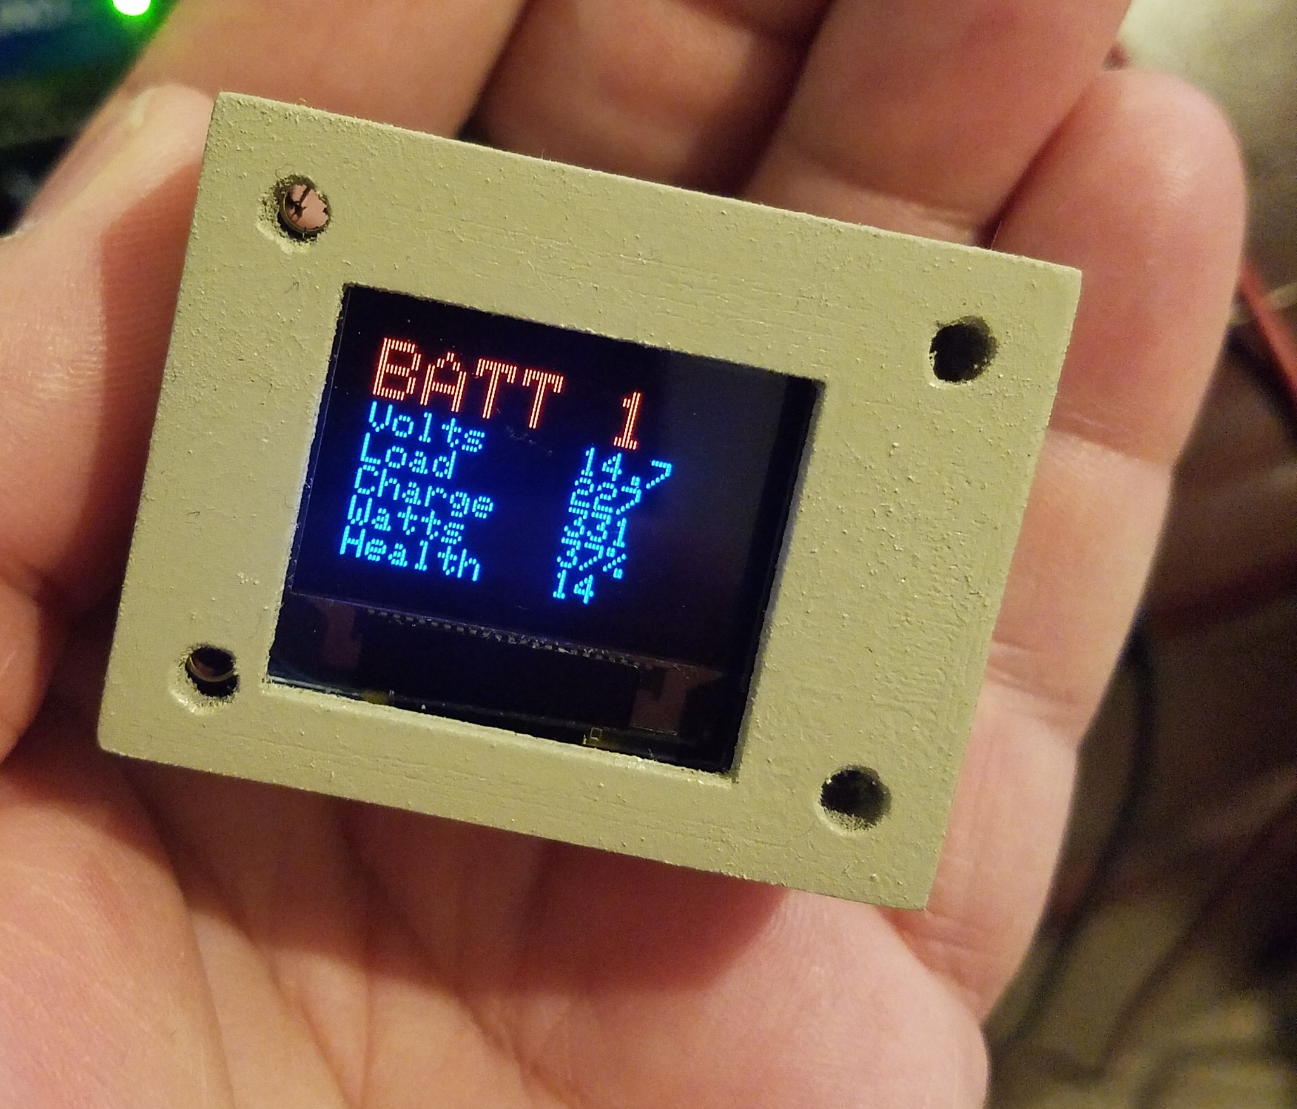
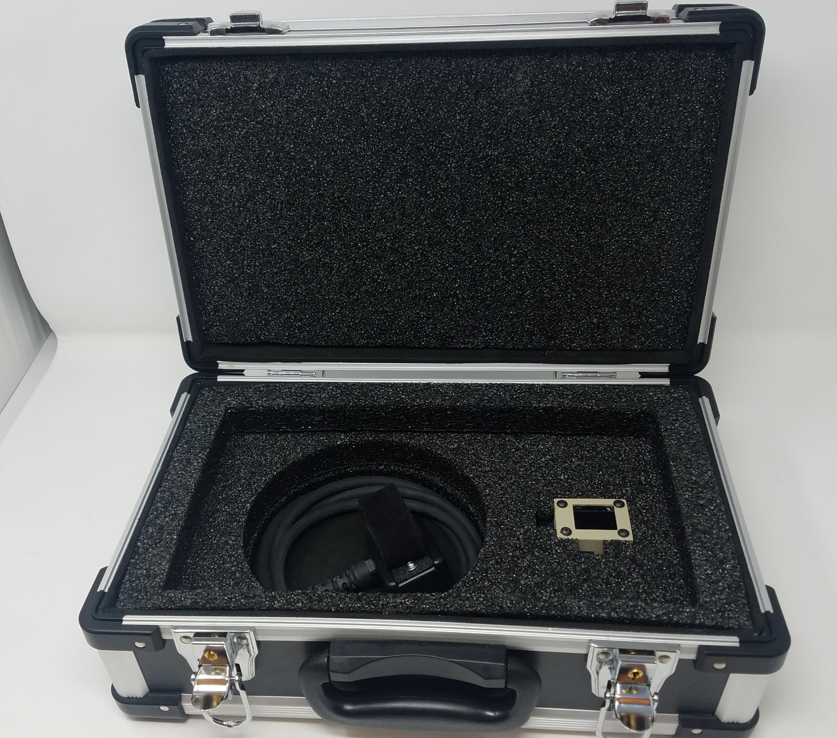
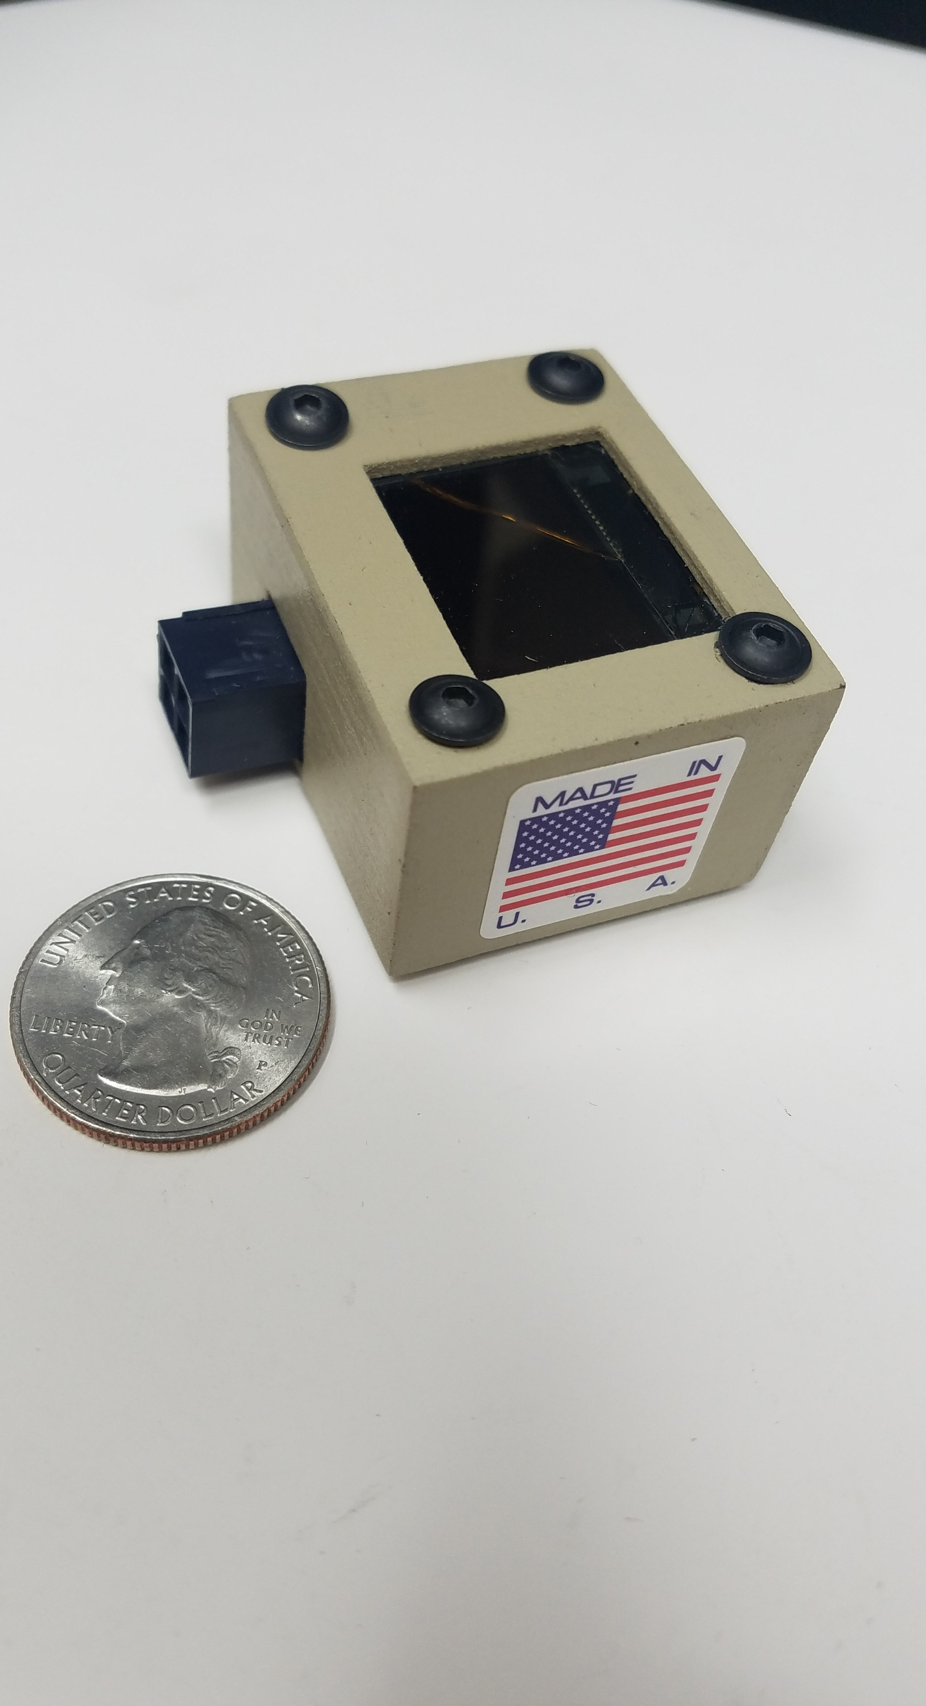


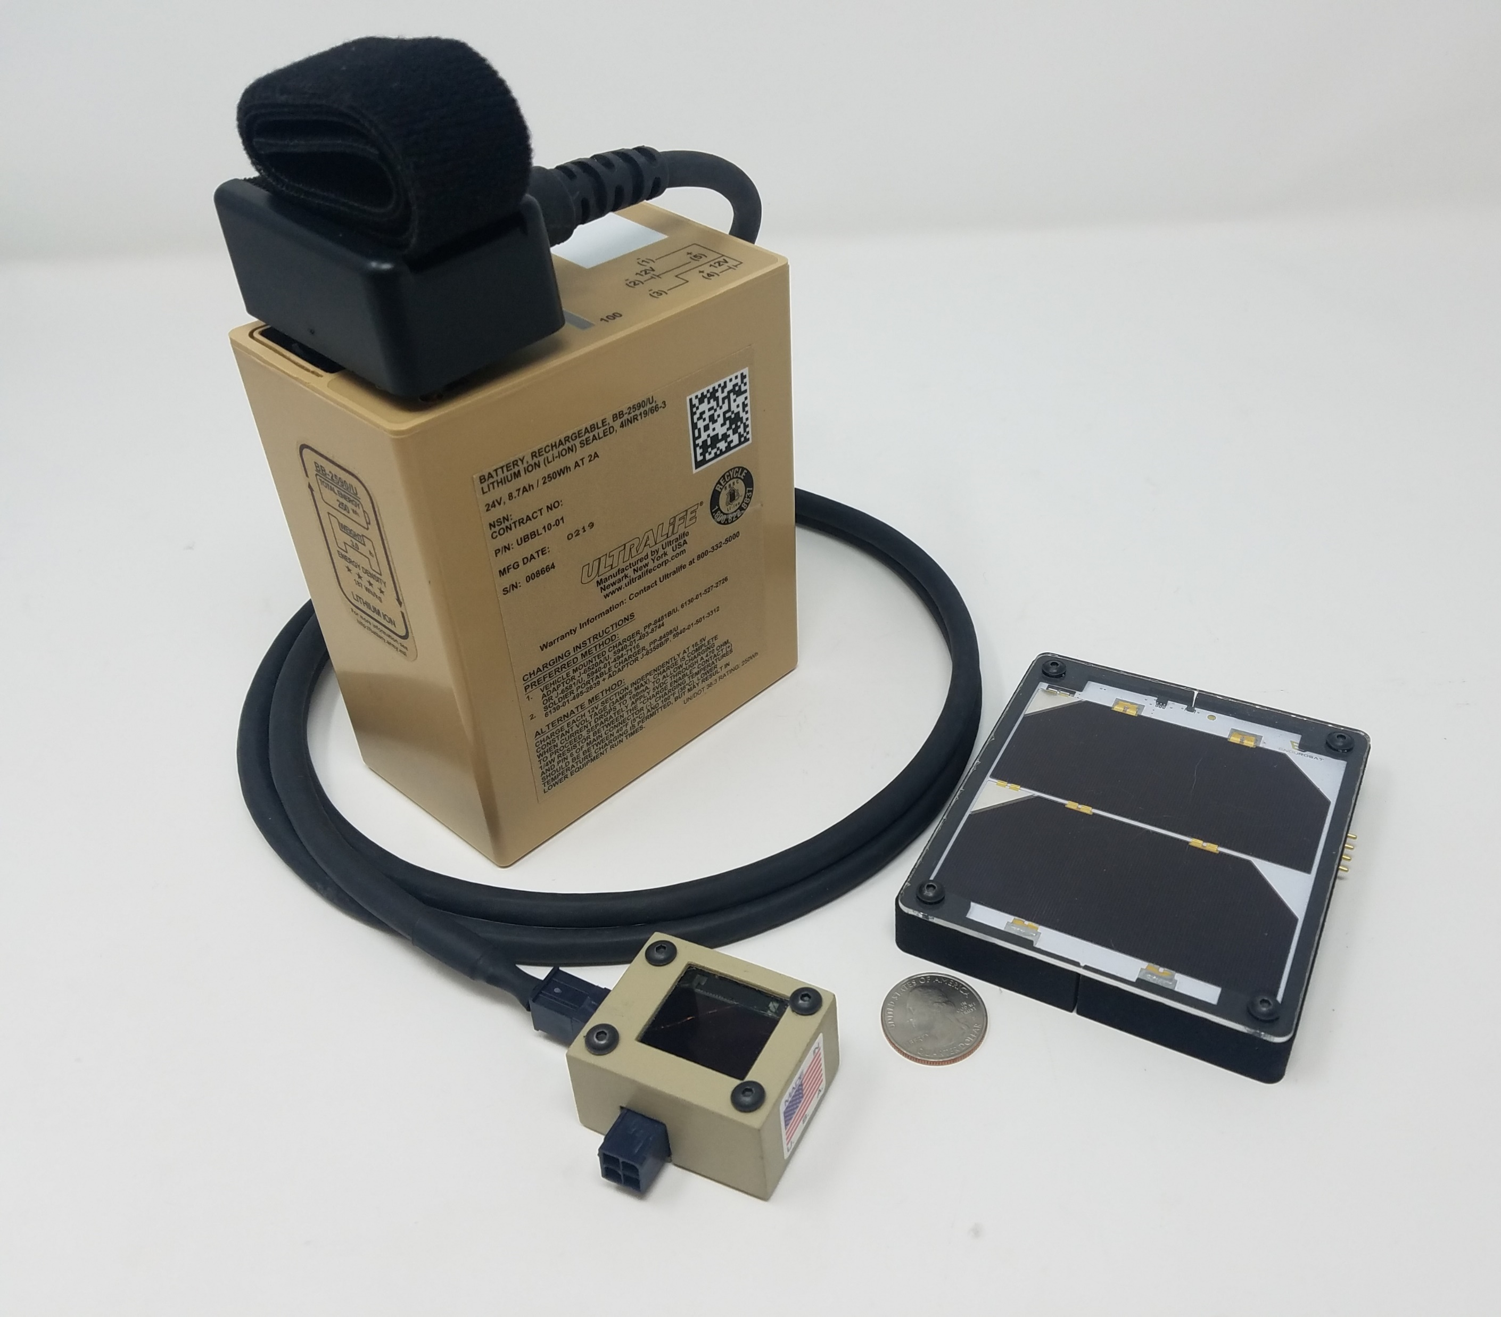

Software Defined
Power Management and
Predictive Maintenance System
Real time output of battery health and state of charge
Utilizing AI-optimized control algorithms, the Teq Strategy power distribution system optimizes Photo Voltaic inputs for high performance applications. The advanced solar charging system is optimized through our patent pending software defined Battery Management System (BMS) and Maximum Power Point Tracker (MPPT). The Solar Charger Battery Management System’s dynamically computed charging waveform uniquely enables the most efficient charging of the battery regardless of solar panel illumination. This process characterizes PV input and individual cell performance and creates a matrix which allows for real time performance evaluation and preventative maintenance alerts for attached equipment
The power management system operates in between the PV and the battery with an output for a load such as communications equipment. This allows for battery charging while the battery is in service
By optimizing the size and weight we can operate in man-packed conditions which were not possible before
Seamless operation with Military batteries such as the BB-2590

