Slide 1





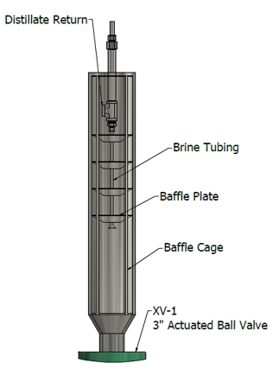
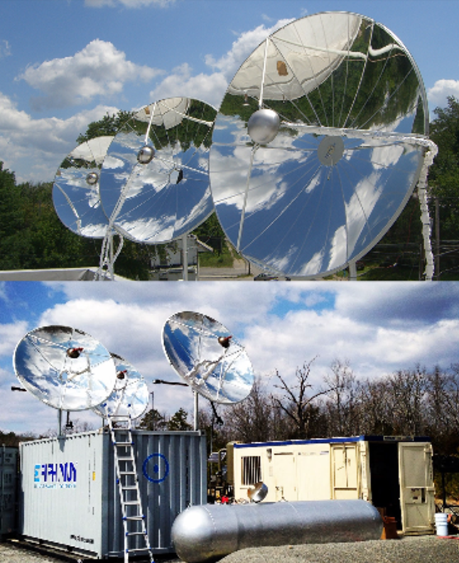
Concentrated Solar Powered Trans-critical Water Desalination
Project team:
Epiphany Solar Water Systems, LLC
Jim Dietz PE - TwoPoint Solutions, Inc.
Dr. David Snyder – Penn State University
Dr. Marc Deshusses – Duke University
Tasman GeoSciences, Inc.
Sandia National Laboratories
Project Goals:
Design Solar Powered (CSP+PV), 500 GPD, ZLD, Trans-Critical Water Desal Prototype
Prove economic viability for providing clean drinking water
Commercialize technology with mass-produced modular systems
Create a lifesaving technology that transforms the
water desalination industry
Will be integrated with…
Epiphany’s Industry Leading CSP Systems
Technical Approach:
Ready! Prototype Crystallizer and Process Design
Create detailed design documents that include technical analysis, component selection & BOM
Set! Prototype and Full Scale Design Documents
  Build and test proof-of-concept crystallizer
  Finalize full-scale production unit design documents
Go! Full-scale Commercial Unit
  Build and test commercial unit with customer
  Optimize size, configuration and materials
  Product techno-economic analysis and evaluation
Trans-critical Desalination Crystallizer
Designed in Ready!

