Slide 1
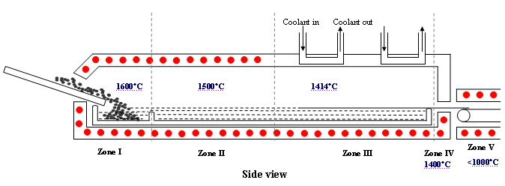
Continuous Silicon Wafer Production iST, Pittsburgh, PA
Core Team: Erik Ydstie (captain), CEO and Founder Integrated Silicon Technologies, LLC
Michael Helman, CFO
Objective: - Reduce the cost of making silicon wafers by 50% by continuous production.
- Introduce technology to control micro-structure in horizontal ribbon growth (HRG).
- Manufacture a 15-50 cm wide ribbon of mono-crystalline silicon suitable for high performance solar cells.
The proof of concept is developed in a $ 2M pilot plant system at Carnegie Mellon University.
Silicon pellets fed to Zone1. The melt and stabilize if Zones II and III. In Zone IV a thin sheet forms and is removed to Zone V for further processing in a continuous manner.
HRG Pilot Plant at CMU

