Slide 1
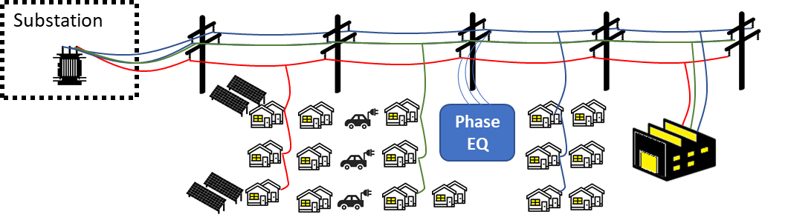
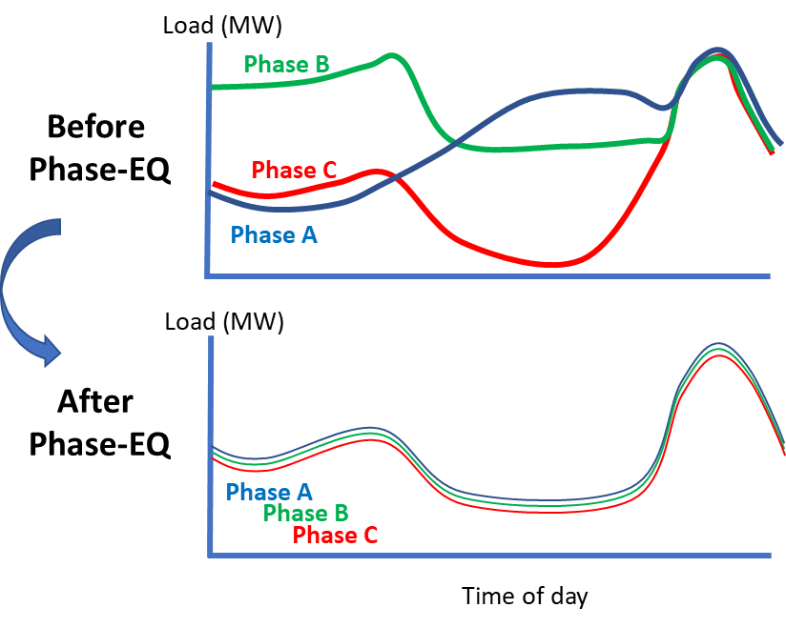
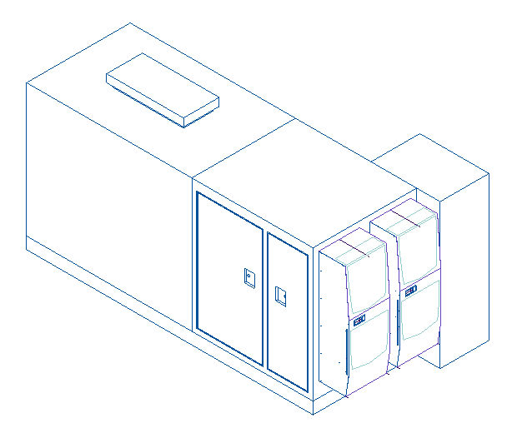

Phase-EQ for Distributing Solar in Communities
Utilities today will reject proposed solar projects or require upgrade costs if voltage imbalances will occur due to phase-imbalance
Switched Source’s Phase-EQ can route power from phase-to-phase, eliminating this voltage imbalance and allowing more solar
In studies performed with research teams at Binghamton University, this technology was shown to enable 2-3x more solar to be connected to the distribution system
In addition to solar benefits, the Phase-EQ can increase the reliability and efficiency of distribution systems, while decreasing operating expenditures for the utility
Phase-EQ beta unit, released to manufacturing
Charles Murray, President
CMurray@SwitchedSource.com

