Slide 1
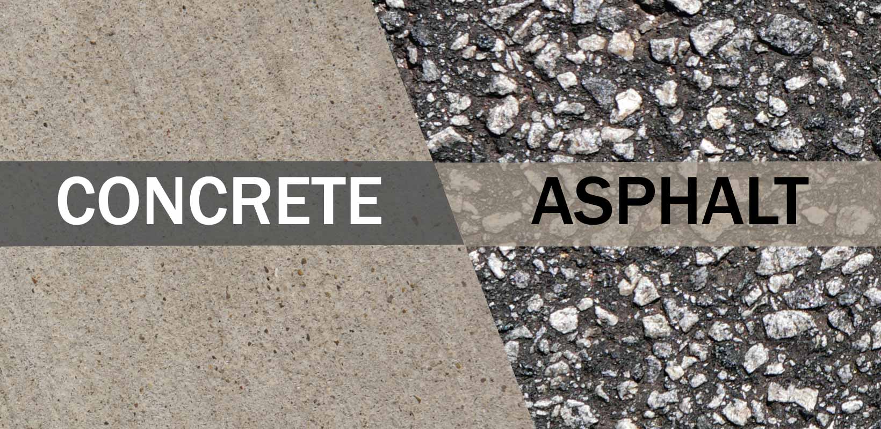
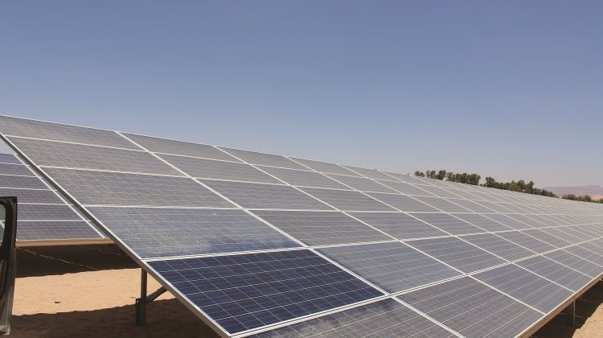
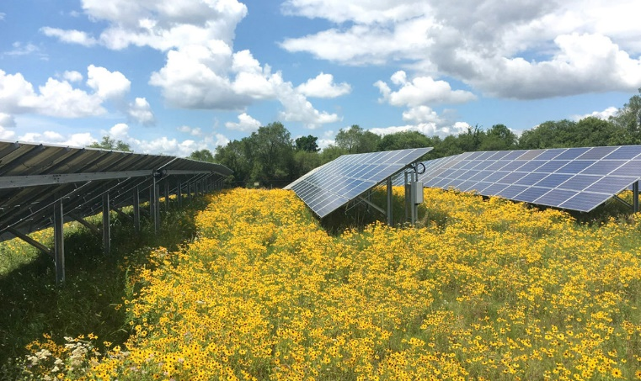
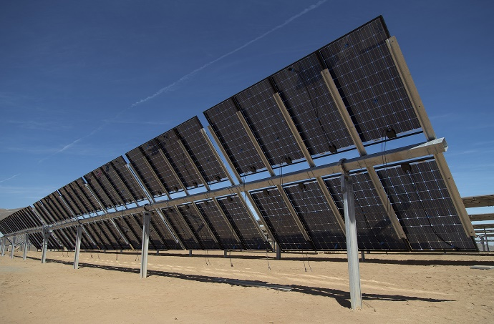
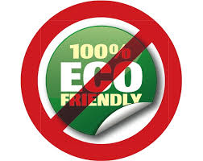

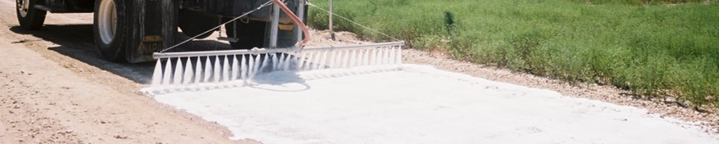





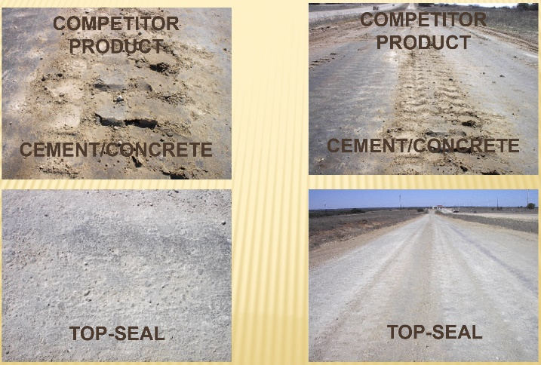
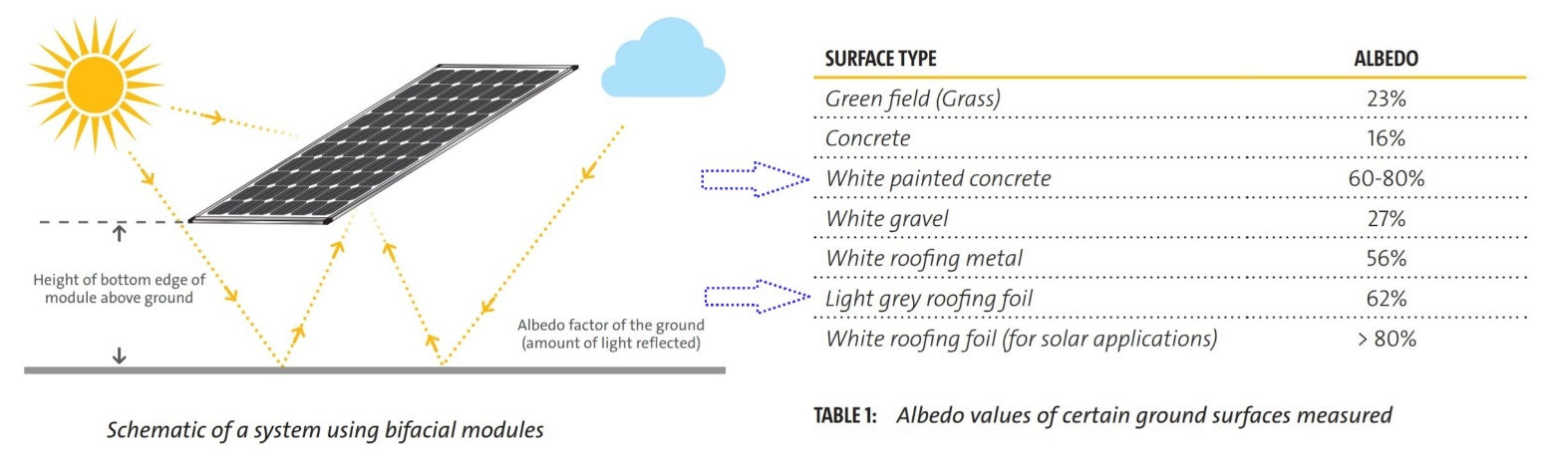
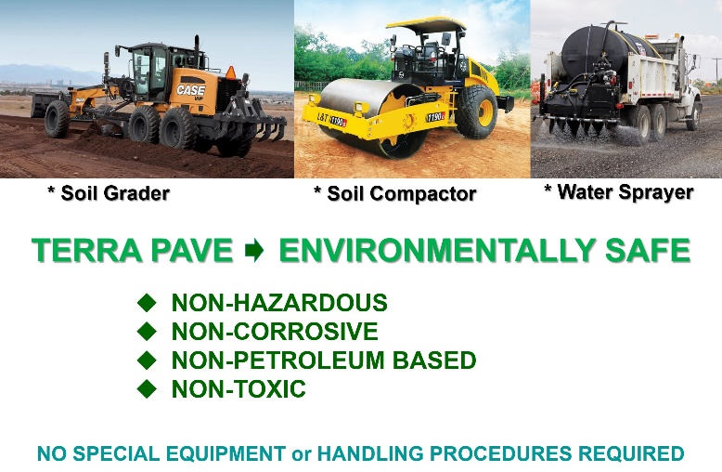

TERRA PAVE PRODUCTS are the ECO-FRIENDLY COST-EFFECTIVE SOLUTIONS for
DUST/VEGETATION CONTROL, ALBEDO, REPLACEMENT of CONCRETE & ASPHALT PAVEMENTS
NOT ECO-FRIENDLY
HIGHWAYS, ROADS, AIRFIELDS, ETC..
DIRT/DUST SOILING
SOLAR PANELS
ASPHALT
GROUND ALBEDO
FOR BI-FACIAL PANELS
REFLECTED SUNLIGHT
CLIMATE WRECKING CONCRETE
OVERGOWN WEEDS &
VEGETATION
The Eco-Friendly Cost-Effective Top-Seal White™, Top-Seal Black™ products are water-based liquid spray-on permanent polymers. They were developed, manufactured in Austin, TX, tested on a small scale basis and then field applied and proven through testing with the Texas Department of Transportation (TXDOT), US Army, the City of Austin, TX and City of San Marcos, TX. The products have superior strength and binding properties, dries within an hour thus allowing work to be completed days and weeks ahead of schedule, have no odor or tracking issues and is much safer to workers and the environment. Product testing, done by San Antonio Testing Labs, a NELAP certified lab, following EPA approved test method shows that no detectable concentrations of volatile, semi-volatile, heavy metals or petroleum hydrocarbons.
BI-FACIAL PV
Top-Seal White™ & Top-Seal White™ Albedo: Durable Strong Low Maintenance, Eco-Friendly dirt/Dust/Vegetation Control, Bi-Facial albedo 24/7/365 = albedo SNOW, strength is >3X to cement/concrete for concrete pavement surfaces and road base replacement.
Top-Seal Black™: Durable/low maintenance, eco-friendly asphalt pavement surfaces replacement, excellent to prevent the penetration of water and air into the pavement surfaces, increase surface friction thereby shortening braking distance.
WWW.ECOESTATES.US INFO@ECOESTATES.US
Top-Seal White™ Albedo for
Bi-Facial PV albedo 24/7/365 = albedo SNOW
WATERPROOF &
COST-EFFECTIVE

