Slide 1

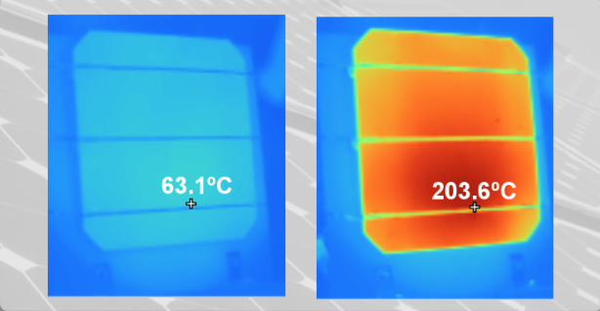
The Locally Grown Power Team
Hot-spots hɑːt spɑːtz
Def: A problem that costs the solar industry untold millions in lost production.
Hot-spots are concentrated spikes in temperature that can occur in solar cells for any number of reasons—shunts, microcracks, partial shading… All it takes is a fallen leaf obscuring part of a cell to trigger a process known as reverse bias. When that happens, all other connected cells force their power through the weakened one. The result? A lot of heat. The image below shows a cell in a conventional panel, just before and after an episode of partial shading: a temperature gain of more than 140º C in a matter if minutes.
Other manufacturers rely on expensive mitigation procedures—everything from cells made of vaporized and re-condensed silicon to bypass diodes and heat-resistant glass. None of which would be necessary were it not for hot-spots.
The work of the Locally Grown Power team takes solar into a new future. We offer the world’s first technology that eliminates hot-spots in solar panels. We achieve this by controlling the root cause—reverse bias.
The possibilities unleashed?
Unparalleled safety
Enhanced efficiency
Dramatically reduced degradation rates
Vast savings in manufacturing

