Slide 1
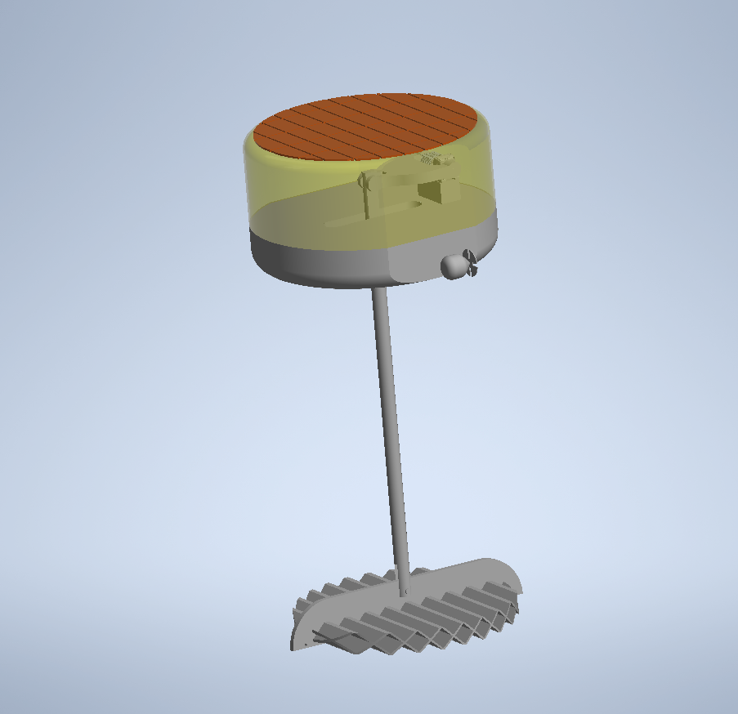
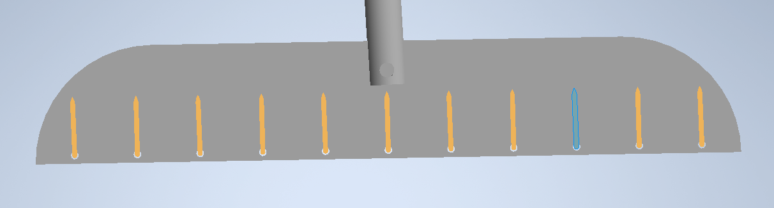
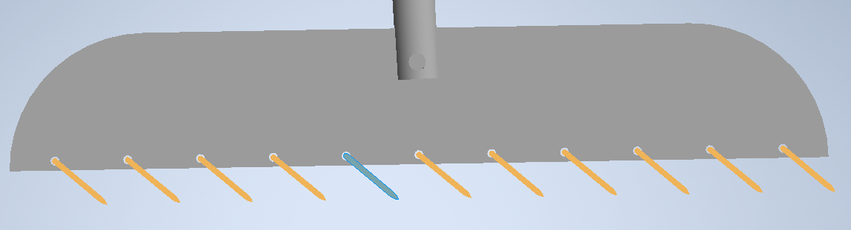
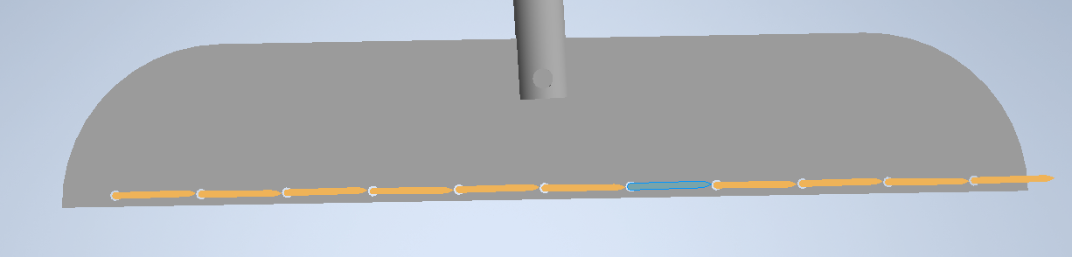
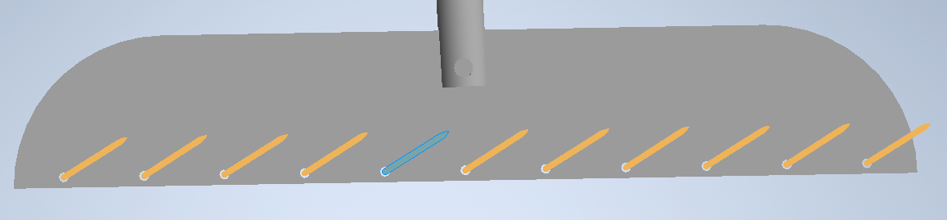
Electric power generator
High Efficiency Solar Panels
Two built in propellers
SEA-DWELLER
Underwater sea sails
Modification allows for AUV docking
Upward position
Upward position
Downward Position
Downward Position

