Slide 1

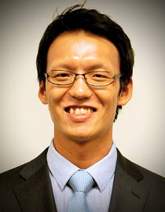
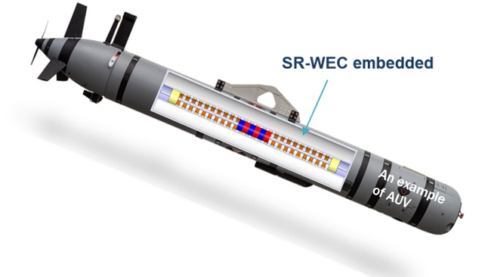
Dr. HeonYong Kang
Research Assistant Professor Assistant Director of OSSCL
Department of Ocean Engineering
Surface Riding WEC is embedded inside a AUV.
When the AUV floats on the free surfaces for data transfer and position correction, the AUV rides on wave slopes and the Surface Riding WEC recharges the battery.
It will substantially extend the underwater operation.

