Slide 1
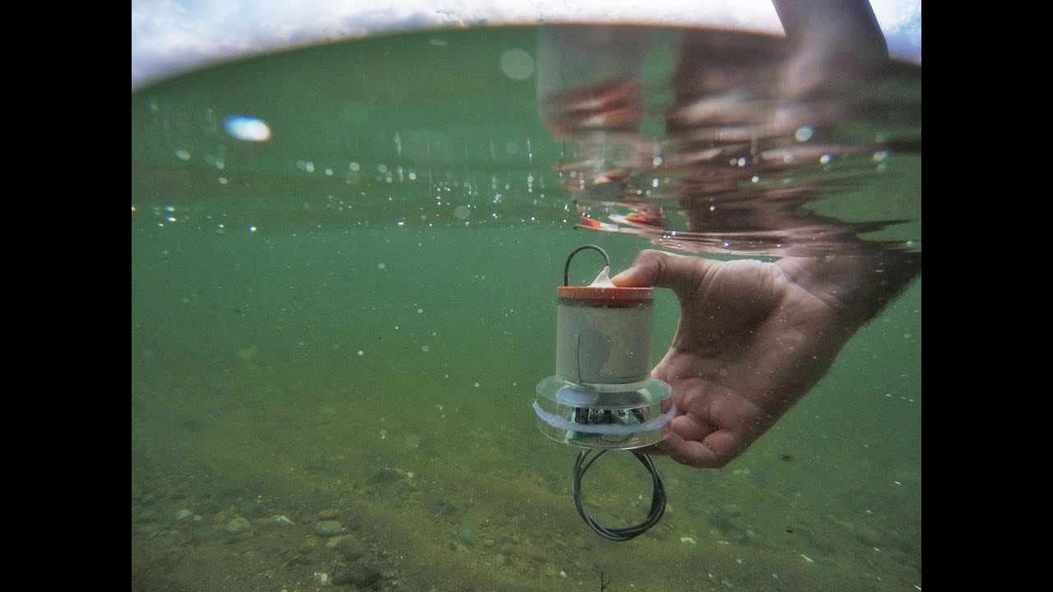

Batteryless Communication and Navigation for the Subsea IoT
The first underwater technology that enables communication and sensing at near-zero power
PAB is a battery-less sensor that can collect the ocean’s temperature, pressure and pH
PAB nodes harvest energy from acoustic signals using piezoelectric interfaces and communicate by modulating the piezoelectric impedance
Deploying a network of these nodes can enable underwater localization and navigation at minimum power

