Slide 1
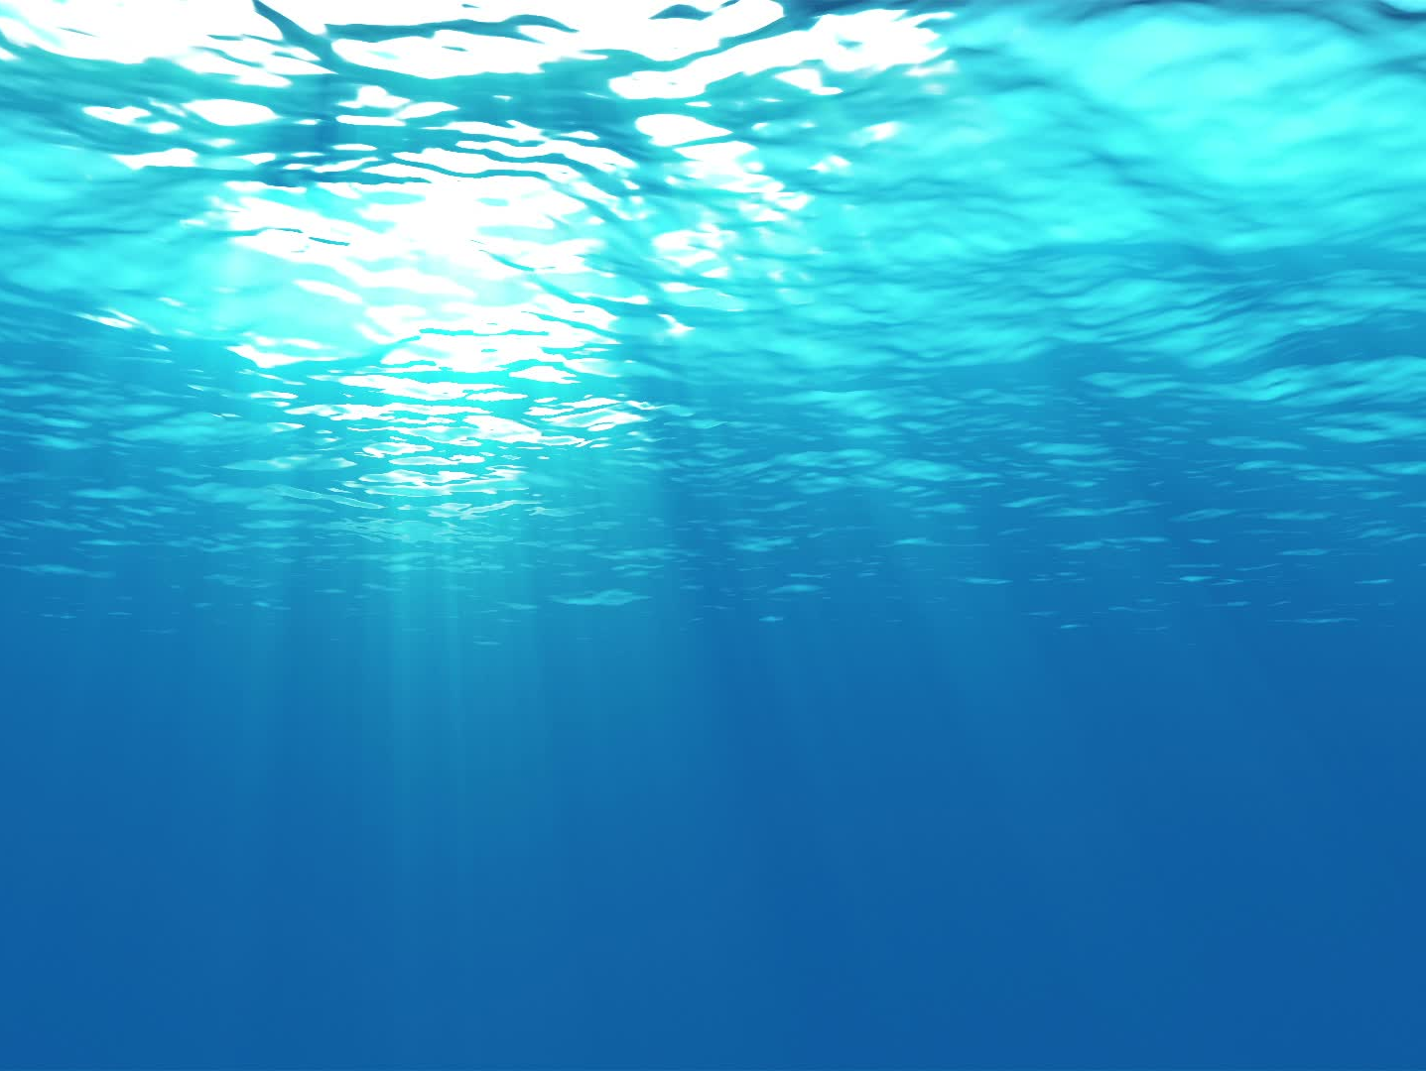


Wave Powered Oceanographic Gliders
We will use wave energy to cheaply power ocean gliders and drift buoys. We will accomplish this through a) integration of onboard power generation and b) integration of advanced energy storage. We have designed a 50W wave energy converter, designed an energy storage system, and have identified a glider architecture to house it. These innovations will improve device lifetime, sensor power budget, deployment and recovery costs, enabling more research, cheaper.

