Slide 1



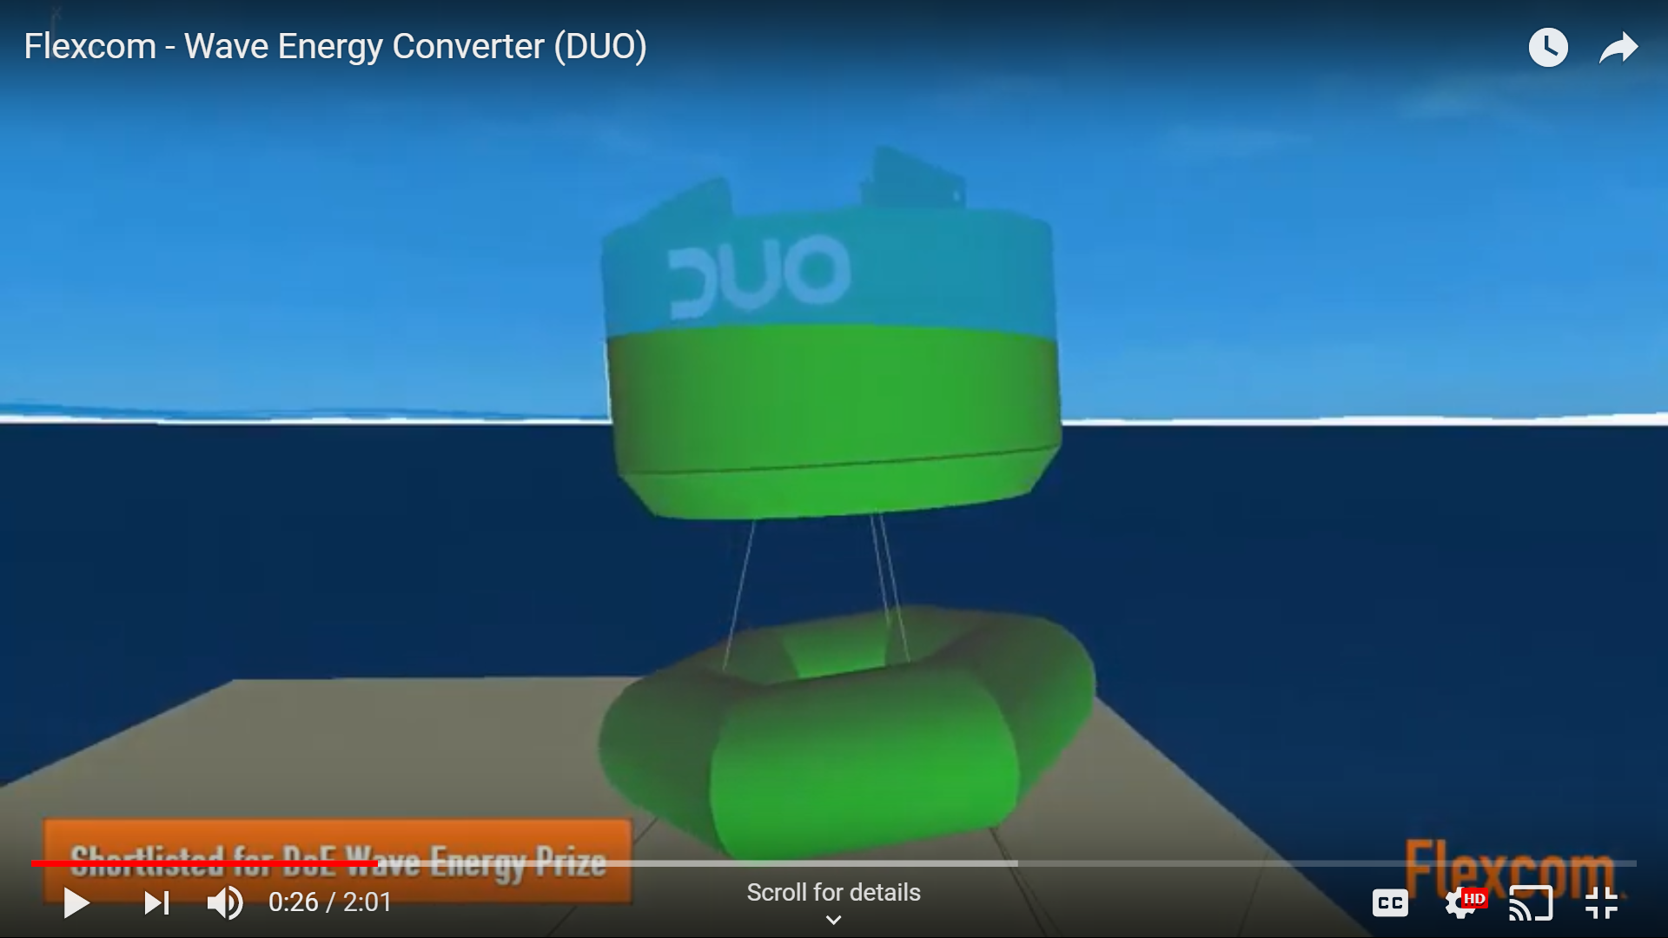
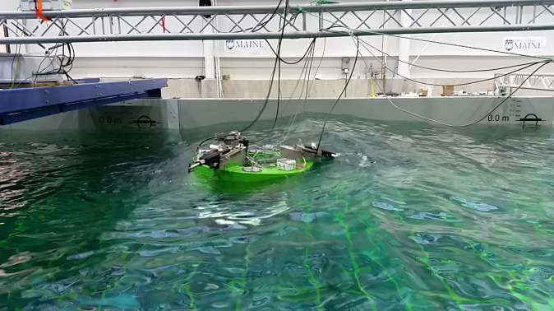
High power buoys for Ocean Observations
Seamless integration with buoy configurations | ☑
High power to buoy size ratio | ☑
No additional anchor or mooring needed | ☑
Deployable in remote & deepwater sites | ☑
Wave power design
Wave power technology

