Slide 1
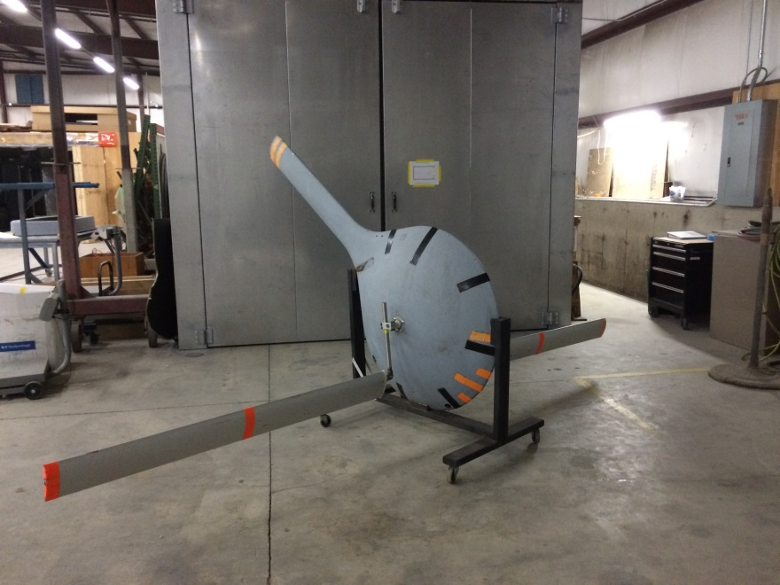
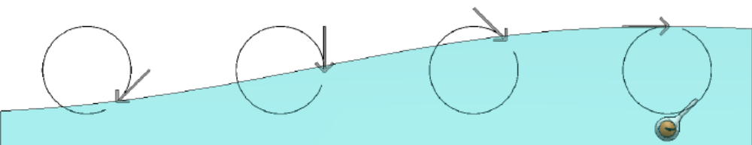
WaveSub Project
DOE Ocean Observing Contest
The WaveSub system directly couples kinetic energy in the orbital motion of water in waves to rotary electrical generators aboard unmanned subsurface vehicles. This technology is applicable to existing buoyancy gliders with modification of external hull form. The WaveSub system may both extend mission length and increase power available to scientific payloads. The idea follows the disclosure of US Patent 8,939,804 “Wave-Powered Autonomous Plankton Collector” issued January 27, 2015.
Water particles orbits in waves are rotating flow vectors that drive rotation of transverse wings to generate power. The hull is streamlined vertically and longitudinally wit sufficient inertia to oppose hydrodynamic acceleration.
Team Lead Name: Eric Goetz
Team Member: John Duke
Team Member: Composite Energy Technologies, Inc. dba Goetz Composites

