Slide 1
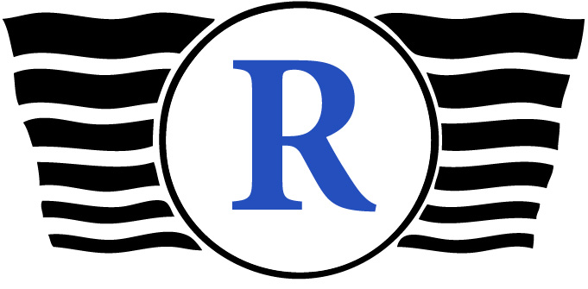

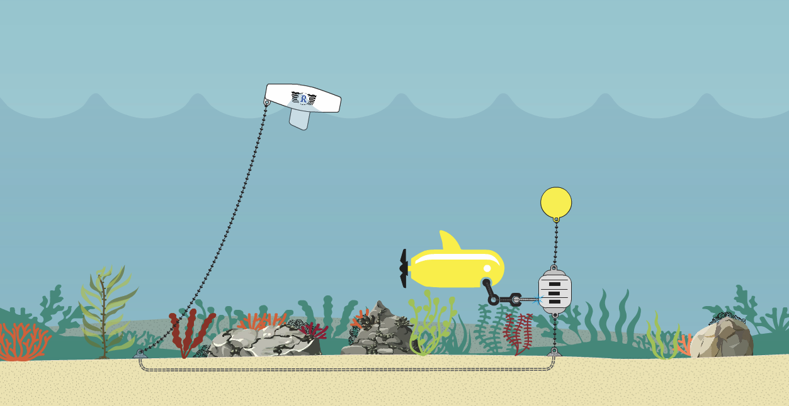
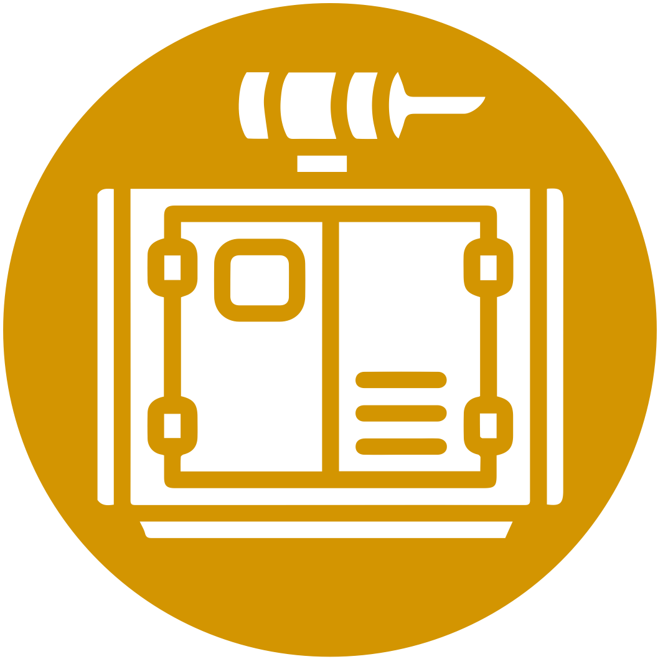




Nereus™
Power Ocean Observation using Ocean Waves
Concealed operations
24/7
operations
Clean for the environment
Limited manpower
Ubiquitous applications

