Slide 1
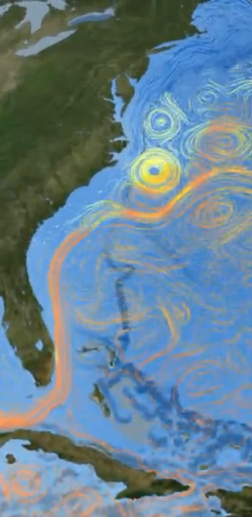
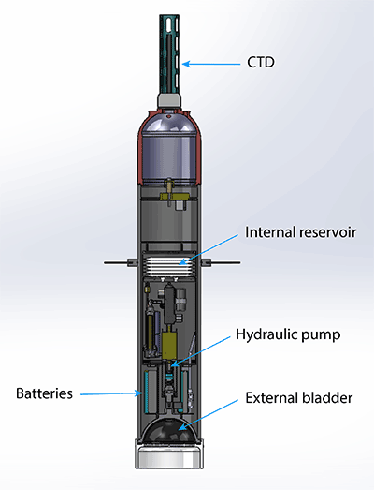
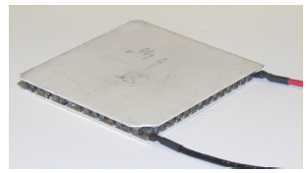
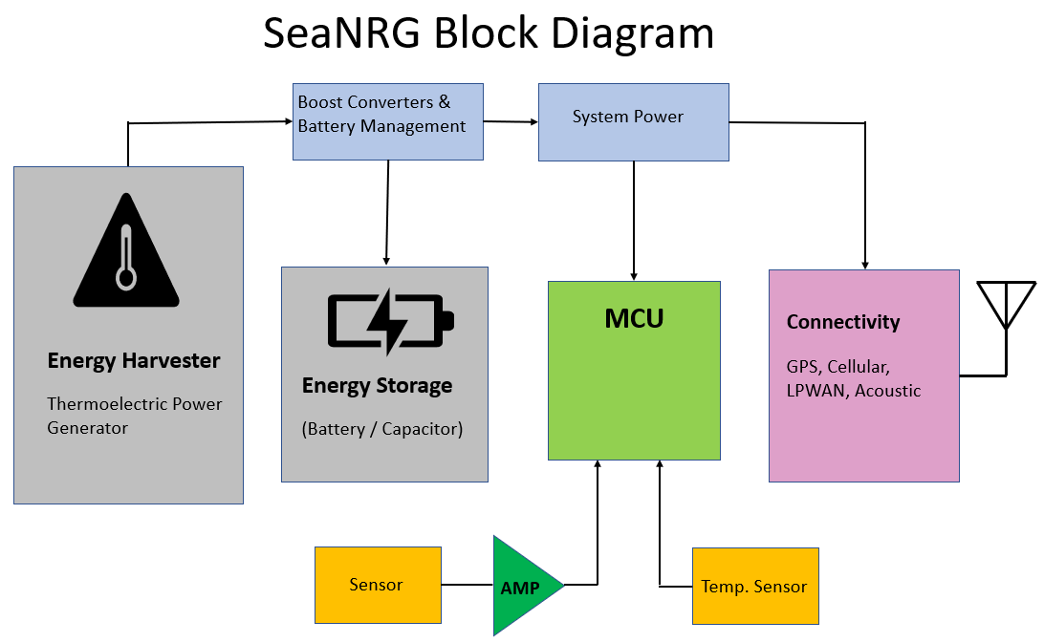
SeaNRG - Tapping into Ocean Thermal Energy to power Observing Systems
Refrigerant Canister
“Heat Sink”
TEGs
Conductive
Spacers
Float
Casing

