Slide 1



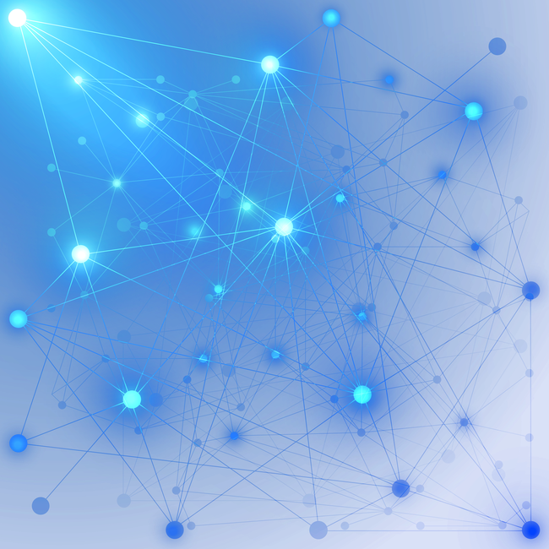

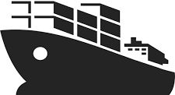
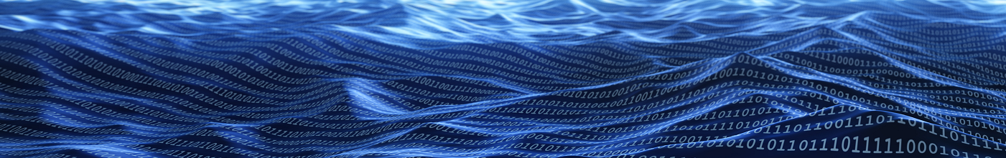
SeaNet
Real-time Ocean Observation Telemetry
Mesh Network
Self-powered
Scalable
Long Range

