Slide 1

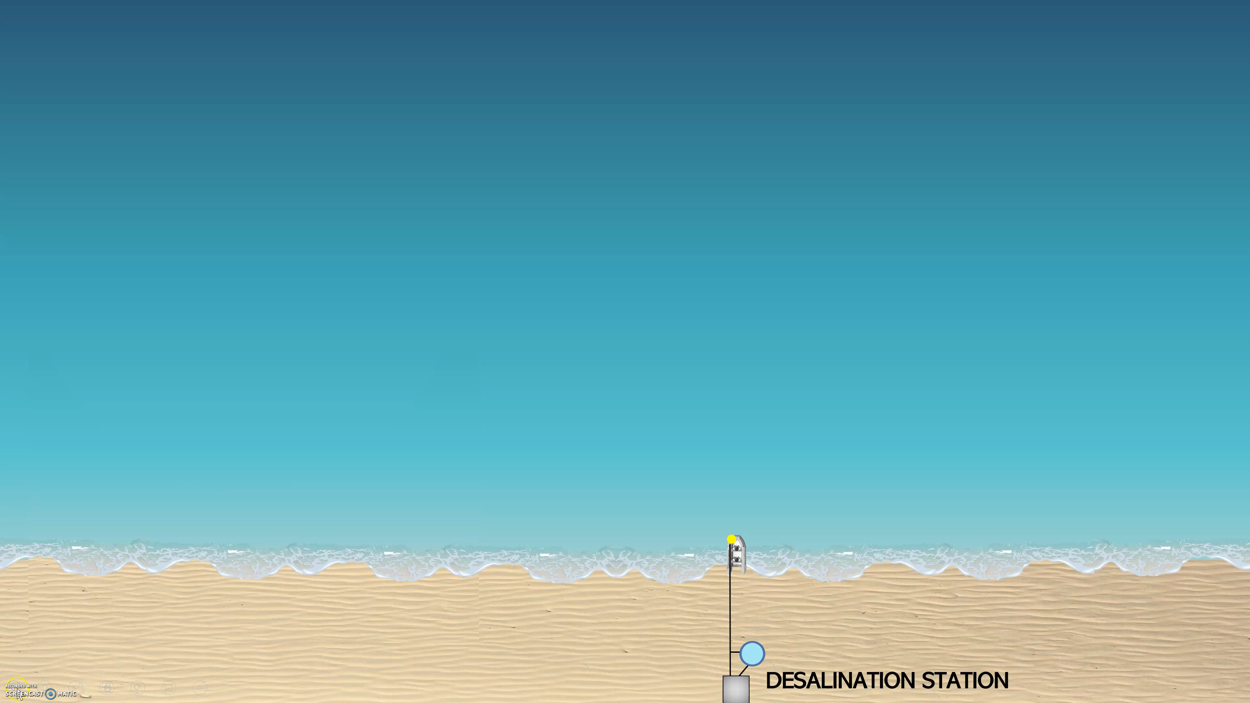
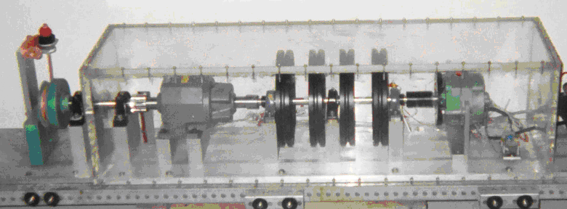
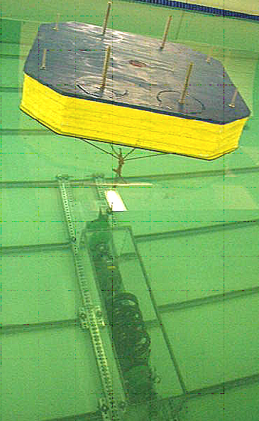
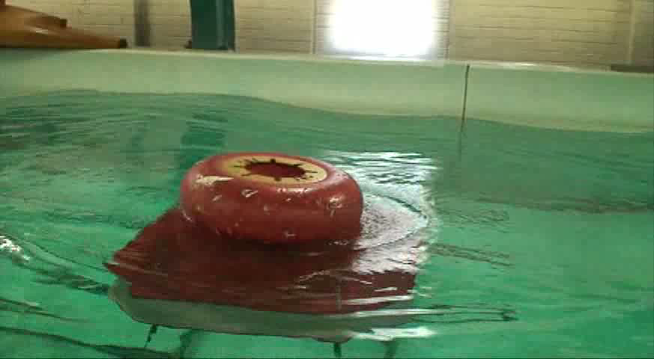
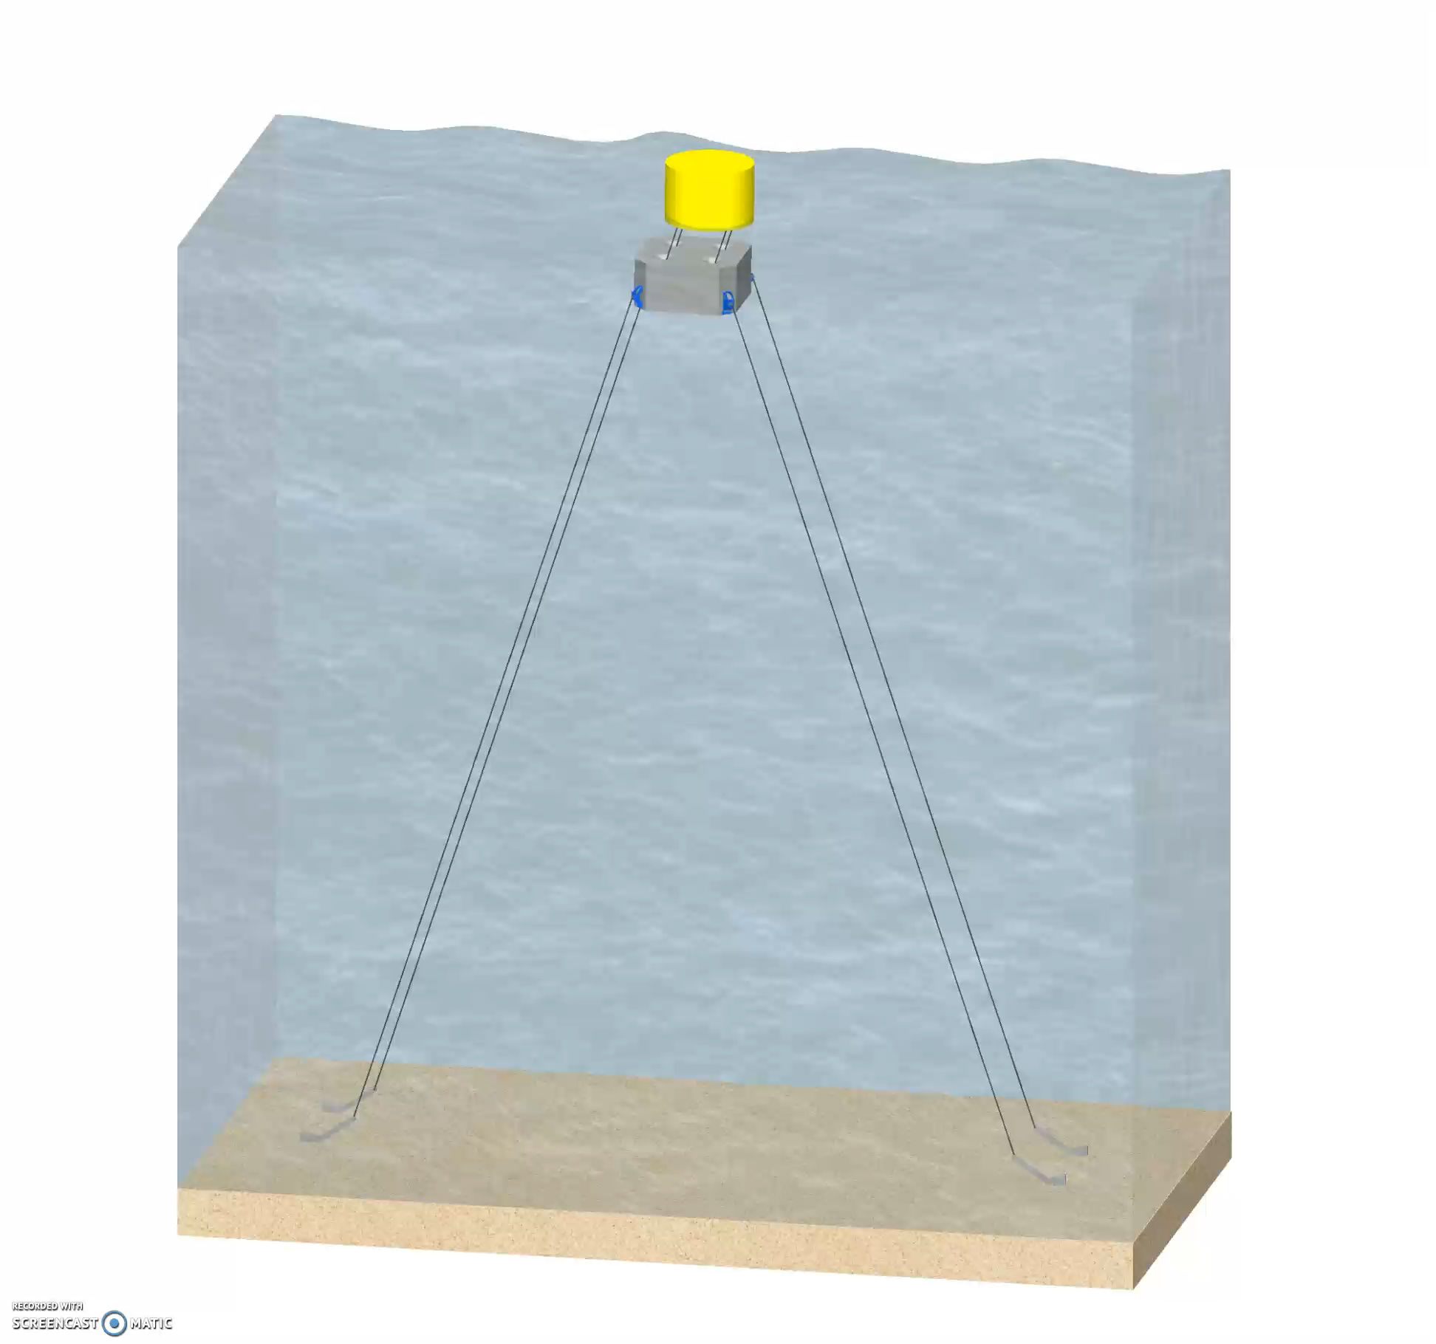
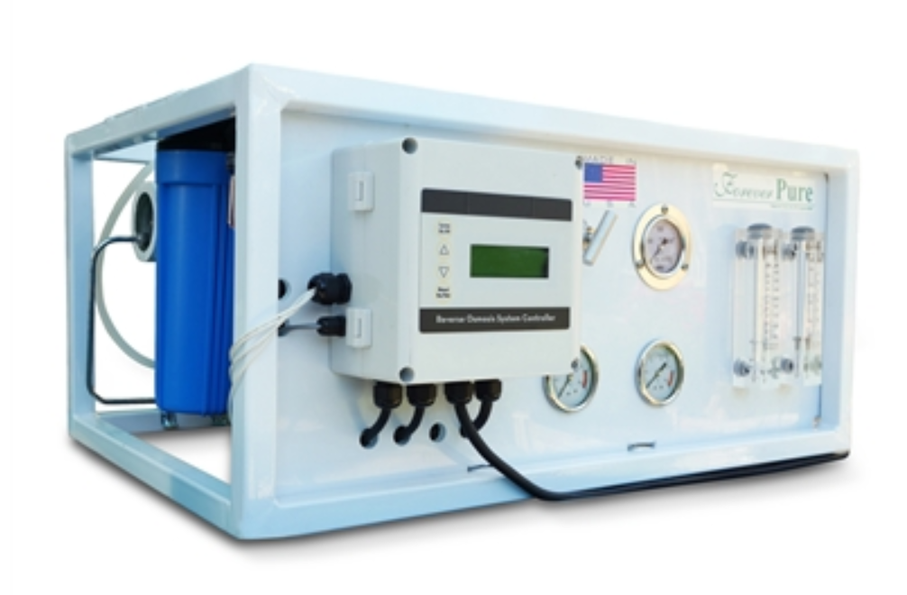
SurfWEC - Wave Energy Powered Desalination System
Pressurized Housing
Buoy
SurfWEC Deployment
200 Gallons per day Desalination Station
Shoaling Feature
Novel SurfWEC technology enables sufficient electricity production in mild to moderate waves to power a conventional 50-200 gallon per day desalination station by generating over 100 Watts of electricity
https://www.foreverpureplace.com/200-GPD-Seawater-Desalination-System-Watermaker-p/swro-200.htm
Motion in Water

