Slide 1


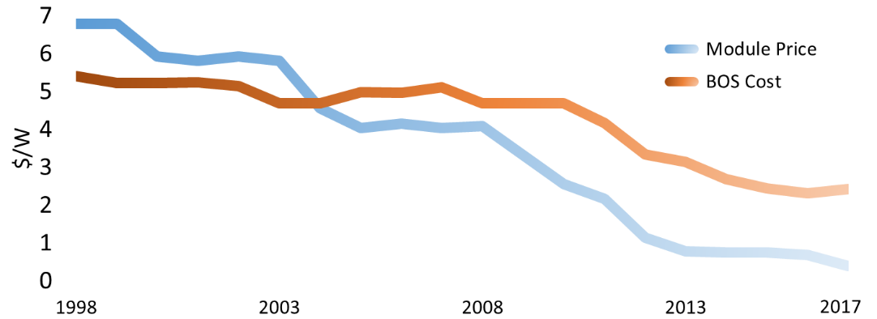
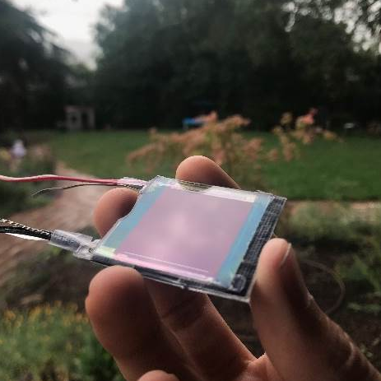
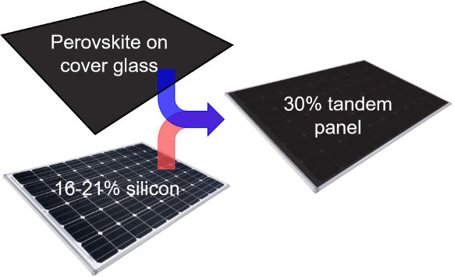
High-efficiency, Low-Cost
Perovskite + Silicon Tandem Product Prototype
Tandem PV, Inc.
Problem Summary:
The cost and efficiency of photovoltaic solar installations limit the rate and diversity of solar power use in the US
Silicon PV technology is near efficiency and cost limits
Other PV technologies have lower efficiency or higher costs
Once a world leader, the US trails in PV manufacturing
Problem: solar panels are cheap but installations are still expensive
Module Cost
Installation Cost
Solution Summary:
Tandems use two materials to split the sunlight between visible and infrared light and are far more efficient
Higher efficiencies reduce PV installation costs
Perovskite is an ideal material for absorbing the visible light and augmenting the performance of silicon PV
Solution: High-efficiency solar panels reduce installed system cost
Proposed Goals:
✓
Set! | Functional integrated perovskite / silicon tandem panel prototype with power matching electronics
Go! | >20% efficient tandem panel prototype on 6” x 6” area
1-year | Field testing of tandem prototypes and letters of intent from prospective customers
✓
Plan: Integrate Tandem PV’s perovskite layer with silicon and develop power matching electronics to validate high-value tandem product form, fit, and function

