Slide 1



SOLAR PRIZE
Solar Guardian®
Photovoltaic Connector
9/4/2019
1
Kenny Blemel & Charmaine Tunell

Slide 2
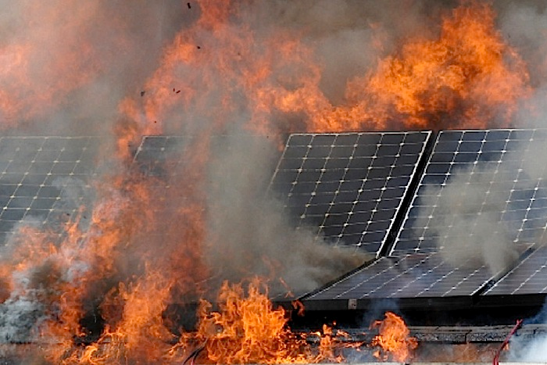

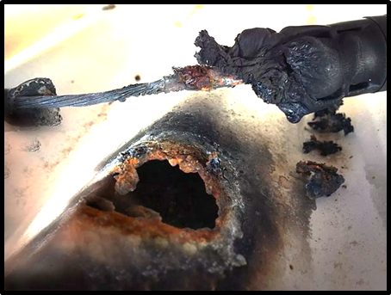

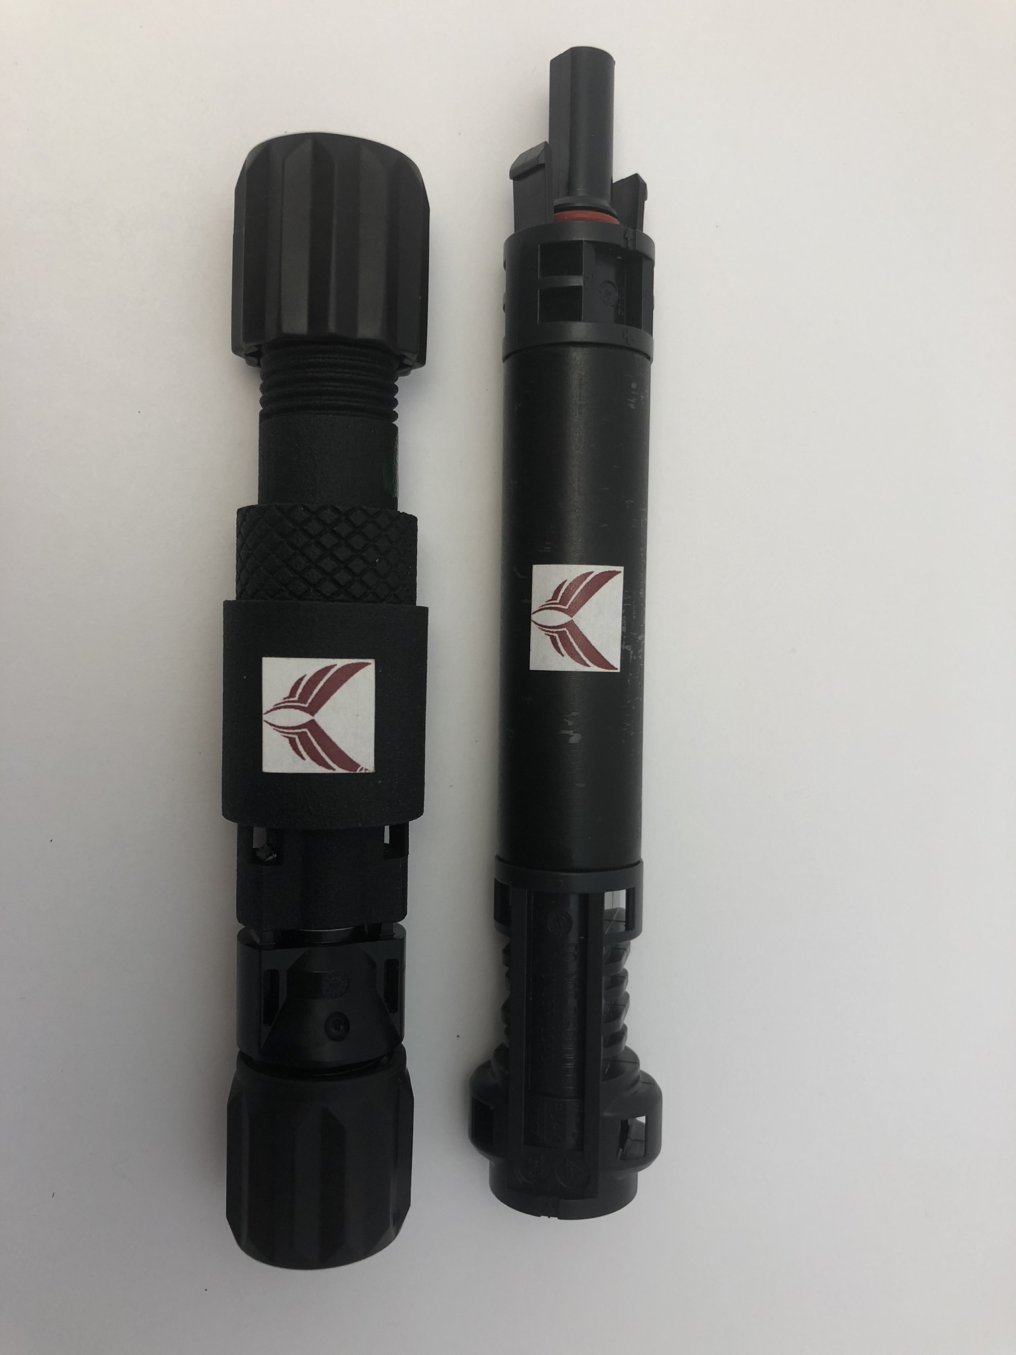
Arc Faults Cause Electrical Fires
Solar
Guardian
®
Management Sciences, Inc.
Solar Guardian® Prevents Electrical Fires
Our patented, Solar Guardian® photovoltaic connector detects existence of circumstances that could lead to an arc-fault before damage occurs. The proprietary proof-of-concept developed by MSI, VAMCO, NMT, and Amphenol has been validated by a national laboratory for feasibility. We continue to work with national laboratories to test and develop a prototype. Capabilities include:
A proprietary solution expands as temperatures rise to unsafe levels, disconnecting electricity, and preventing an arc fault before damage occurs!
Potential secondary arcs are quenched.
The affected panels in a string are disconnected.
Unaffected panels continue to operate at full capacity to produce clean energy and a maximum return on investment.
Patented!
https://energiasolarfotovoltaica.org/seguro-para-paneles-solares
https://www.cleanenergy.org.au/gbu/corrosion-failure-of-pv-module-connectors/
http://www.themunicipal.com/2014/09/solar-panel-fires/
Patent # 9464946

