Slide 1

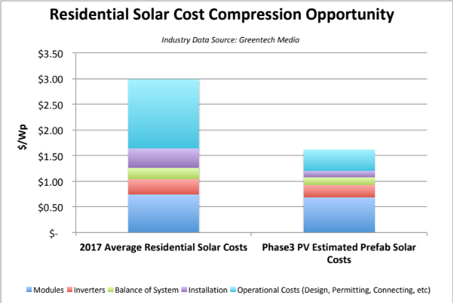
Factory Installed Solar Solutions for Manufactured Homes
Problem
Solution
Team
Plan
Cleverly Designed Power Integration for a New Wave of American Home Buyers
Residential solar is widely available to the upper end of the single family home market; however, as many as 22 million Americans, live in modular or prefab homes.
By leveraging the construction expertise of pre-fabricated home builders, we estimate a reduction of system costs close to 60% at $1.60/Wp, if the systems are integrated within factories.
Partnerships & Marketing
Today – Month 6
Design & Customization
Months 6 – 12
Training & Installation
Months 13-18
Partner with Key Builders
Assess Appropriate Markets
Create Website & Calculators
Establish Supply Chain
Onboard Design Team
File Permitting Templates
Identify Beta Customers
Complete Initial System Designs
Source Components
Integrate Manufacturing of Smart Home Concepts
Complete Regulatory Compliance
Arrange Modified Logistic Providers
On-Site Manufacturing Support
On-Site Installation Support
Collect Customer Feedback
Build Design and Instruction Kits for Mass Production at Select Partners
Establish Service and Warranty Contractors
  Solar industry scientists who built the current technologies behind today’s:
  Modules
  Certifications
  Standards
  Permitting
  Suppliers
  Distribution
Our vision is to begin with a straightforward solution, cultivate a reputation of competent execution, and extend learnings on platform to the entirety of the new home industry.

