Slide 1




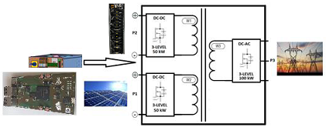


Three-Port Modular, Power Conversion System for 1500V Solar PV and EV Applications
Rationale
There is a need to integrate solar PV with energy storage to make it dispatchable and to increase solar PV penetration.
Electrical isolation is needed for the integrated system of solar PV and storage with grid.
Existing systems use bulky transformers for electrical isolation and solar PV operating voltage is capped at 1000V, limiting power rating.
Proposed system is an extremely compact (>6 kW/L), high efficiency 50kW-50W-100kW, three-port solar/storage/grid power conversion system.
Using SiC devices, higher voltage and efficiency is achieved.
A novel three-port 100kW, high frequency transformer is used to reduce the transformer size by two orders of magnitude.
Technology Enablers and Market Drivers
Imagen’s Integrated
ESS
Naval Applications
Infineon’s 3-Level SiC Technology
Imagen’s Compact Multi-Level Inverter Technology
Grid Support
Applications
Imagen’s Proprietary HF
Magnetics Design
Imagen’s Hi-Speed FPGA Controls
EV Applications
Imagen’s Proprietary Power Electronics Packaging/magnetic design.
Low Inductive SiC Power Module Packaging in 3-Level. configuration supported by High frequency magnetics
High bandwidth FPGA based control with control step time <0.1us
Innovative faster controls for common mode voltage and neutral
point voltage controls including reduced EMI.
Integrated cooling for size reduction.
Proprietary control board to control all devices by one board.
Technology and Economical Impact
Introduction of SiC-based next generation power electronics systems for future 1500 VDC solar systems with high energy harness efficiency.
The developed three-port system can also be used for EV (including Vehicle-to-Grid and Vehicle-to-Load and Vehicle-to-Vehicle) and Naval applications, where compactness and efficiency are required while connecting several sources.
4th DC-DC port can be added to support EV 12V/48V Loads.

