Slide 1
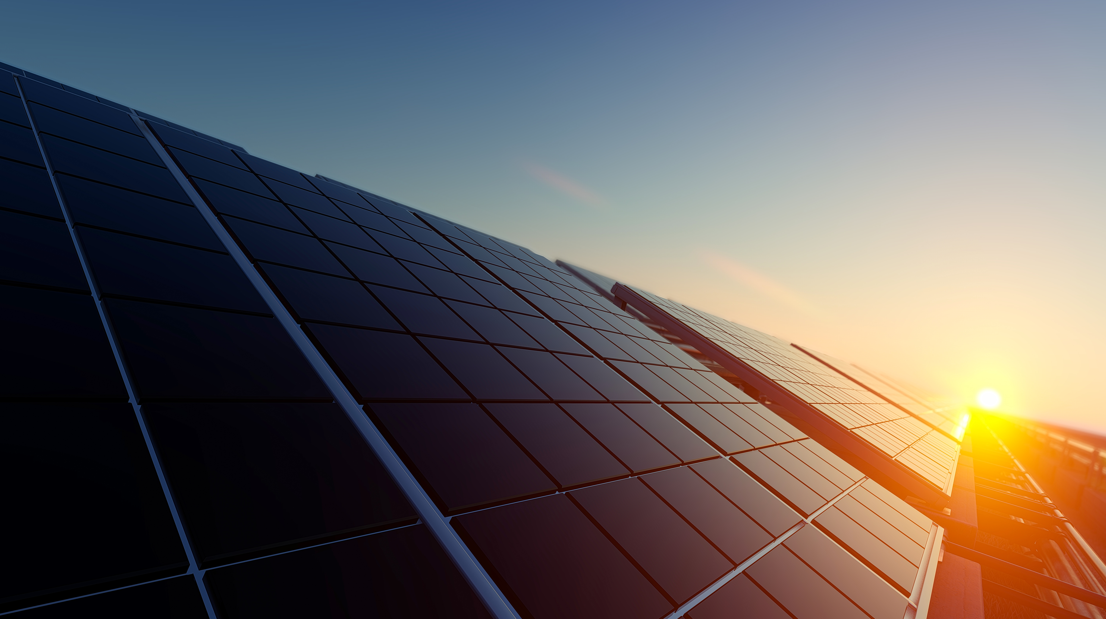

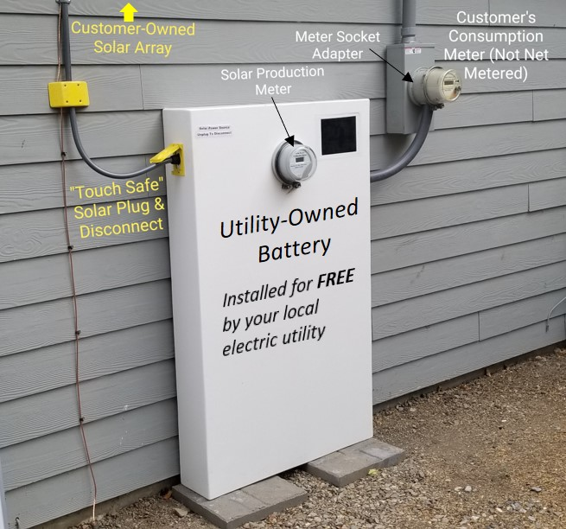
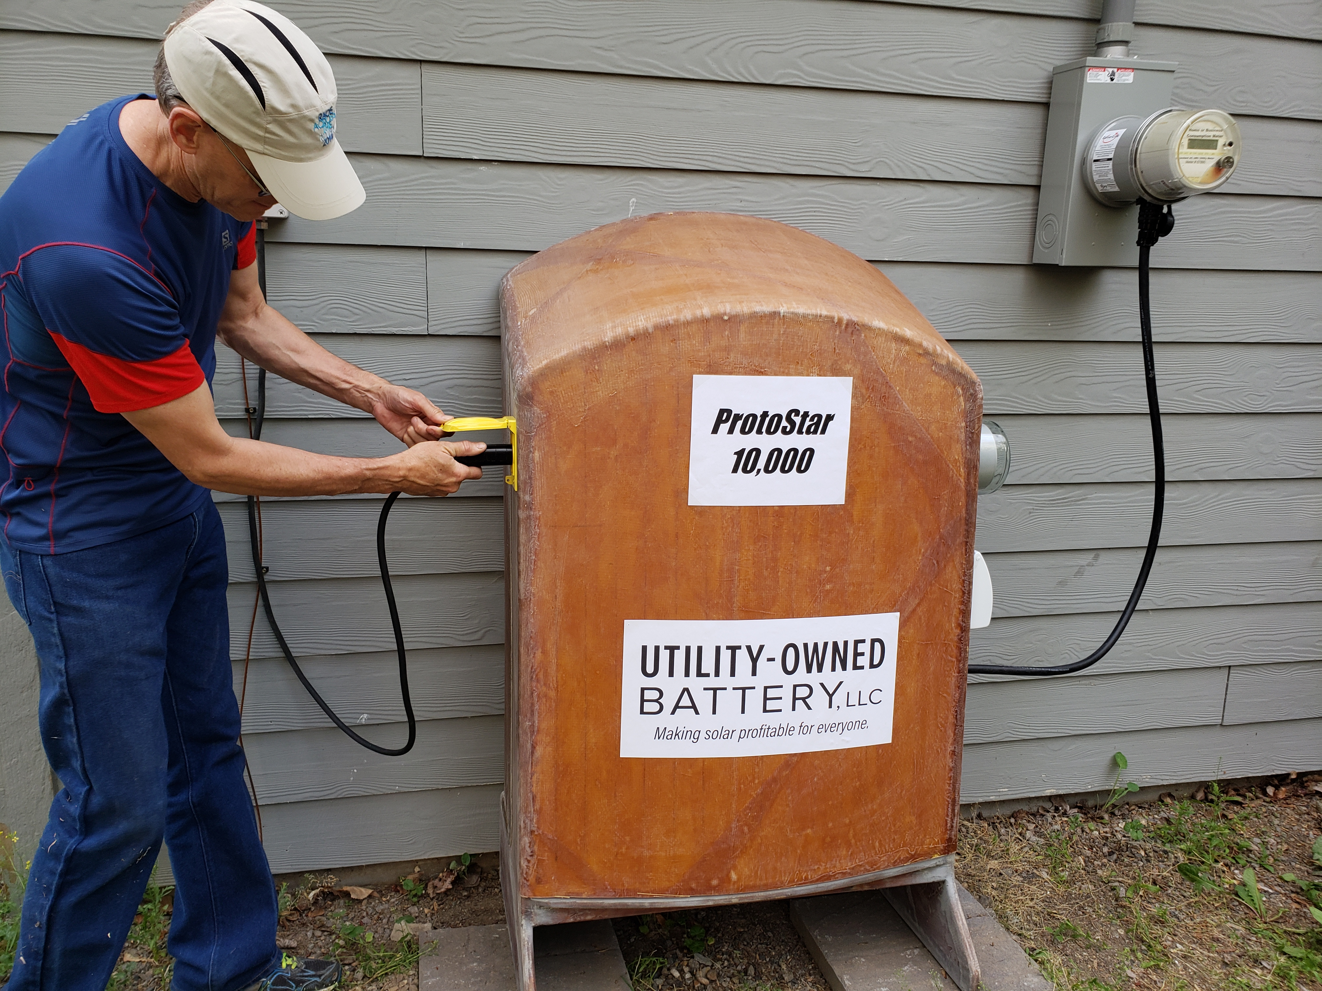
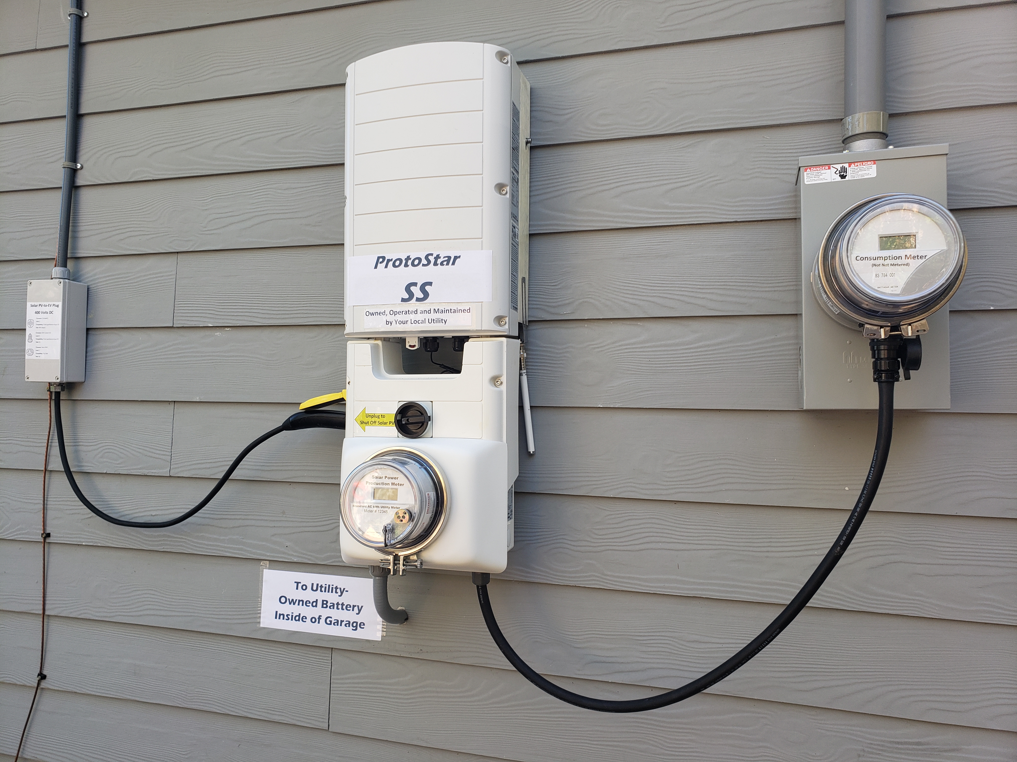

Ready!
Set!
Go!
High Voltage
Solar DC Plug CHAdeMo,
CCS or
Tesla
Simple utility interconnection
Utility-Owned Battery
9/4/2019
1

